Slide 1
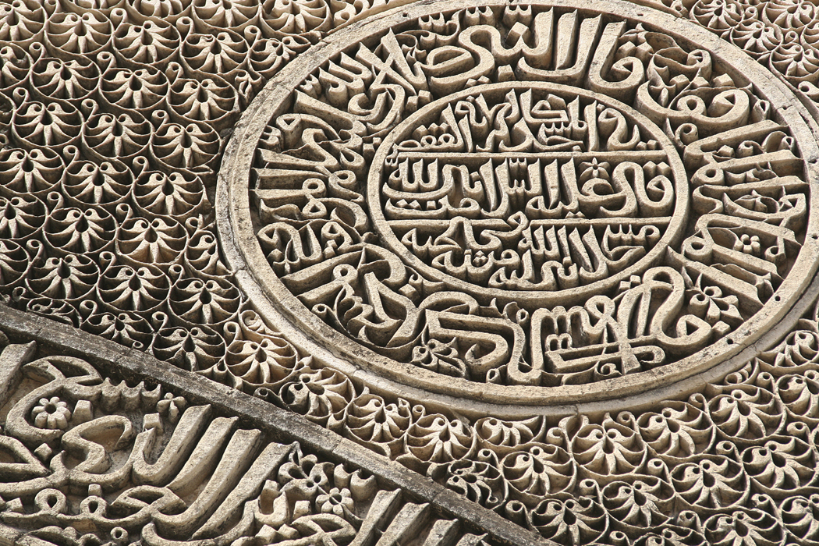
Young Geographers Project
India

Slide 2
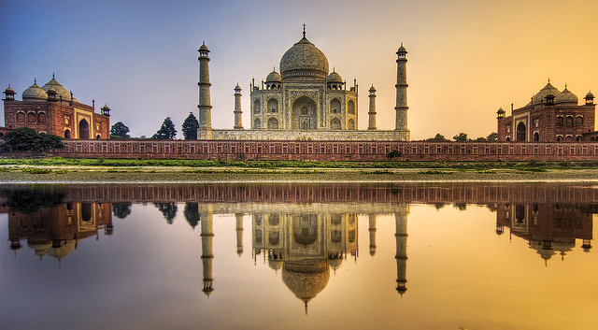
Human-made features
Taj Mahal
http://www.flickr.com/photos/stuckincustoms/2035748576/

Slide 3
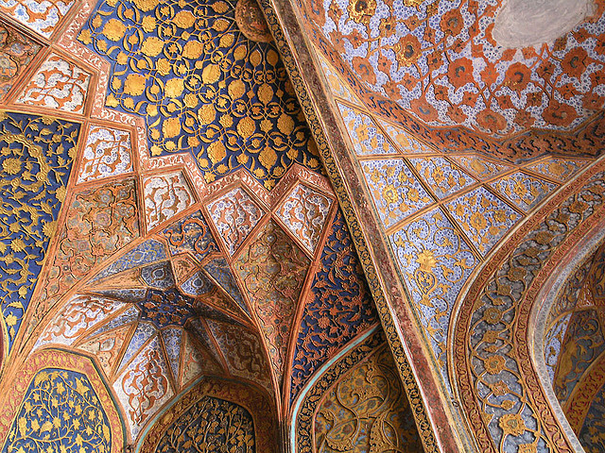
Human-made features
Architecture

Slide 4
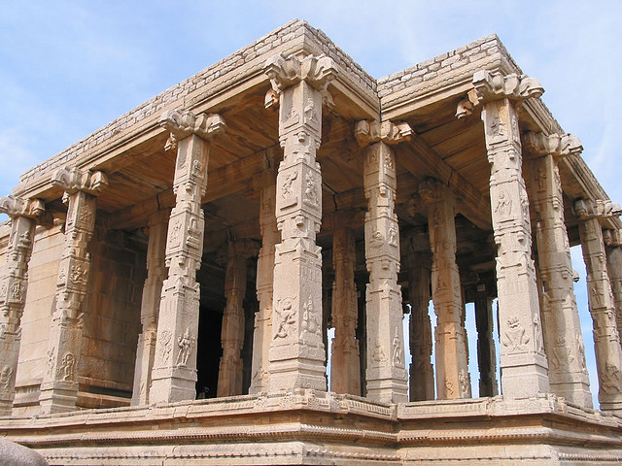
Human-made features
Architecture, Hampi
http://www.flickr.com/photos/dey/2864026/

Slide 5
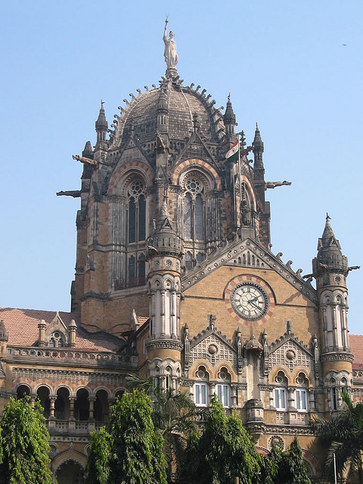
Human-made features
Architecture
http://www.flickr.com/photos/dey/3136325/

Slide 6
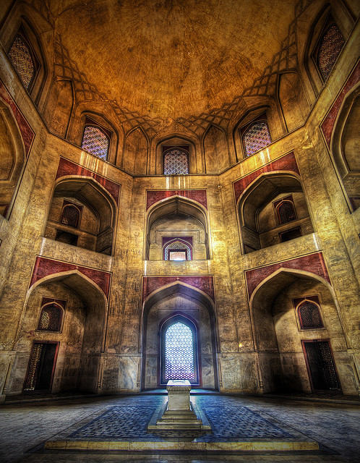
Human-made features
Architecture – Humayun’s Tomb

Slide 7
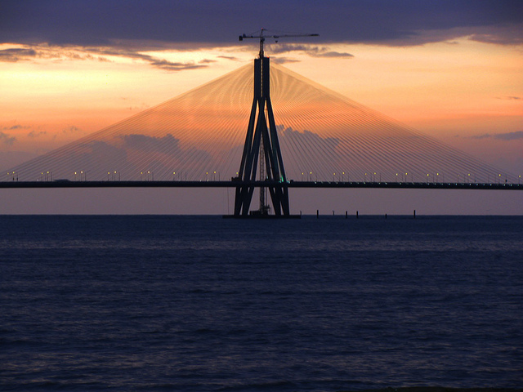
Human-made features
Bridge
http://www.flickr.com/photos/kaushal/4990531140/

Slide 8
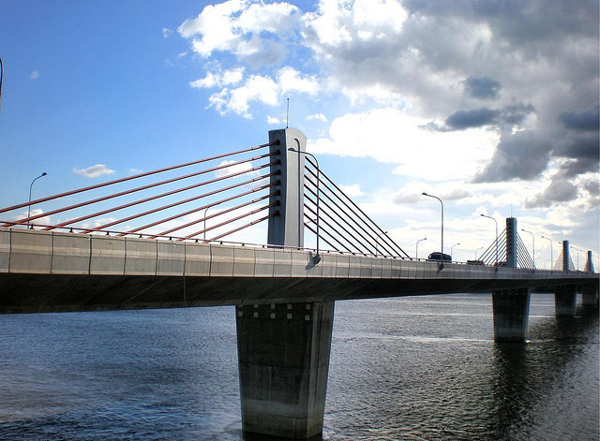
Human-made features
Bridge - Nivedita Setu, Kolkata
http://www.flickr.com/photos/85296574@N00/2716236677/

Slide 9
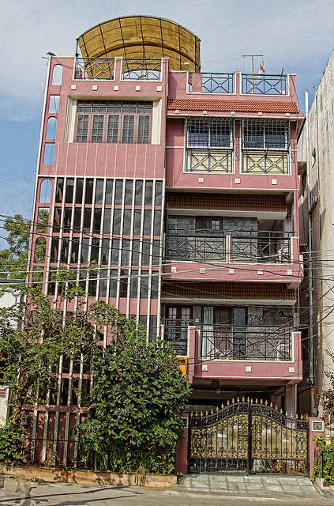
Human-made features
Housing
http://www.flickr.com/photos/adityakolli/4205907794/

Slide 10
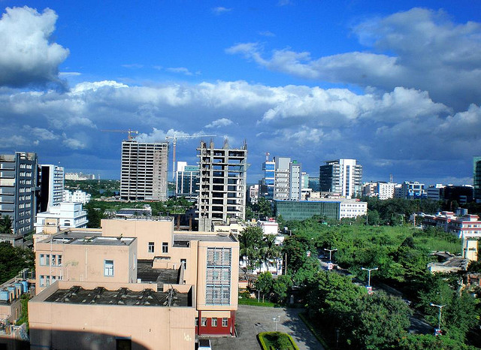
Human-made features
Nabadiganta skyline, Kolkata
http://www.flickr.com/photos/85296574@N00/3736756827/

Slide 11
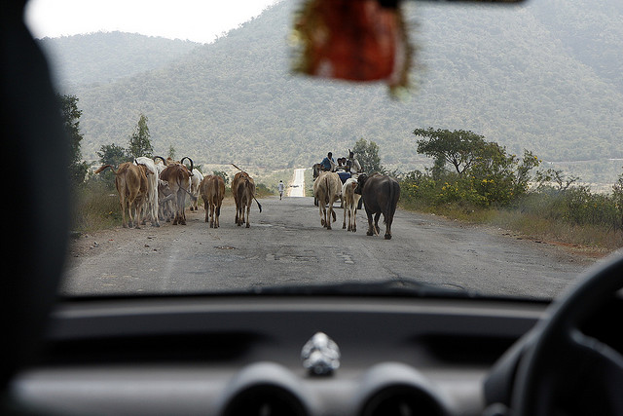
Human-made features
Road
http://www.flickr.com/photos/83762626@N00/3547990466/

Slide 12
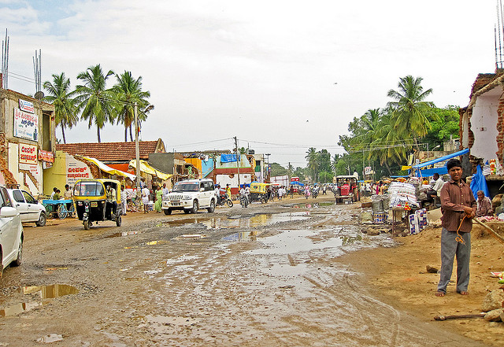
Human-made features
Road - Kanakapura, Karnataka
http://www.flickr.com/photos/natarajam/3669021655/

Slide 13
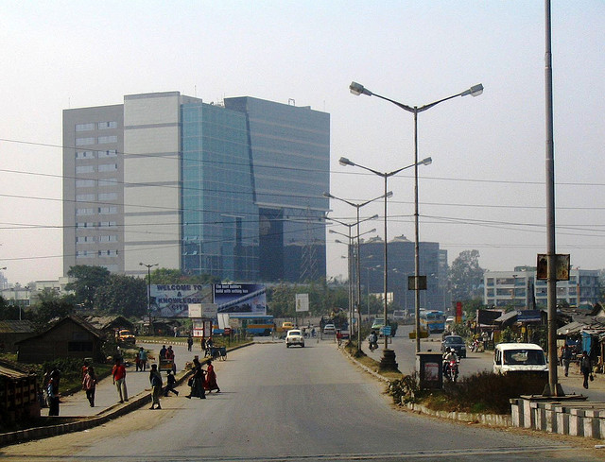
Human-made features
Road, Buildings

Slide 14
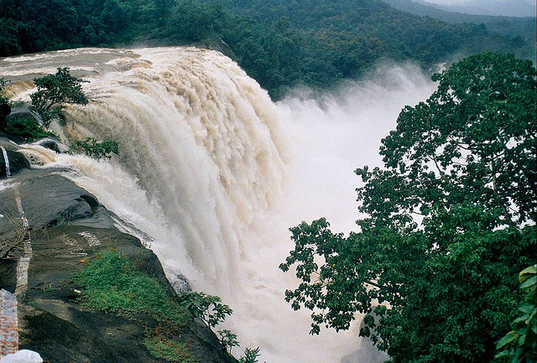
Natural features
Athirappilly Waterfall in Kerala
http://www.flickr.com/photos/internationalrivers/3854359222/

Slide 15
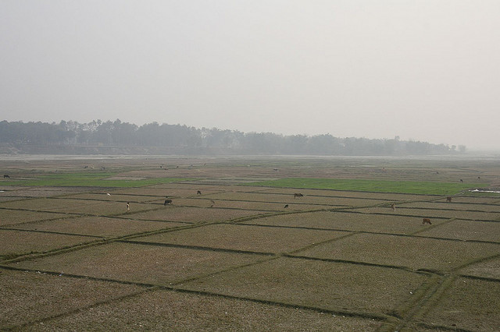
Natural features
Border plains
http://www.flickr.com/photos/marcs-album/2214322993/

Slide 16
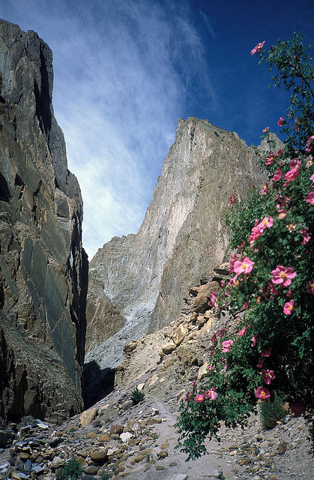
Natural features
Spangtang Canyon
http://www.flickr.com/photos/sabamonin/3484314224/

Slide 17
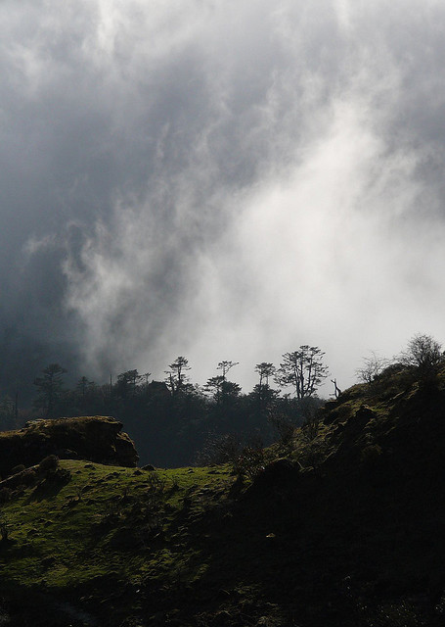
Natural features - forest
Kangchenjunga National Park in Sikkim
http://www.flickr.com/photos/petitnic/4448268381/

Slide 18
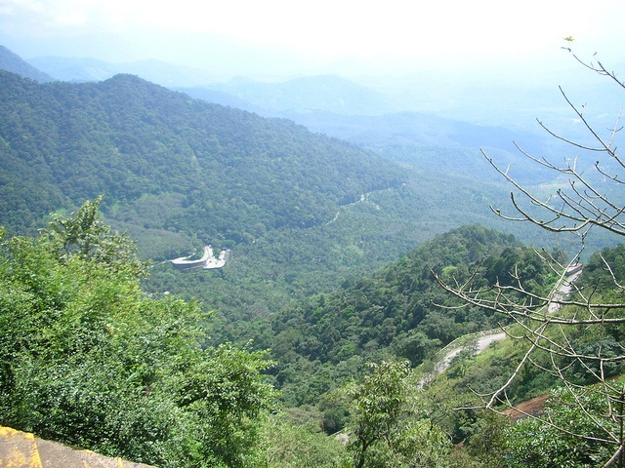
Natural features
Hills

Slide 19
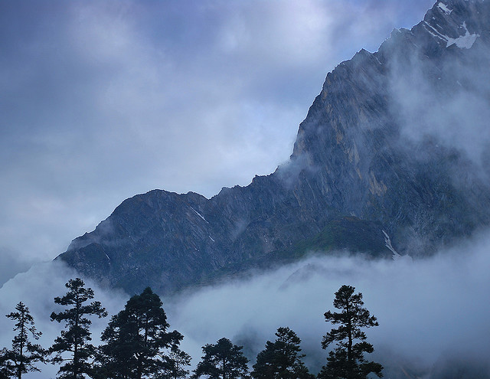
Natural features
Himalayan Mountains
http://www.flickr.com/photos/himalayan-trails/3990203670/

Slide 20
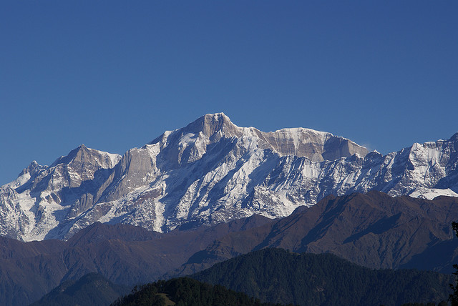
Natural features
Mountains

Slide 21
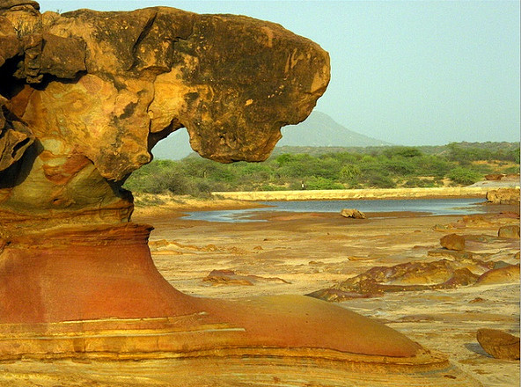
Natural features
Rock formations
http://www.flickr.com/photos/jvblogger/3694603654/

Slide 22
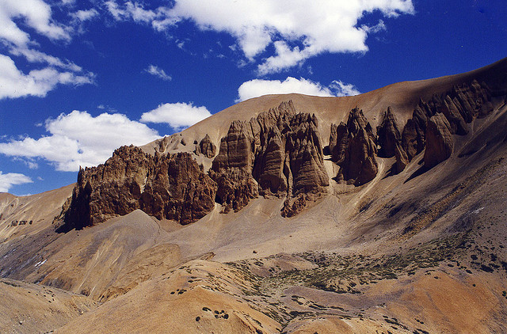
Natural features
Himalayan rock formations
http://www.flickr.com/photos/dey/3864780/

Slide 23
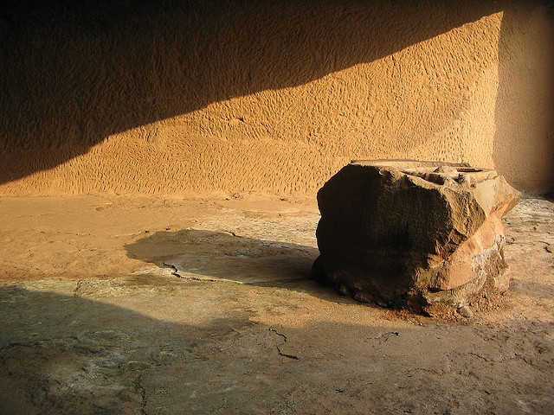
Natural features
Lonavala Buddhist caves
http://www.flickr.com/photos/penny7b/1524007412/

Slide 24
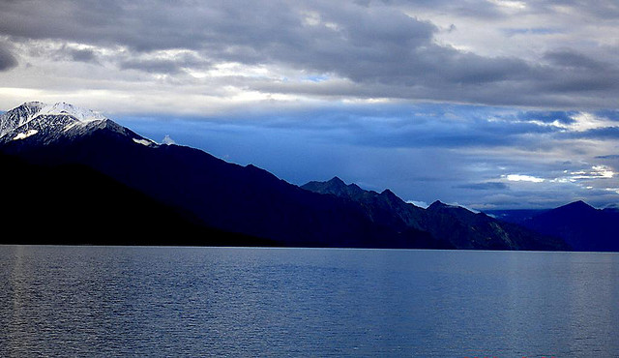
Natural features
Pangong Lake
http://www.flickr.com/photos/himalayan-trails/322156167/

Slide 25
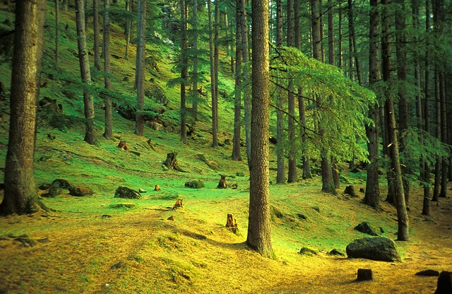
Natural features
Parvati Valley
http://www.flickr.com/photos/sabamonin/4987336577/

Slide 26
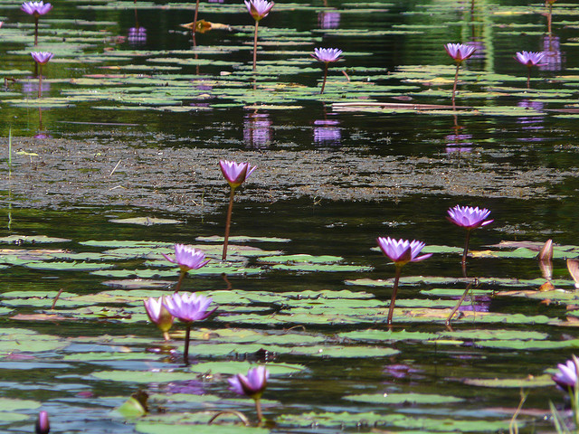
Natural features
Pookode Lake
http://www.flickr.com/photos/christianbaudet/4404008199/

Slide 27
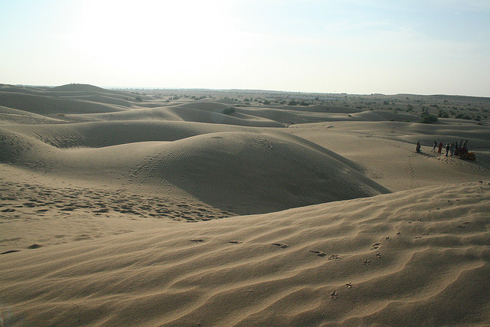
Natural features
Sand dunes
http://www.flickr.com/photos/kumarasastry/576786956/

Slide 28
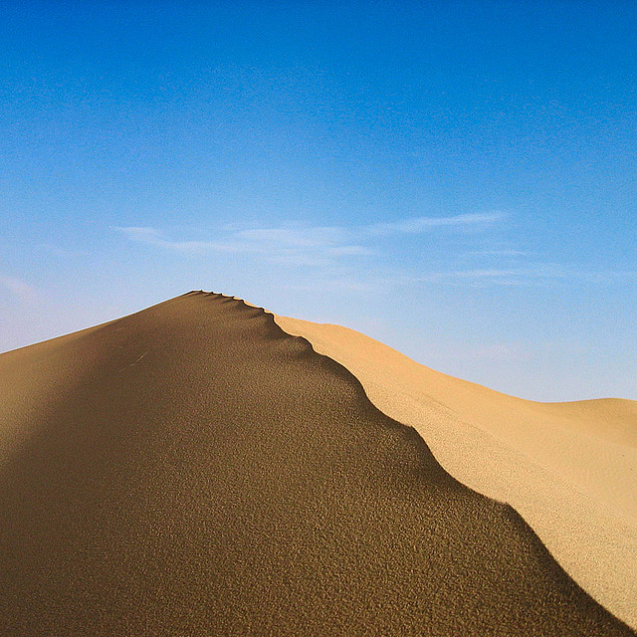
Natural features
Sand dune - Thar desert
http://www.flickr.com/photos/burnblue/104767702/

Slide 29
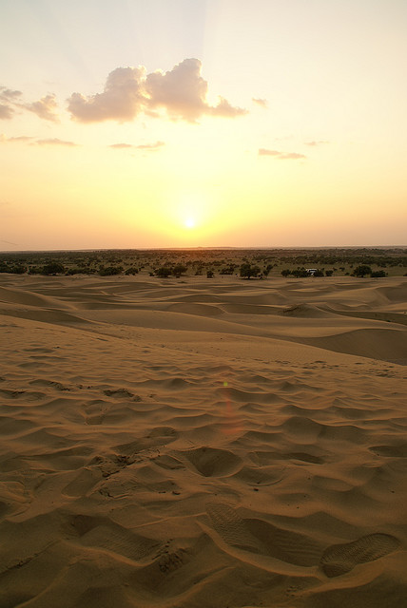
Natural features
Thar desert
http://www.flickr.com/photos/clara/2120269800/

Slide 30
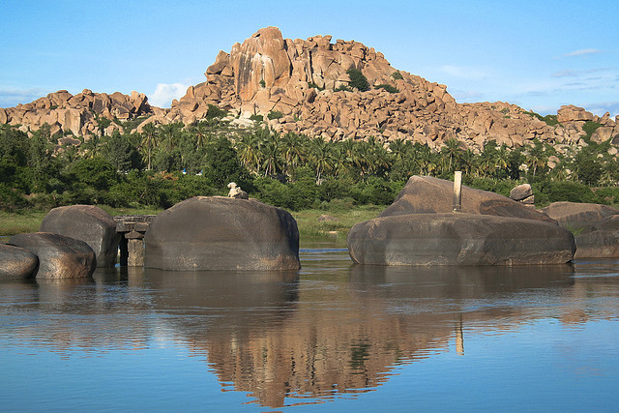
Natural features
Tungabhadra River
http://www.flickr.com/photos/diegowyllie/537796189/

Slide 31
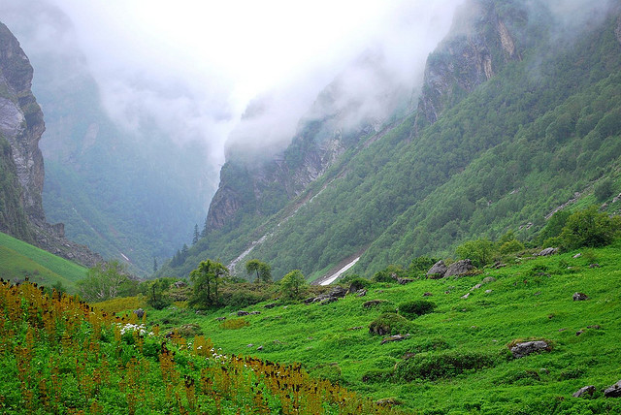
Natural features
Valley of Flowers National Park in Uttranchal
http://www.flickr.com/photos/himalayan-trails/3417360067/

Slide 32
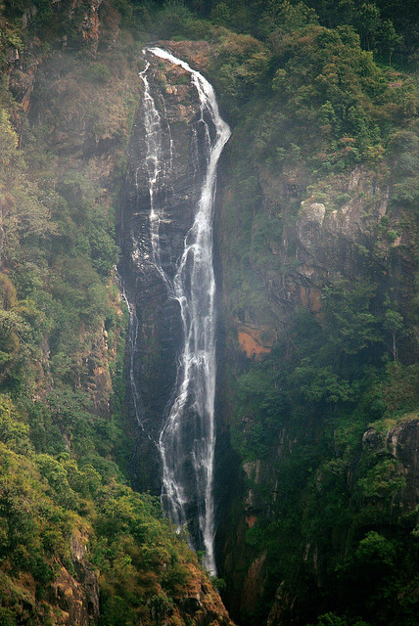
Natural features
Waterfalls
http://www.flickr.com/photos/ravages/2703542712/

Slide 33
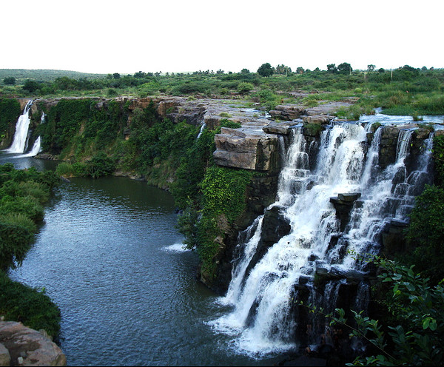
Natural features
Waterfalls
http://www.flickr.com/photos/suneelmadhekar/2934853050/

