Slide 1
Young Geographers Project
Brazil

Slide 2
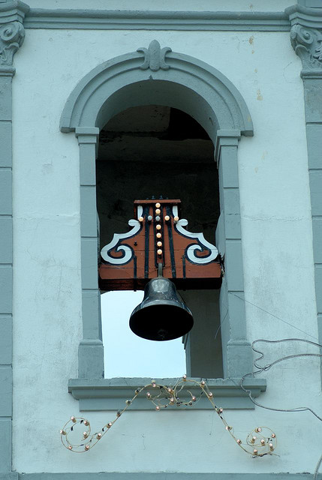
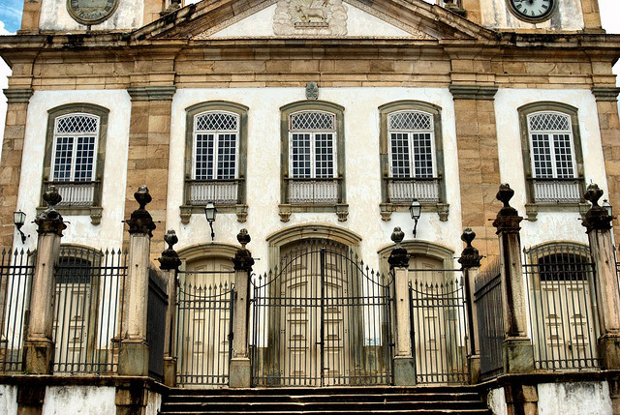
Human-made features Architecture
http://www.flickr.com/photos/bob_wall/4263046709/
http://www.flickr.com/photos/bob_wall/4263042395/

Slide 3
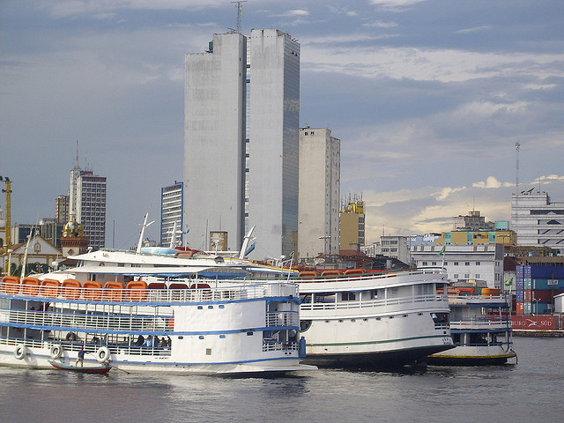
Human-made features Buildings, Boats
http://www.flickr.com/photos/whltravel/4008393347/

Slide 4
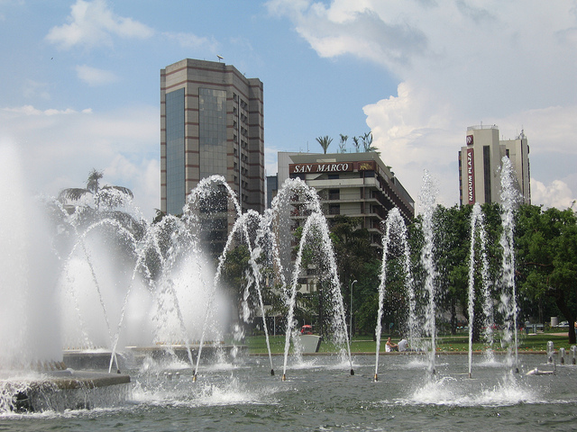
Human-made features Buildings, Fountains in Brasilia
http://www.flickr.com/photos/carlosoliveirareis/5190075686/

Slide 5
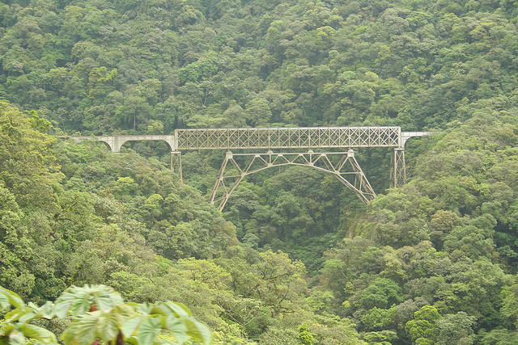
Human-made features Railroad Bridge - Ponte Sao Joao
http://www.flickr.com/photos/carlosoliveirareis/2149752591/

Slide 6
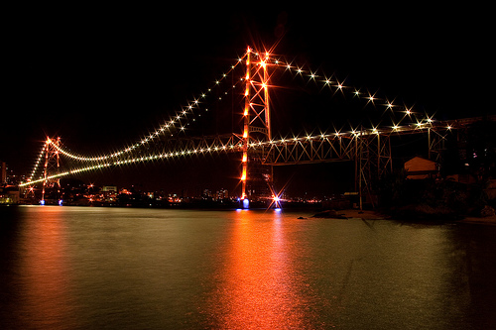
Human-made features Bridge
http://www.flickr.com/photos/marcosbonfim/3639781843/sizes/l/in/photostream/

Slide 7
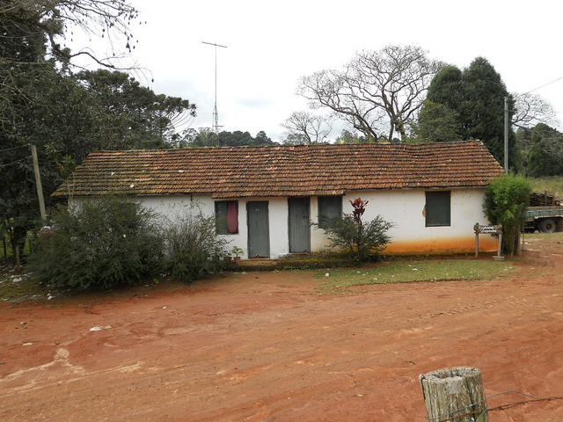
Human-made features House
http://www.flickr.com/photos/mikecogh/4835348305/

Slide 8
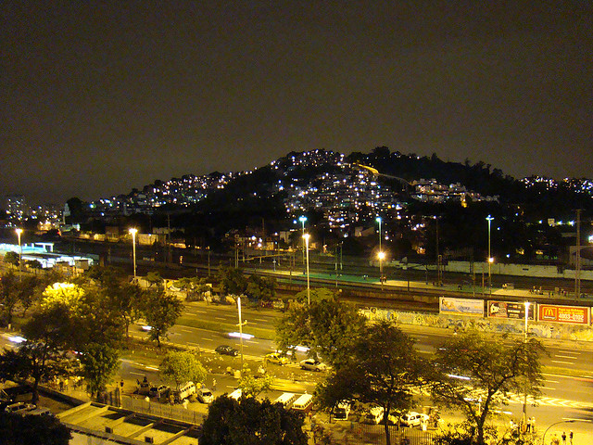
Human-made features Rio de Janeiro
http://www.flickr.com/photos/soldon/2761927633/

Slide 9
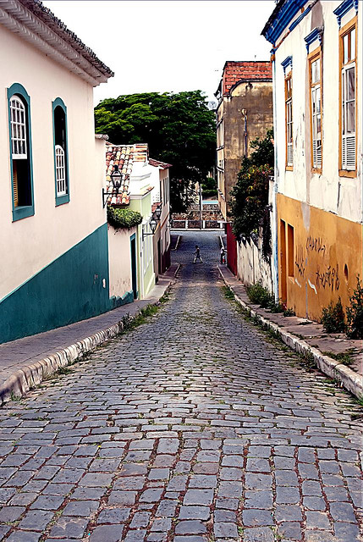
Human-made features Houses, Street
http://www.flickr.com/photos/bob_wall/4263045121/

Slide 10
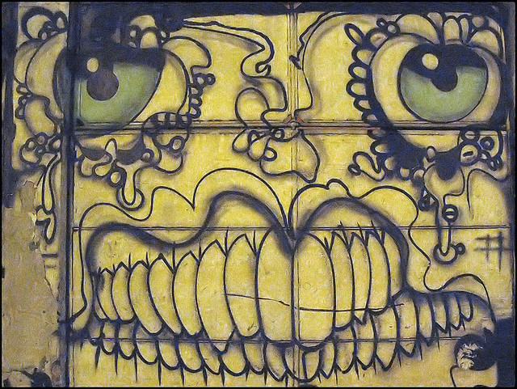
Human-made features Street Art
http://www.flickr.com/photos/tais/2039749220/

Slide 11
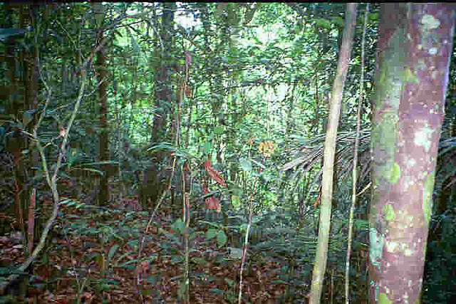
Natural features Amazon Rainforest
http://www.flickr.com/photos/yvettemn/2503645662/

Slide 12
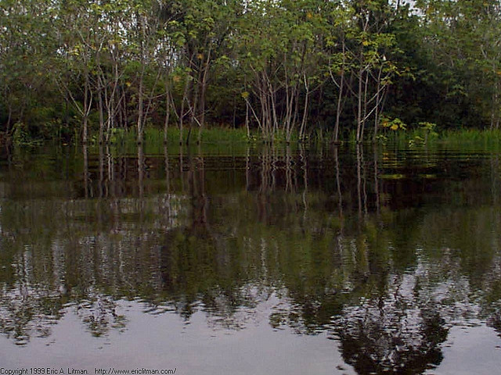
Natural features Amazon Rainforest
http://www.flickr.com/photos/ericlitman/122362298/

Slide 13
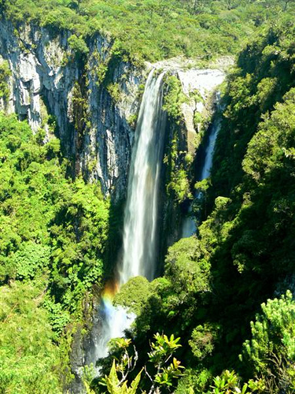
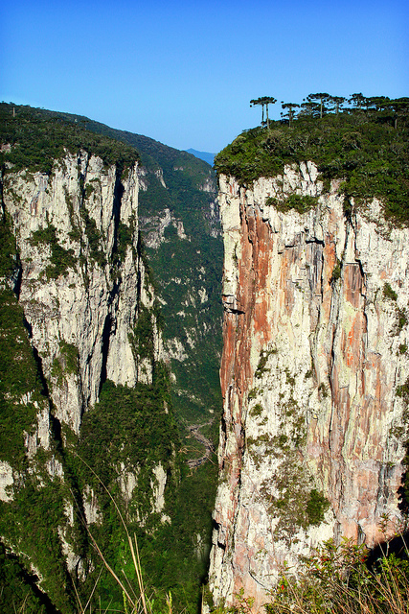
Natural features Canyon, Waterfall
http://www.flickr.com/photos/kinho/408292991/
http://www.flickr.com/photos/sabordigital/4816500933/

Slide 14
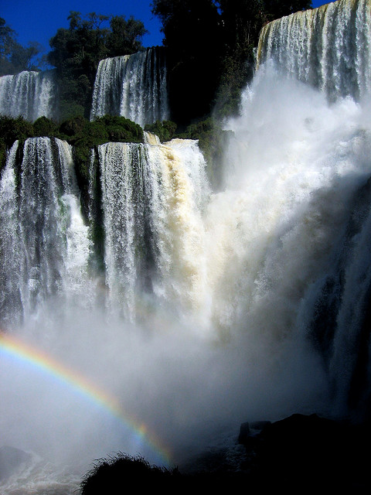
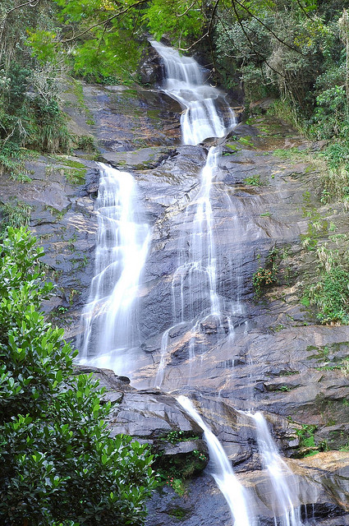
Natural features Waterfalls - Foz de Iguacu, Rainforest
http://www.flickr.com/photos/joost81/2853394770/
http://www.flickr.com/photos/zackbittner/1463888996/

Slide 15
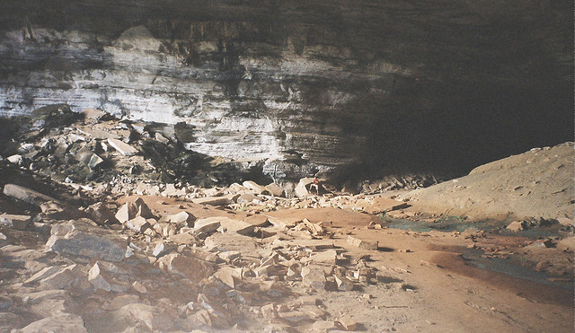
Natural features Cave - Gruta da Lapa Doce
http://www.flickr.com/photos/as500/184632774/

Slide 16
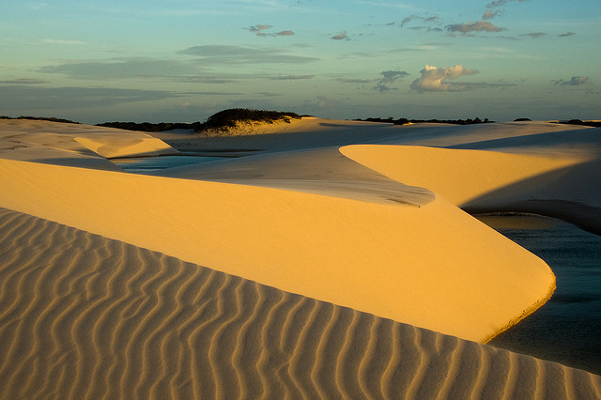
Natural features Desert - Atins, Parque do Lençois Maranhenses
http://www.flickr.com/photos/sylvainbourdos/4196942229/

Slide 17
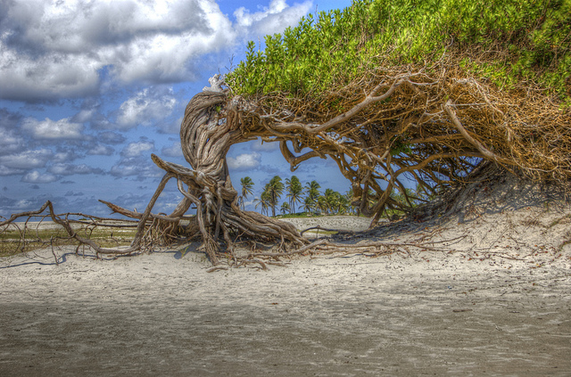
Natural features Desert - Jijoca de Jericoara
http://www.flickr.com/photos/bjakeb/4714713795/

Slide 18
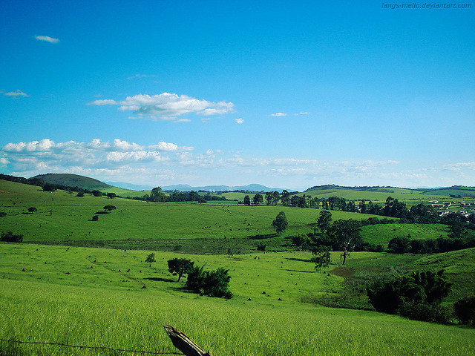
Natural features Fields, Hills
http://www.flickr.com/photos/langs_mello/2389303906/

Slide 19
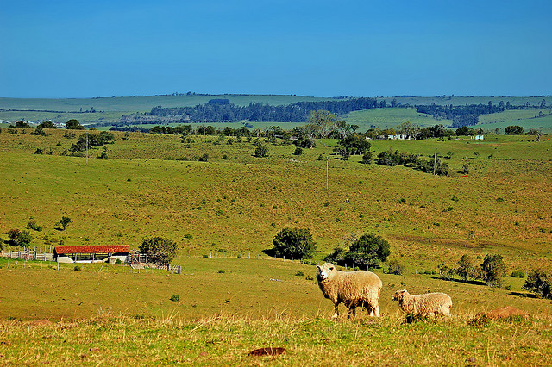
Natural features Fields, Hills
http://www.flickr.com/photos/bombeador/2943744723/

Slide 20
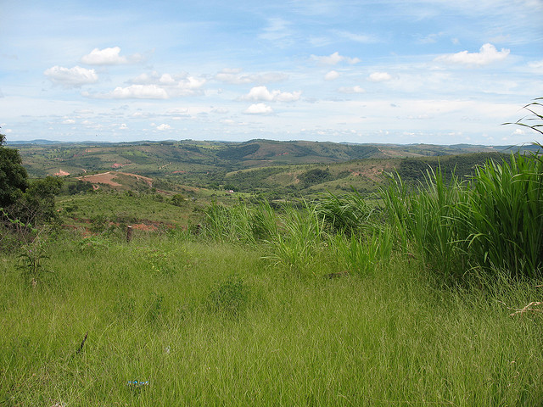
Natural features Fields, Hills
http://www.flickr.com/photos/dozerbones/2277347774/

Slide 21
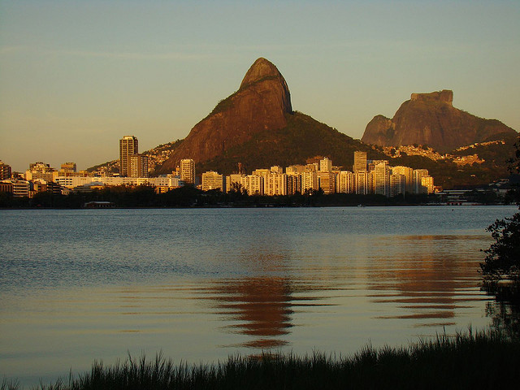
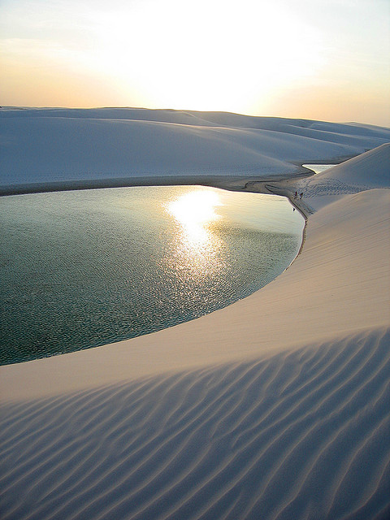
Natural Features Lakes
http://www.flickr.com/photos/soldon/1192559227/
http://www.flickr.com/photos/ricardo_ferreira/248186704/

Slide 22
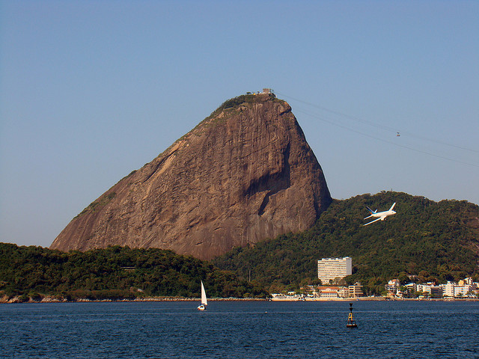
Natural features Lake, Mountain - Pão de Açúcar
http://www.flickr.com/photos/soldon/2768110929/

Slide 23
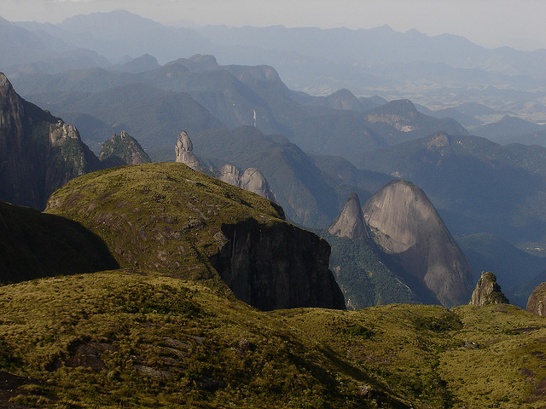
Natural features Mountain - Serra dos Orgaos
http://www.flickr.com/photos/fernandosilveira/421888073/

Slide 24
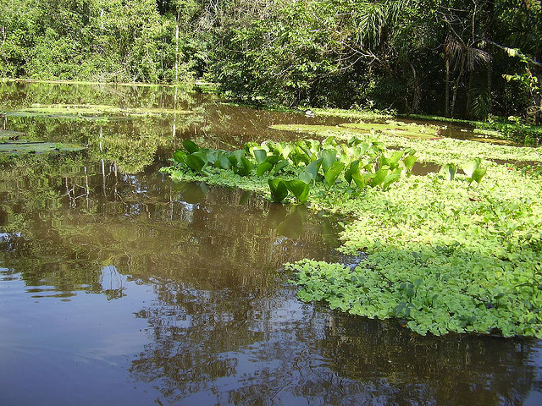
Natural features River
http://www.flickr.com/photos/adman_as/428170144/

Slide 25
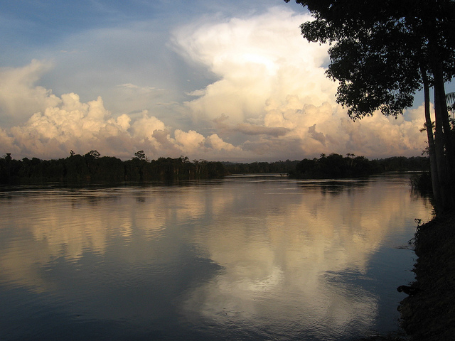
Natural features Xingu River
http://www.flickr.com/photos/internationalrivers/4584780367/

Slide 26
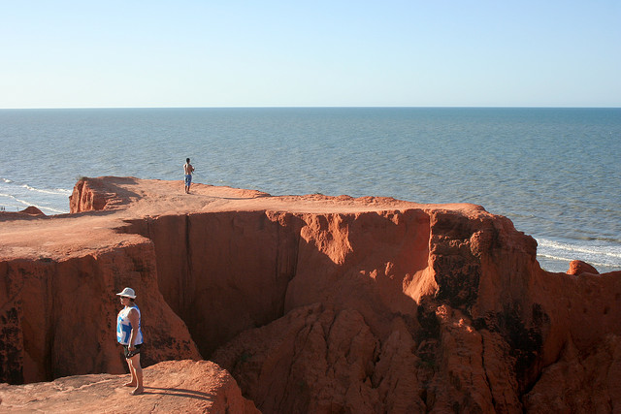
Natural features Rock formation
http://www.flickr.com/photos/dreamofalife/3792351913/

Slide 27
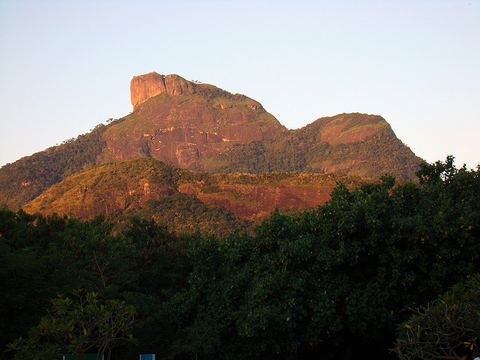
Natural features Rock formation - Pedra da Gávea
http://www.flickr.com/photos/soldon/2591982533/

Slide 28
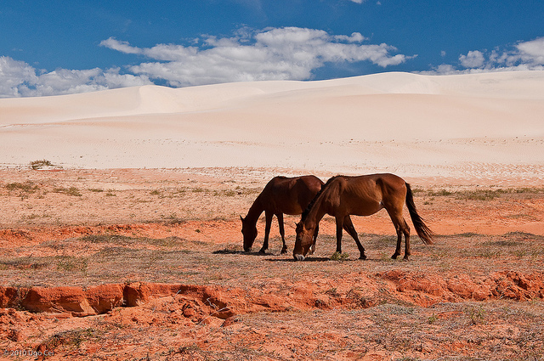
Natural features Sand dunes - Ariea Branca
http://www.flickr.com/photos/ugocei/4912438931/

Slide 29
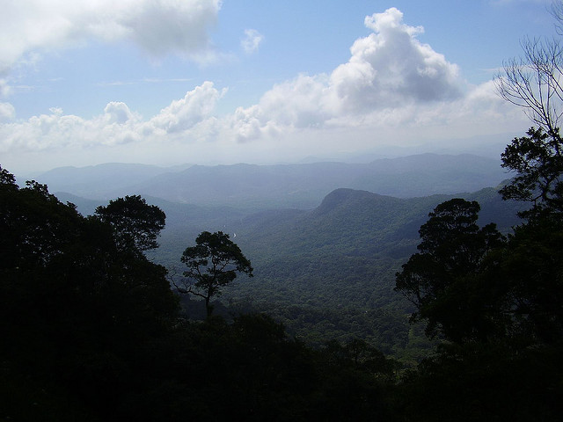
Natural features Valley
http://www.flickr.com/photos/adman_as/428177629/

