Slide 1
Young Geographers Project

Slide 2
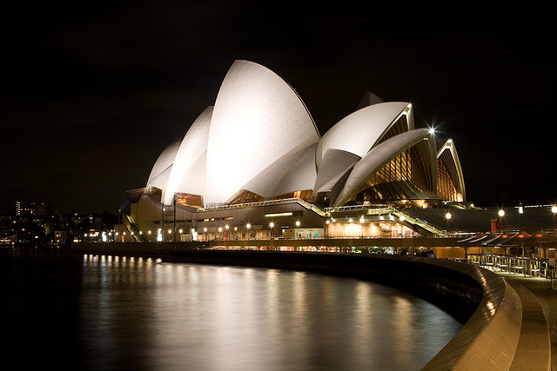
Human-made features
Sydney Opera House
http://www.flickr.com/photos/lethalpossum/3216061315/

Slide 3
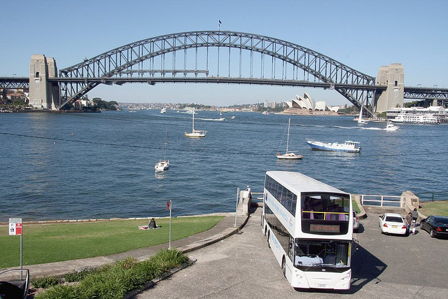
Human-made features
Bridge
http://www.flickr.com/photos/25653307@N03/2633159926/

Slide 4
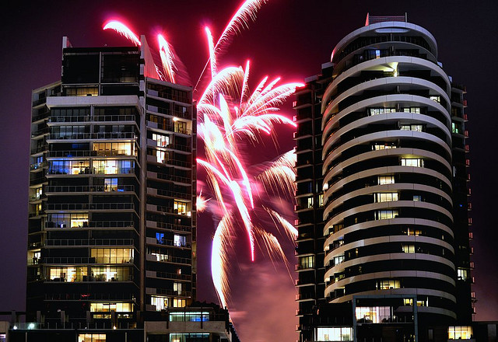
Human-made features
Buildings
http://www.flickr.com/photos/mugley/3230232071/

Slide 5
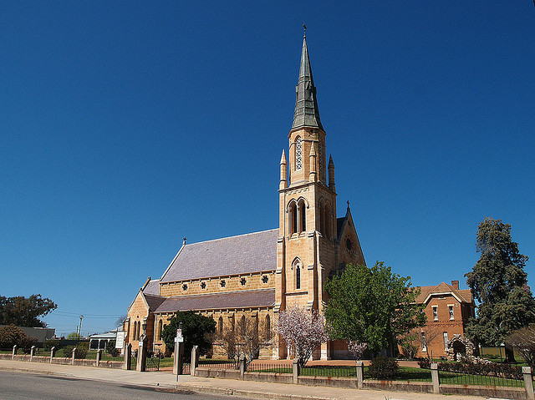
Human-made features
Church in Mudgee
http://www.flickr.com/photos/rogeroz/215895410/

Slide 6
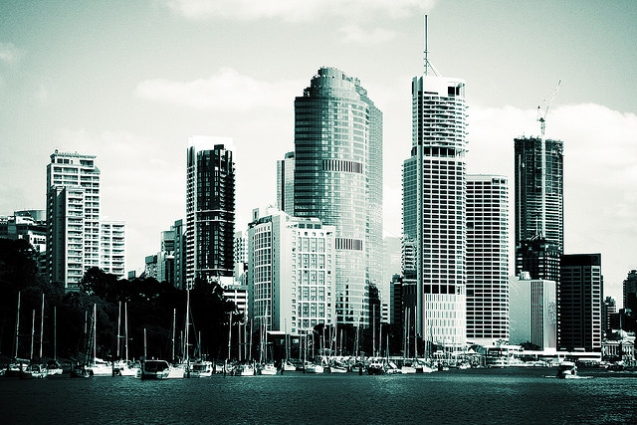
Human-made features
City of Brisbane
http://www.flickr.com/photos/monkeyc/95247784/

Slide 7
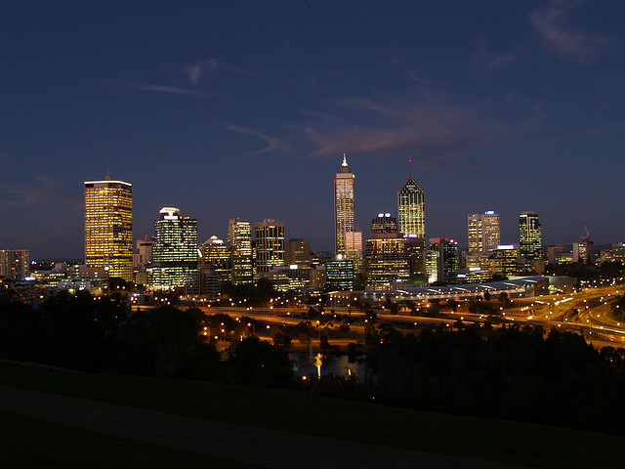
Human-made features
City of Perth
http://www.flickr.com/photos/earthhour_global/2372082092/

Slide 8
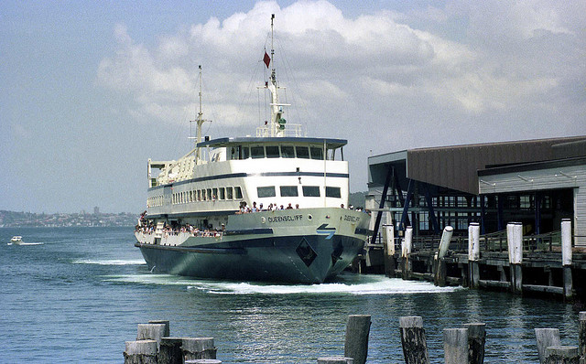
Human-made features
Ferry
http://www.flickr.com/photos/25653307@N03/2951145436/

Slide 9
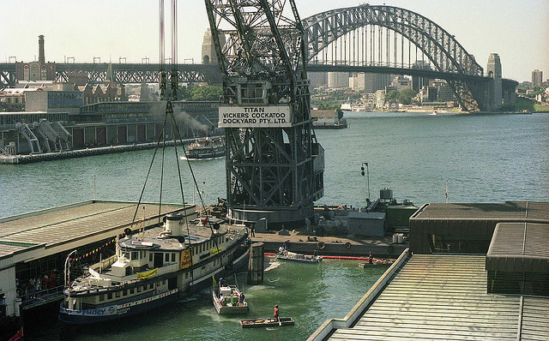
Human-made features
Bridge, floating crane, dock
http://www.flickr.com/photos/25653307@N03/2951145432/

Slide 10
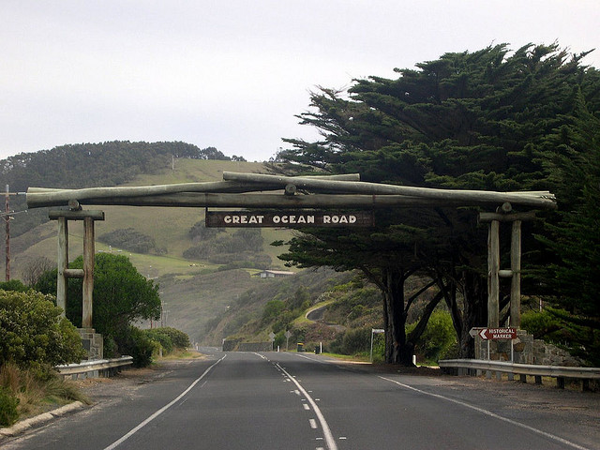
Human-made features
Great Ocean Road
http://www.flickr.com/photos/lucazappa/9995993/

Slide 11
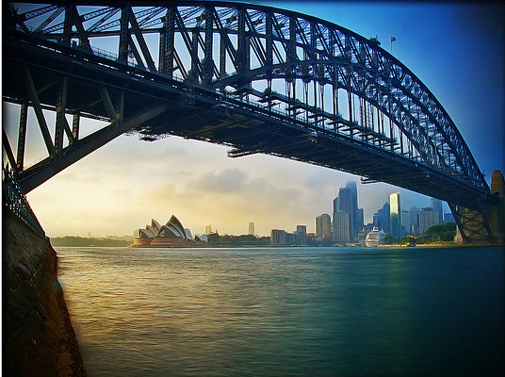
Human-made features
Harbour City
http://www.flickr.com/photos/sgmdigital/3268261787/

Slide 12
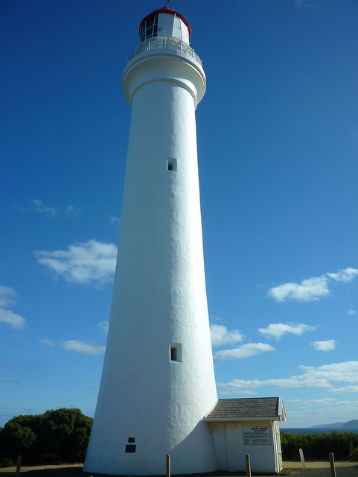
Human-made features
Split Point Lighthouse
http://www.flickr.com/photos/raguy/4483423564/

Slide 13
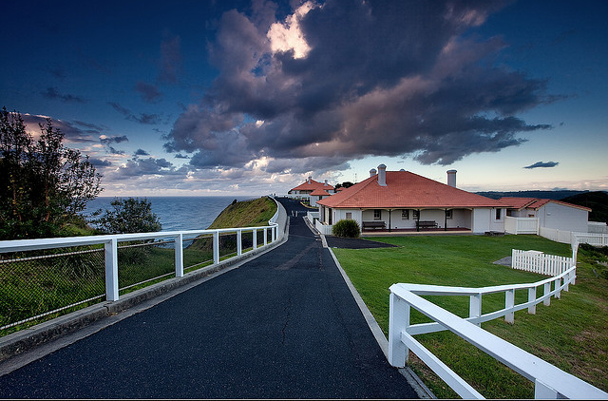
Human-made features
Lighthouse keepers cottages
http://www.flickr.com/photos/garry61/3742924360/

Slide 14
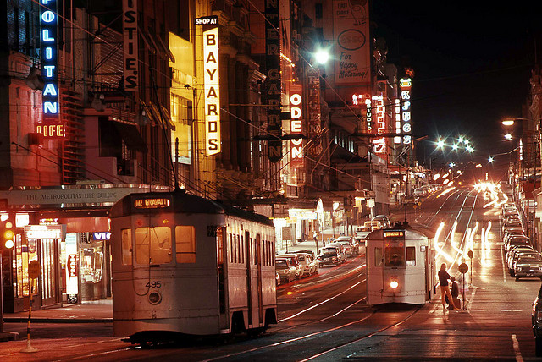
Human-made features
City buildings, trams
http://www.flickr.com/photos/25653307@N03/2555964986/

Slide 15
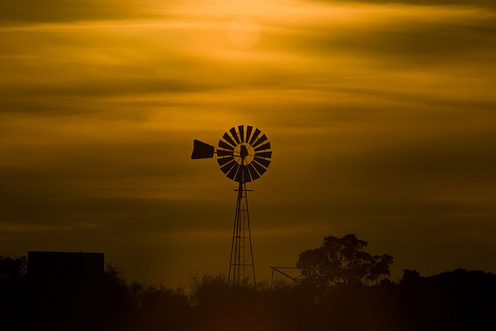
Human-made features
Windmill
http://www.flickr.com/photos/vermininc/2844593298/

Slide 16
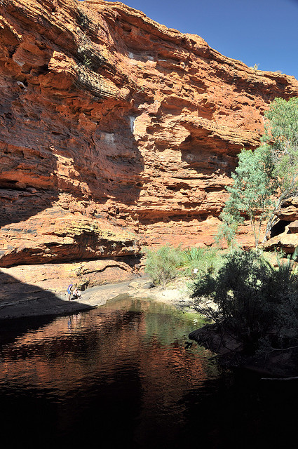
Natural features
Kings Canyon, Garden of Eden
http://www.flickr.com/photos/rosswebsdale/3449813796/

Slide 17
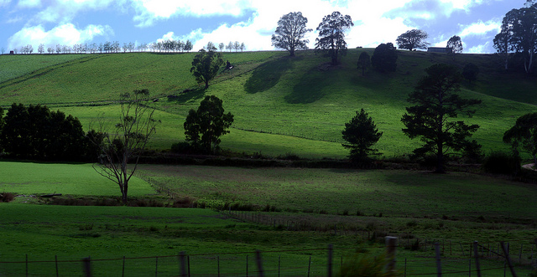
Natural features
Hills
http://www.flickr.com/photos/xlynx/4517146291/

Slide 18
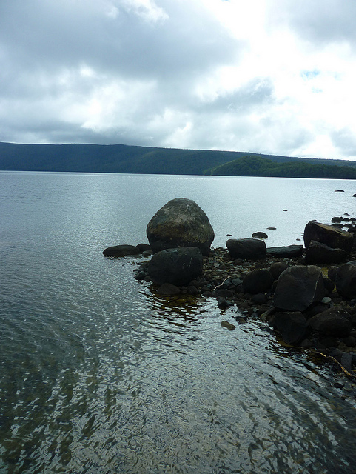
Natural features
Lake St Clair, Tasmania
http://www.flickr.com/photos/raguy/4501953857/

Slide 19
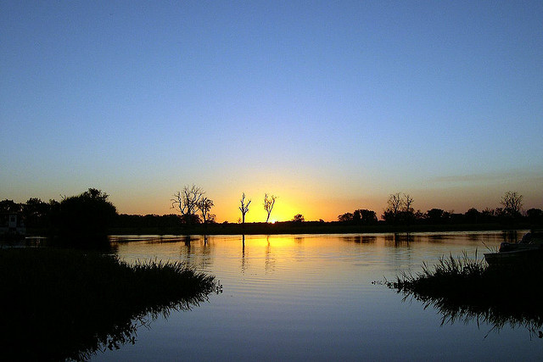
Natural features
Lake, Kakadu National Park
http://www.flickr.com/photos/lucazappa/9995988/

Slide 20
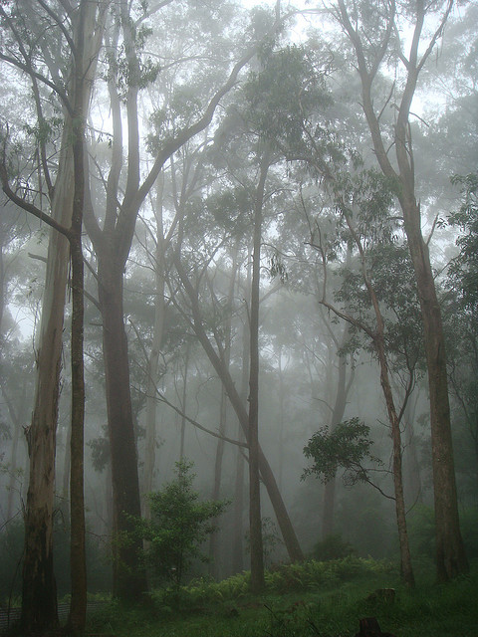
Natural features
Eucalypt Forest
http://www.flickr.com/photos/louisa_catlover/3177050514/

Slide 21
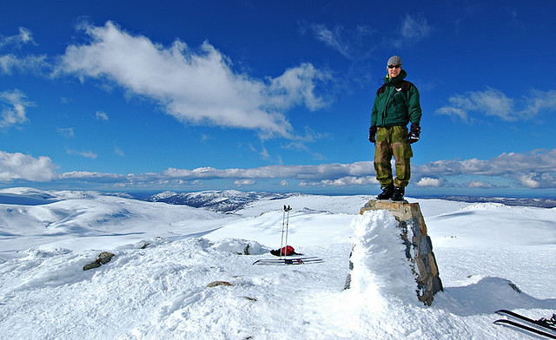
Natural features
Mountain, Mt. Kosiuzsco
http://www.flickr.com/photos/klareralt/214862716/

Slide 22
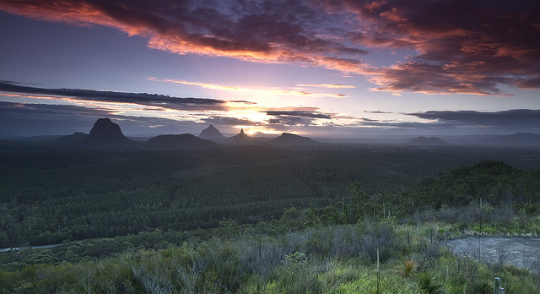
Natural features
Mountain, Wildhorse Mountain
http://www.flickr.com/photos/garry61/3555795831/

Slide 23
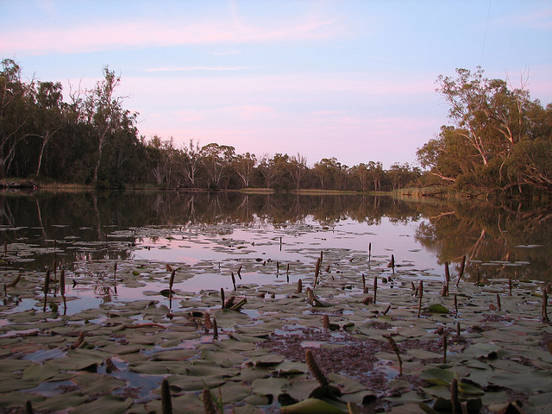
Natural features
Murray River, Victoria
http://www.flickr.com/photos/erceofrivendell/321837382/

Slide 24
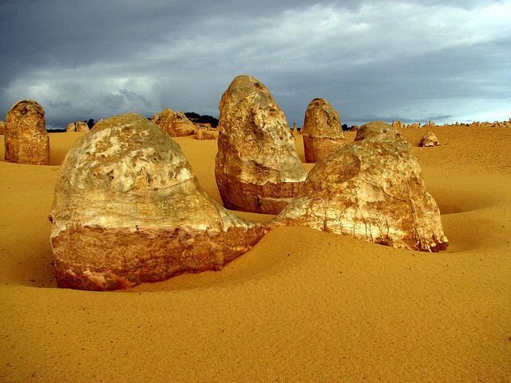
Natural features
Pinnacles Desert
http://www.flickr.com/photos/rosswebsdale/2658725344/

Slide 25
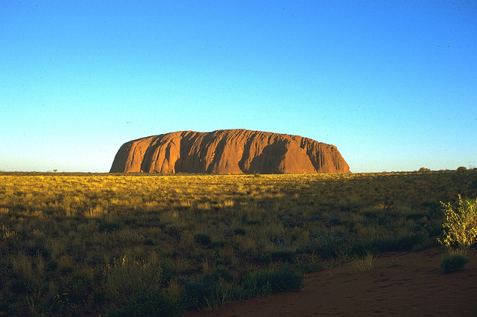
Natural features
Rock formation, Ayer’s Rock
http://www.flickr.com/photos/yourdon/499328506/

Slide 26
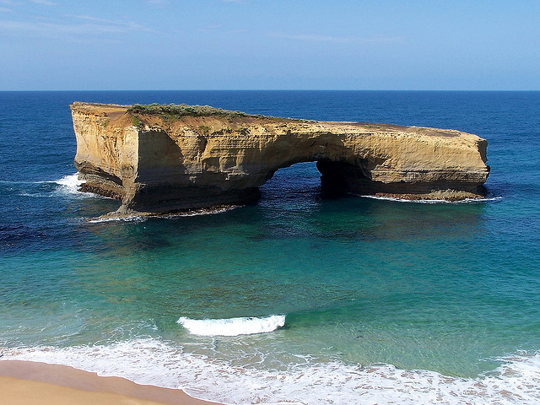
Natural features
Rock formation, London Arch
http://www.flickr.com/photos/mkuhn/64024710/

Slide 27
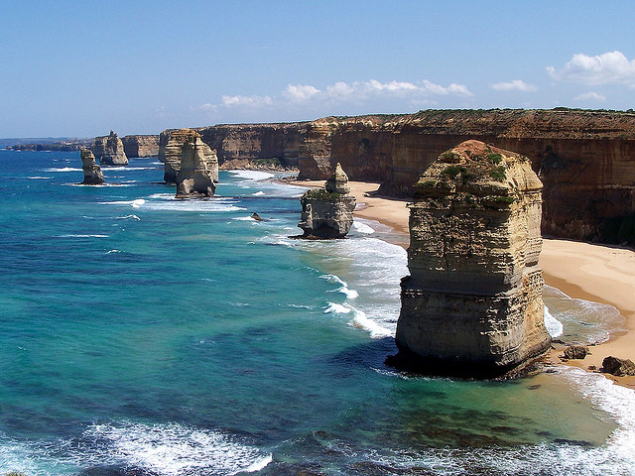
Natural features
Rock formation, Twelve Apostles
http://www.flickr.com/photos/mkuhn/65419352/

Slide 28
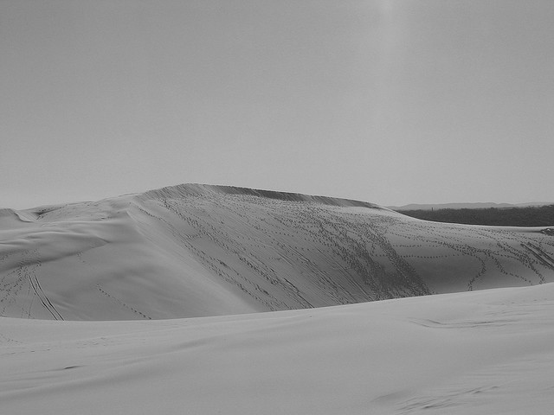
Natural features
Stockton Bight sand dunes
http://www.flickr.com/photos/kayhadrin/133930613/

Slide 29
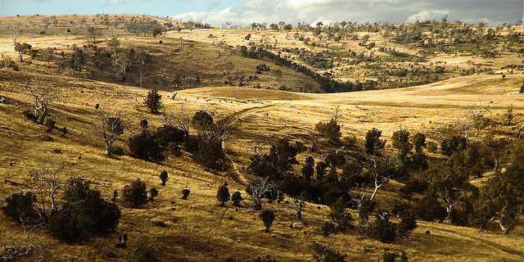
Natural features
Tasmanian plains
http://www.flickr.com/photos/walmink/181004831/

Slide 30
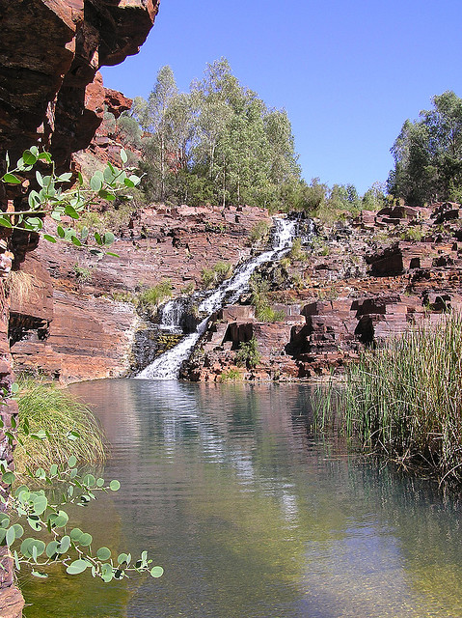
Natural features
Waterfall
http://www.flickr.com/photos/snarff/124165001/

Slide 31
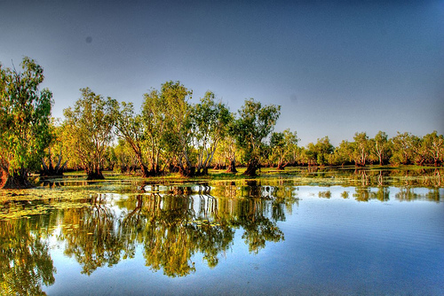
Natural features
Yellow Waters Billabong
http://www.flickr.com/photos/pedroqtc/1808992968/

Slide 32
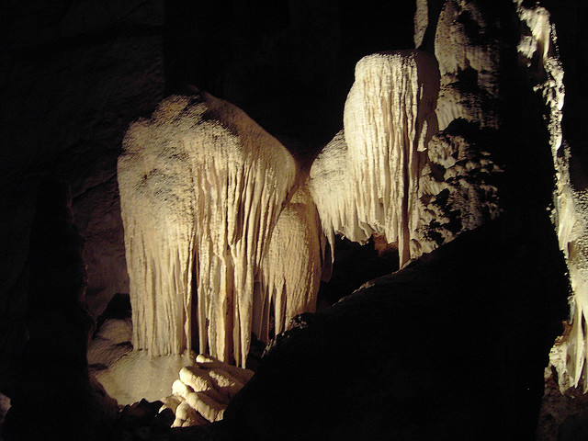
Natural features
Wombeyan Caves
http://www.flickr.com/photos/t_lawrie/164566794/

