Slide 1
Brazilian Street Art
MP3 Grade 1 Brazilian Culture Project
Created by Melissa McDonald, MLS

Slide 2
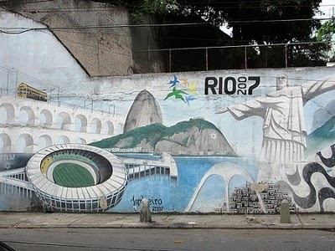
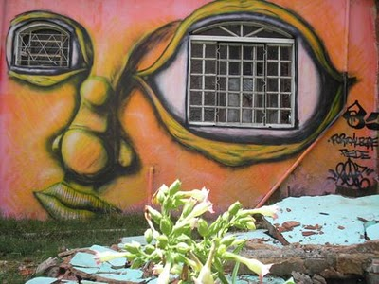
Notes:
All photographs found on http://km-stressnet.blogspot.com/2010/07/unusual-and-fun-street-art-from-brazil.html

Slide 3
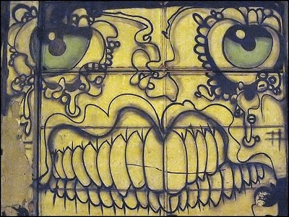
Taís Melillo, the photographer who took the above photograph, said this face was painted on a wall in Sao Paulo, Brazil*.
*I emailed her and asked!
Notes:
Tais Melillo: http://www.flickr.com/photos/tais/2039749220/

Slide 4
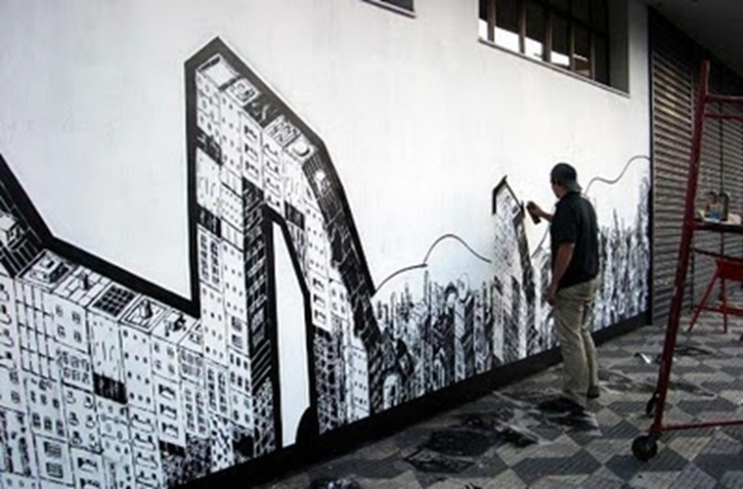

Slide 5
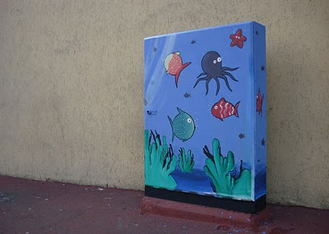
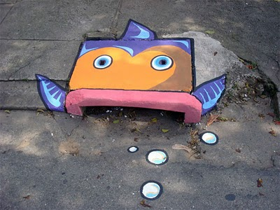
Notes:
http://km-stressnet.blogspot.com/2010/07/unusual-and-fun-street-art-from-brazil.html

Slide 6
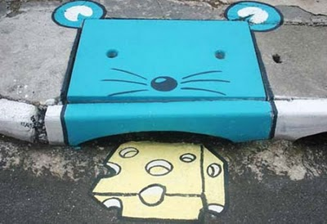
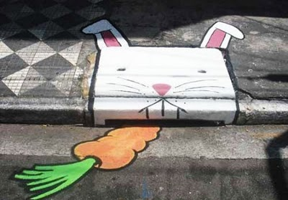

Slide 7
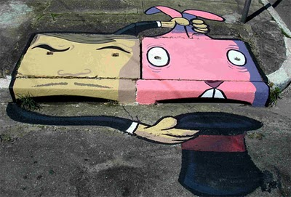
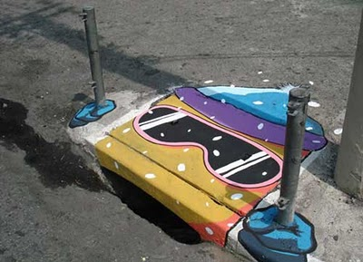

Slide 8
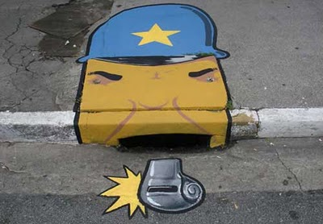
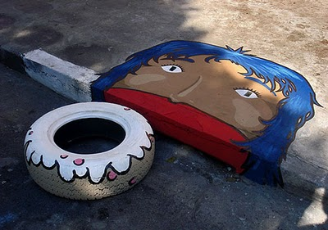

Slide 9
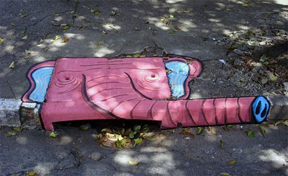
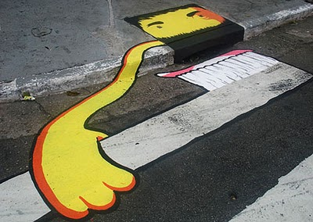

Slide 10
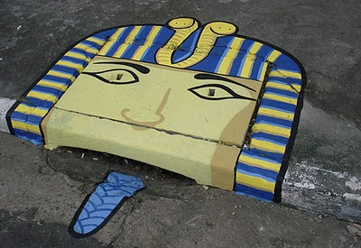
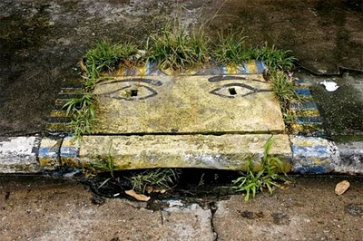

Slide 11
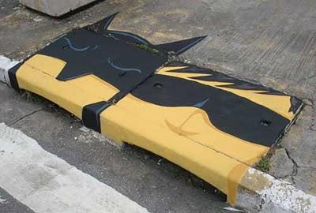
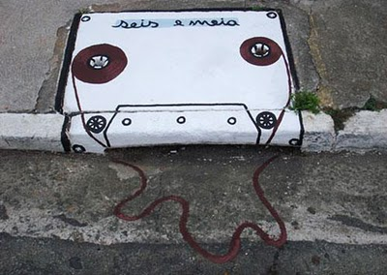

Slide 12
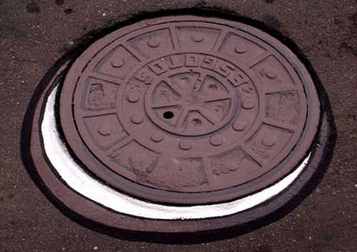
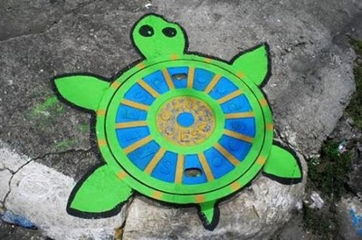

Slide 13
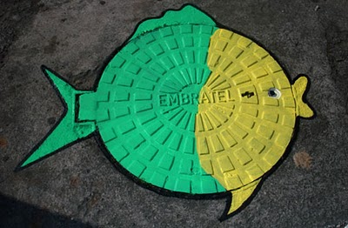
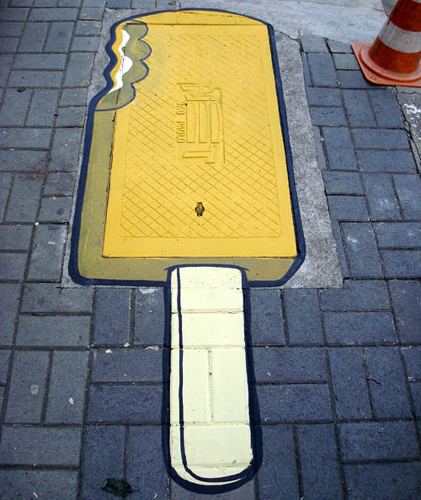

Slide 14
Websites
Unusual and Fun Street Art from Brazil:
http://km-stressnet.blogspot.com/2010/07/unusual-and-fun-street-art-from-brazil.html
Taís Melillo’s Flickr PhotoStream:
http://www.flickr.com/photos/tais/

