Slide 1
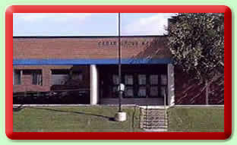

Salad Science
Comes To
Cedar Grove 2011

Slide 2
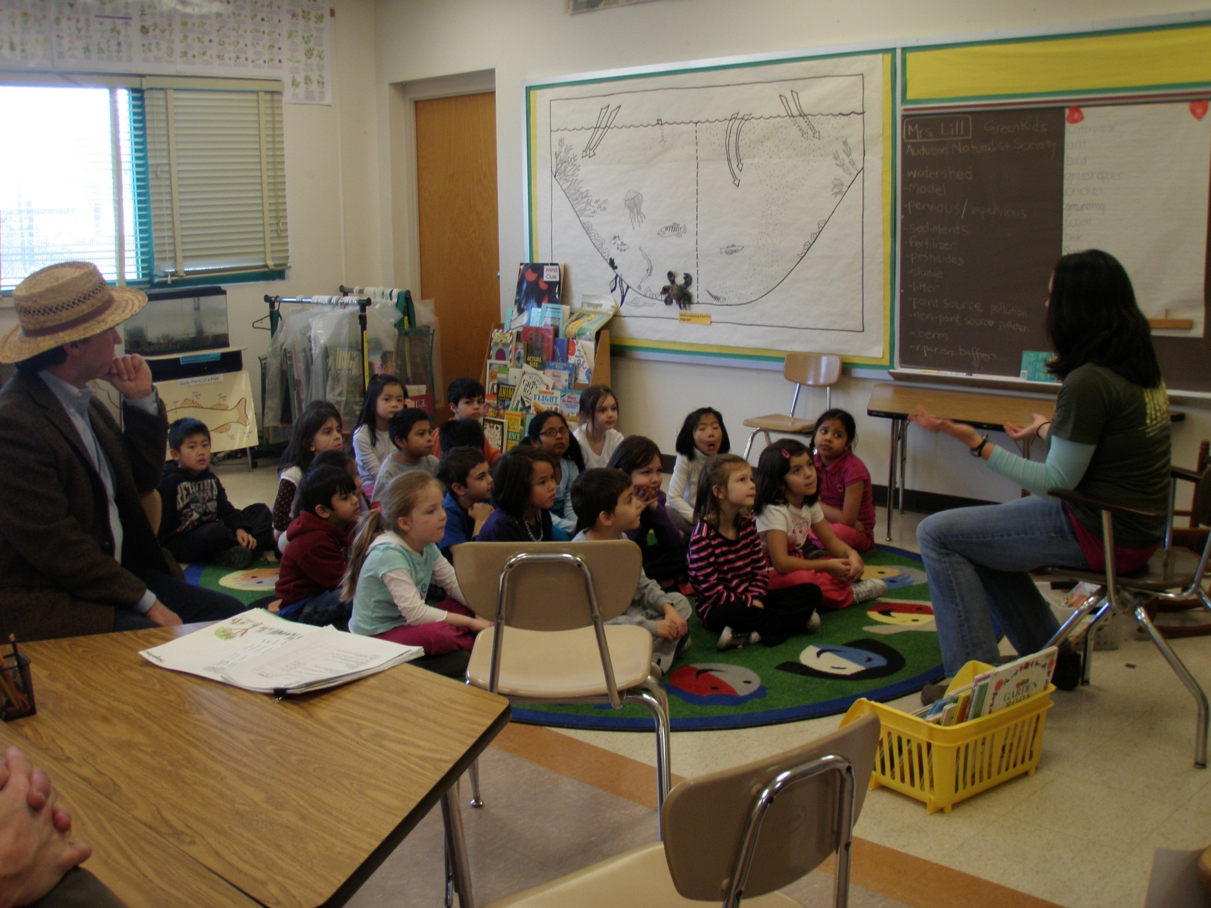
Miss Liz and Mister Woody from
Red Wiggler Farm
1

Slide 3
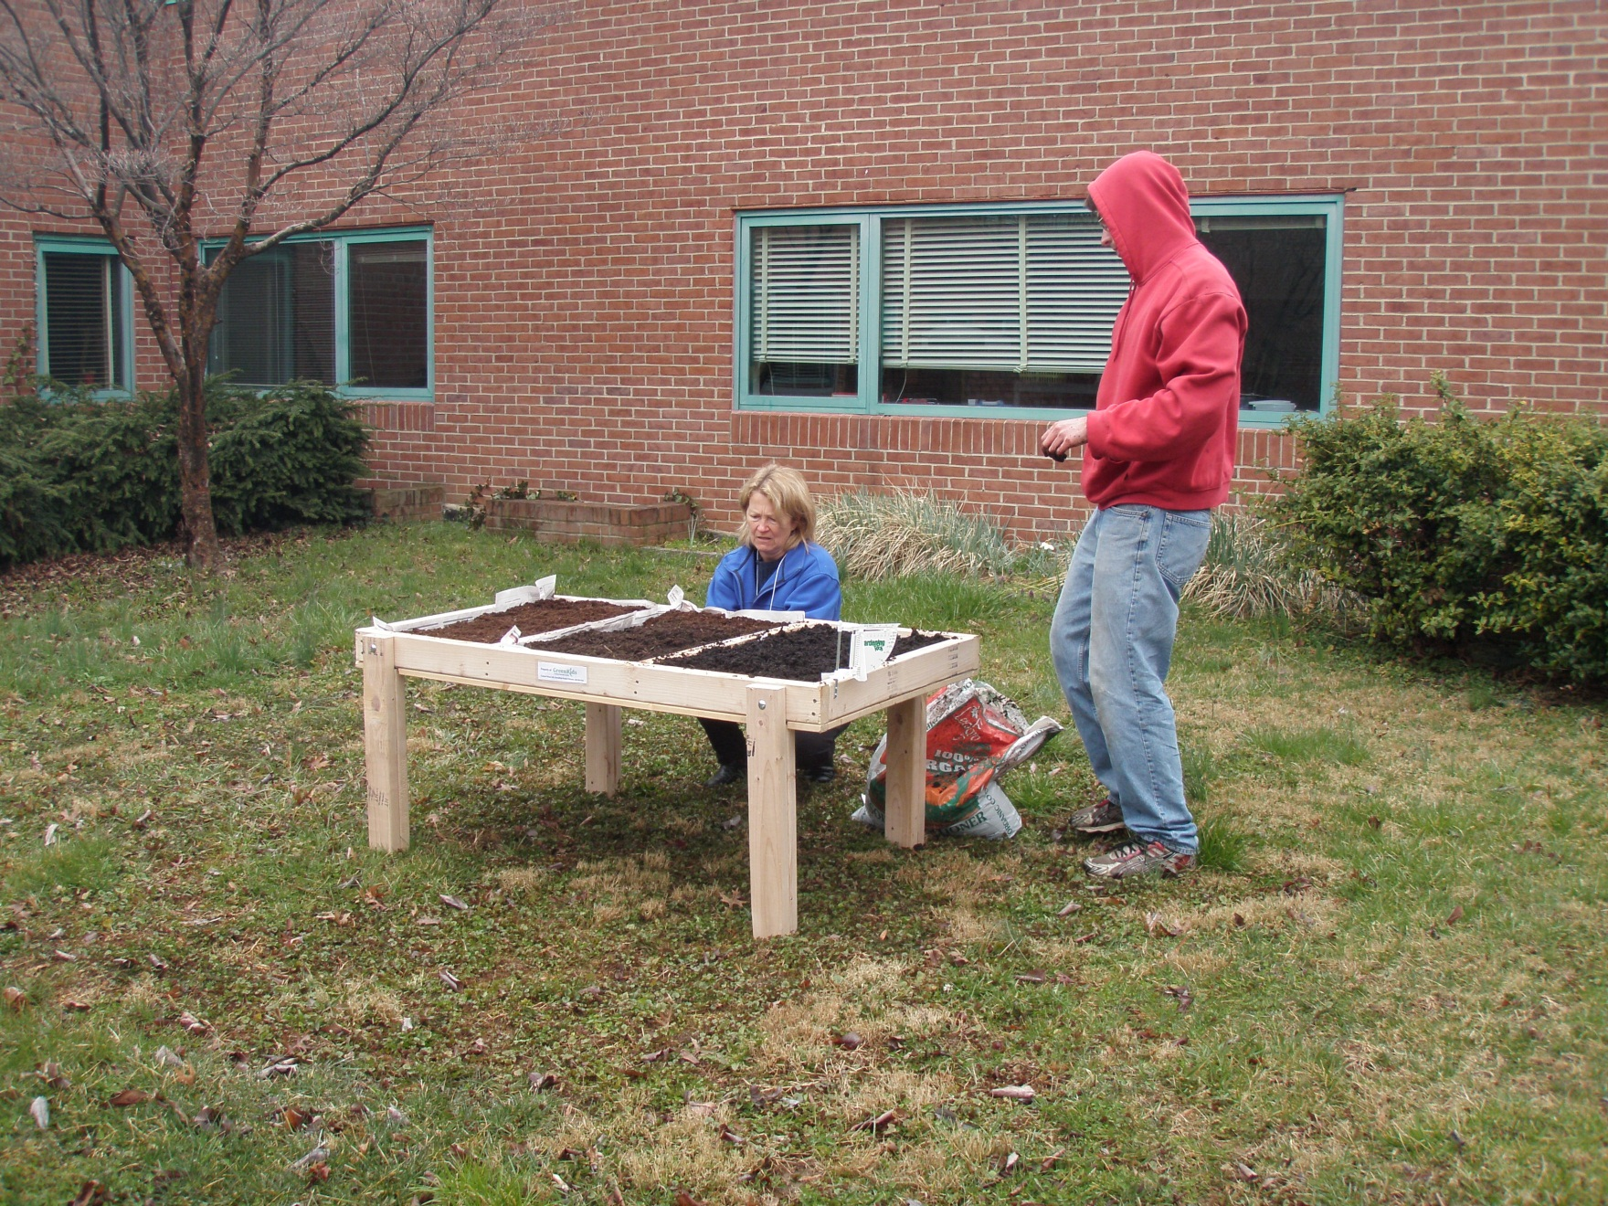
Miss Jenny and her helper set up the salad table
March 31
2

Slide 4
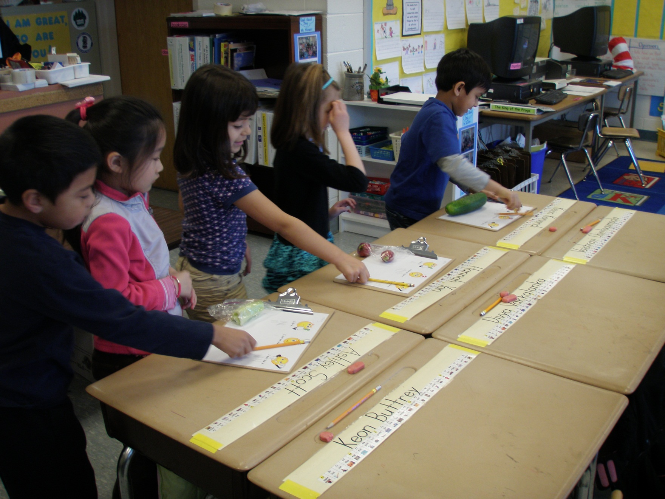
Taking the veggie survey
April 4
3

Slide 5
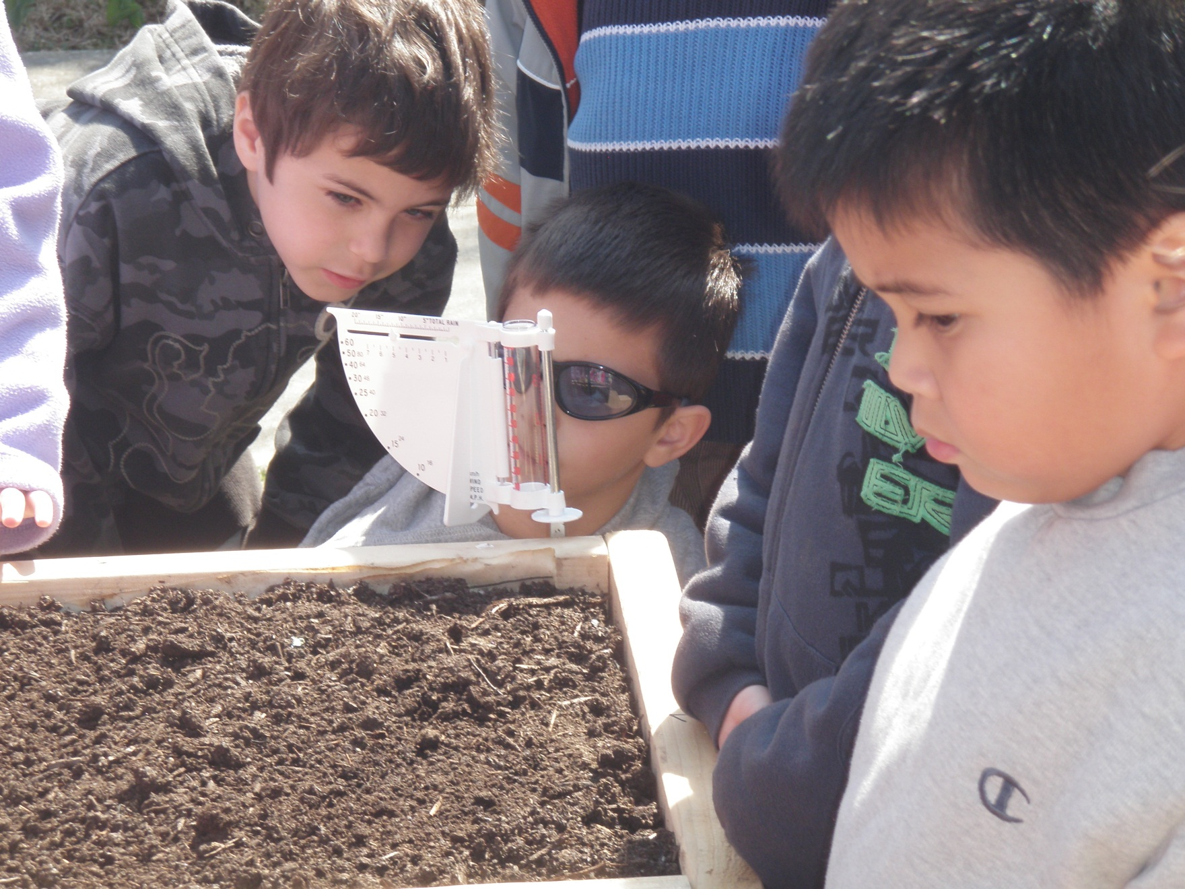
Checking the weather station
April 4
4

Slide 6
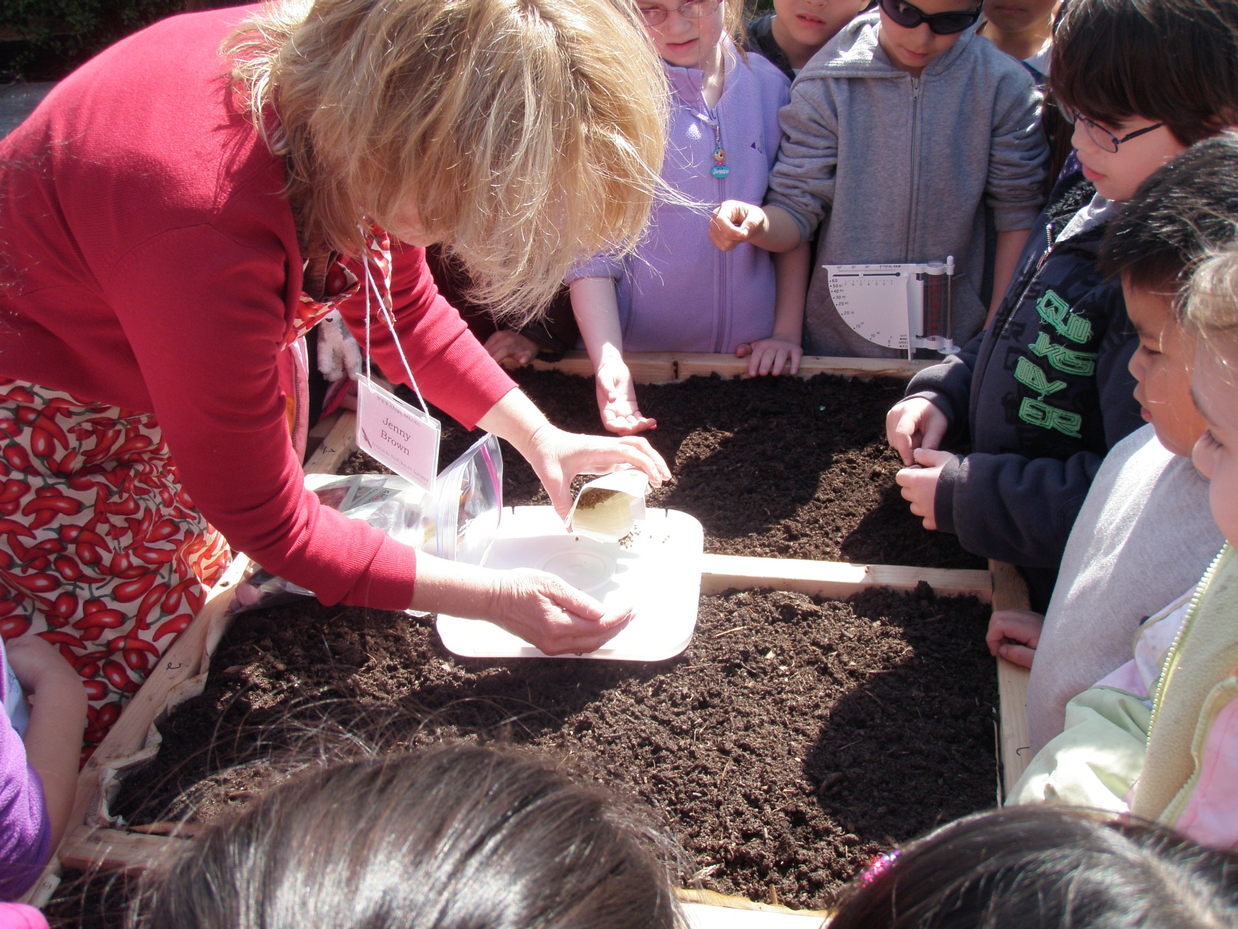
Trying to block the wind
5

Slide 7
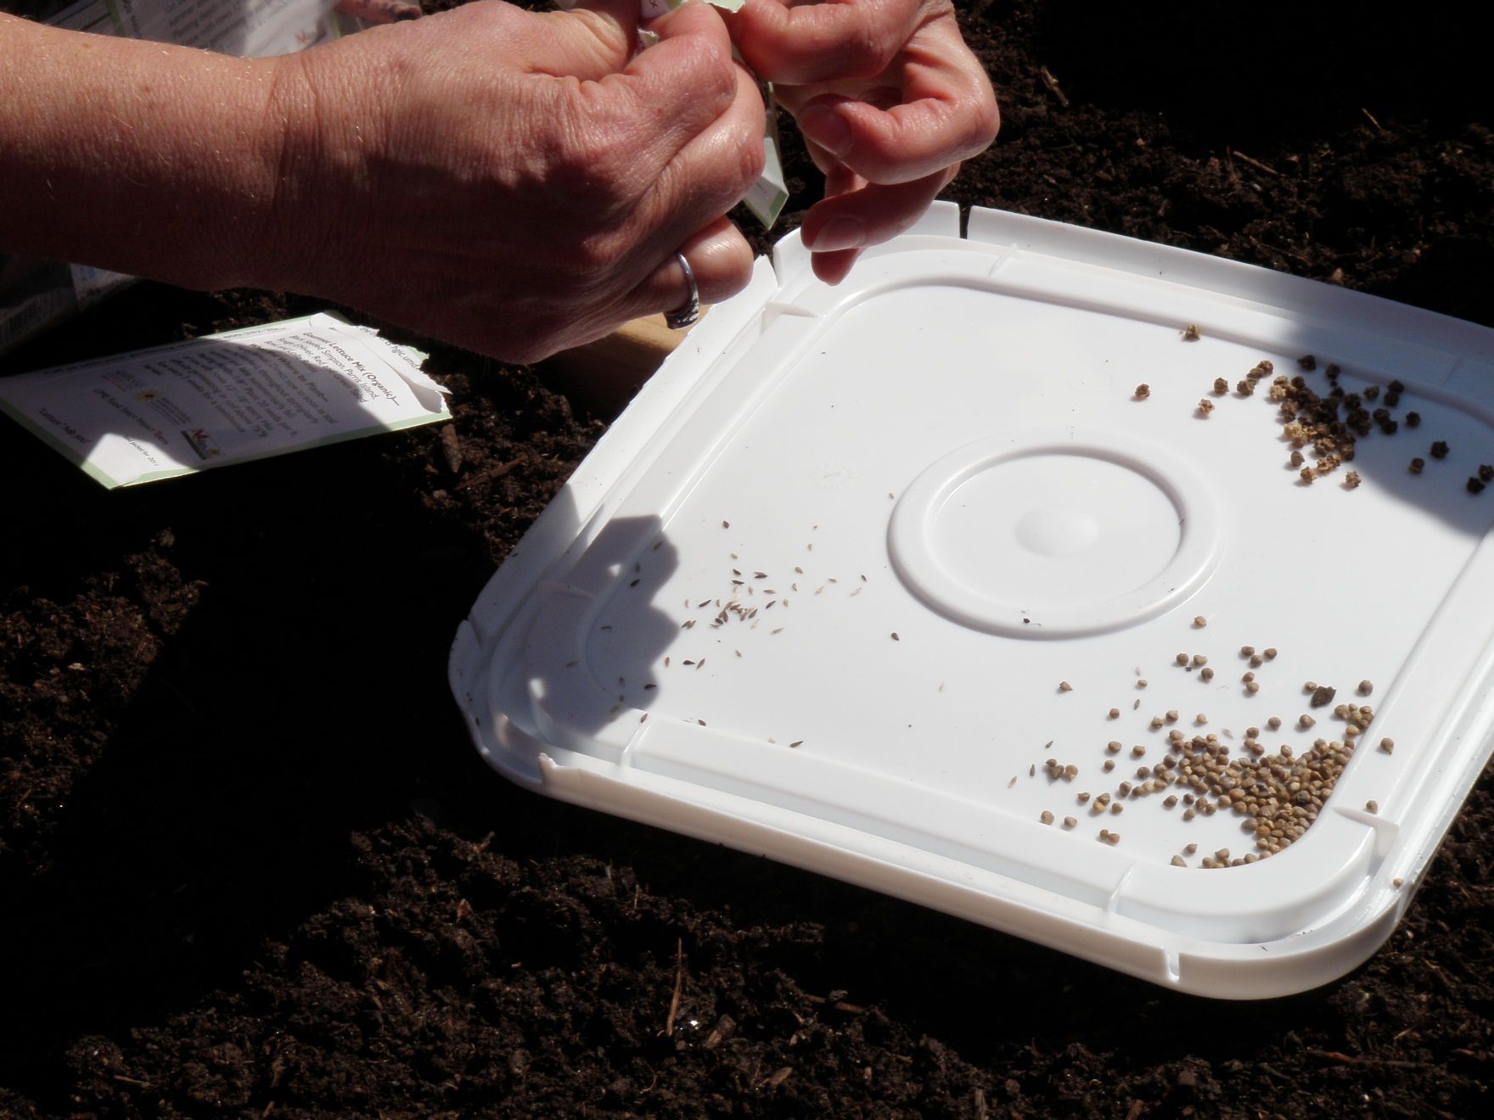
Tiny seeds
6

Slide 8
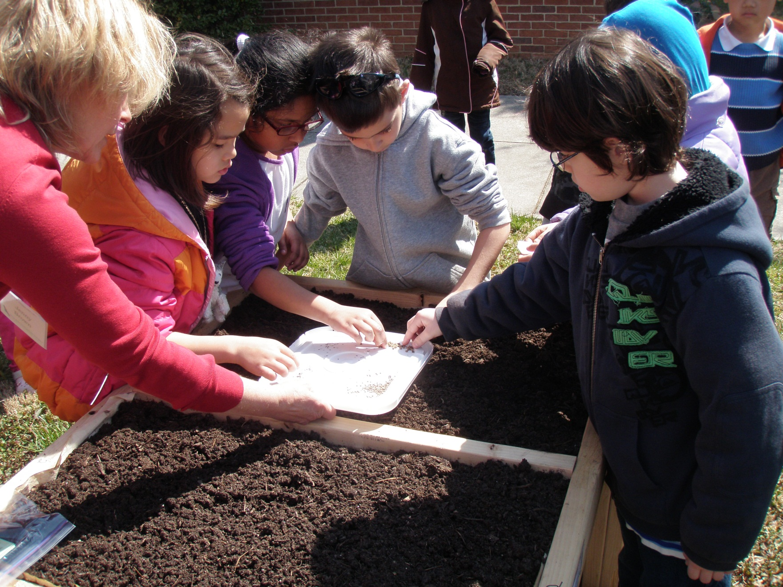
Seeds scattered by us and the wind!
7

Slide 9
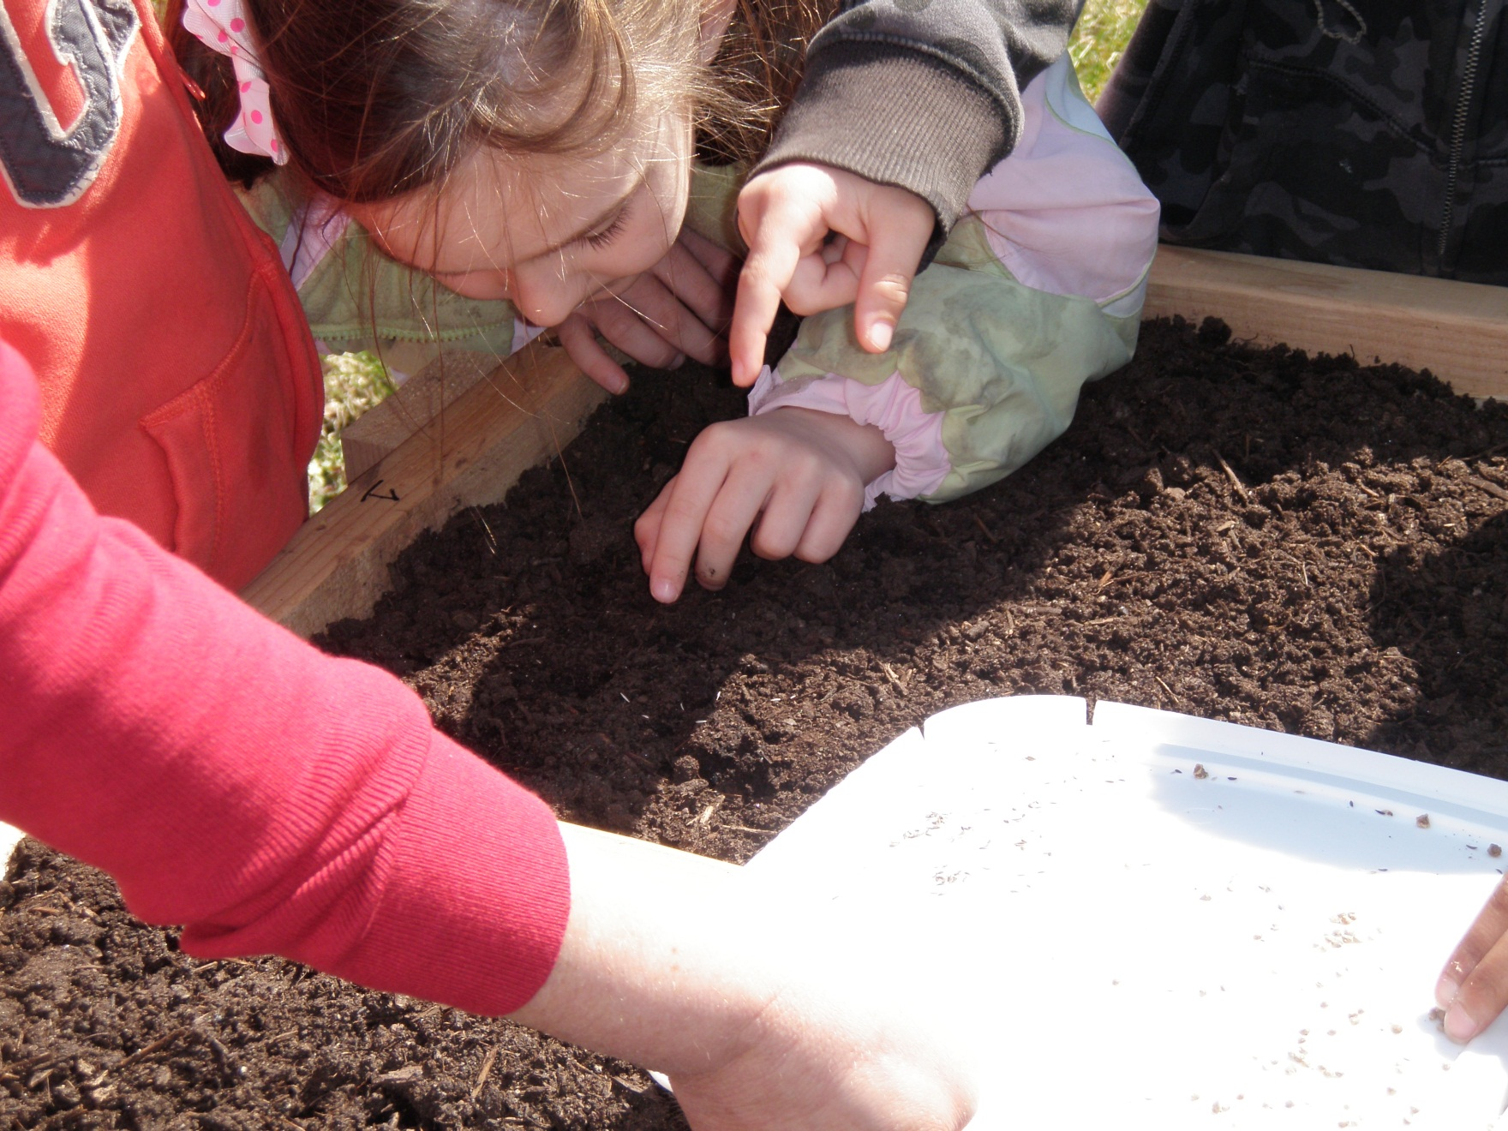
Press lightly
8

Slide 10
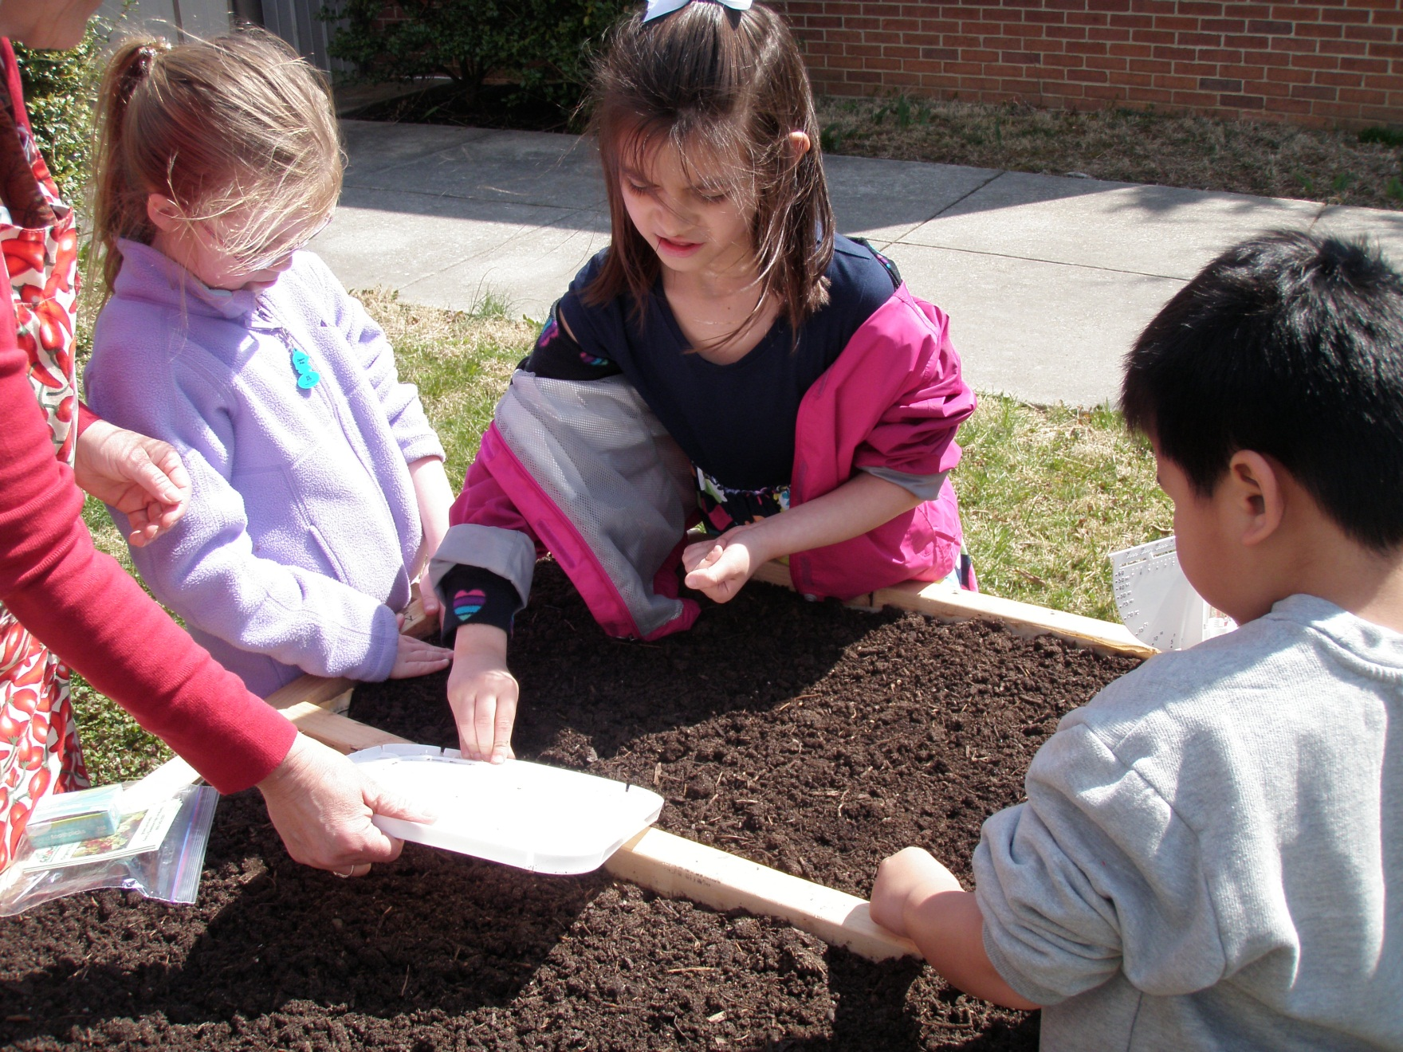
9

Slide 11
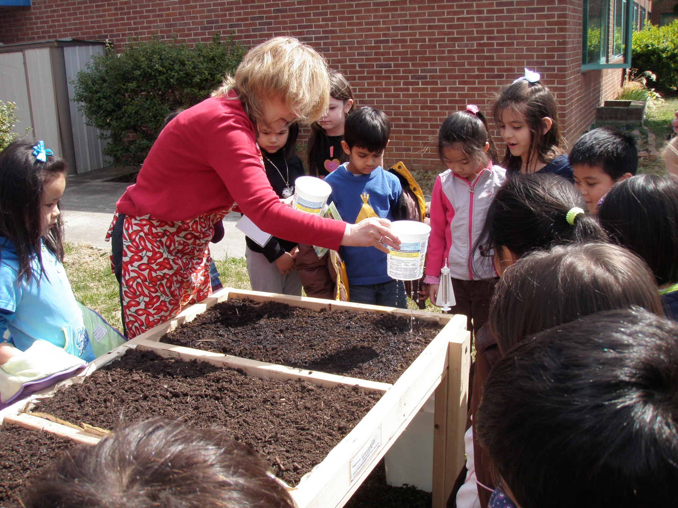
Water gently
10

Slide 12
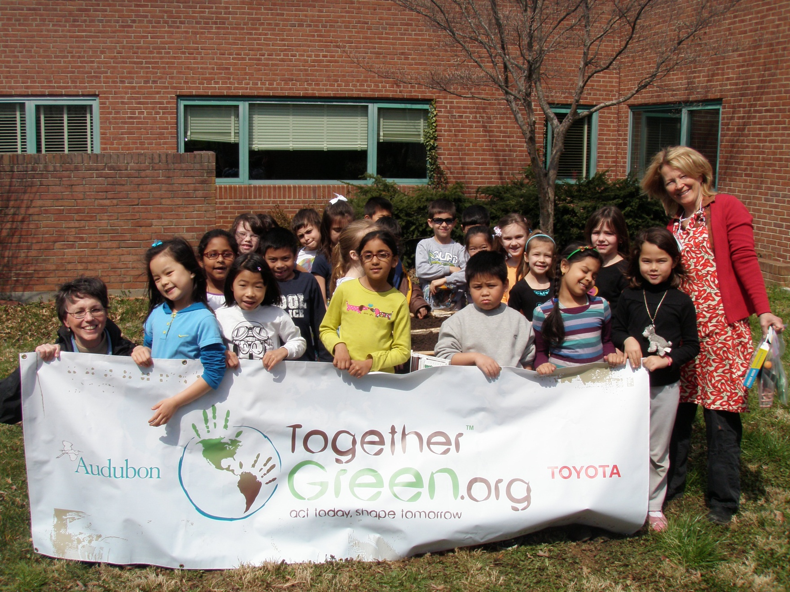
11

Slide 13
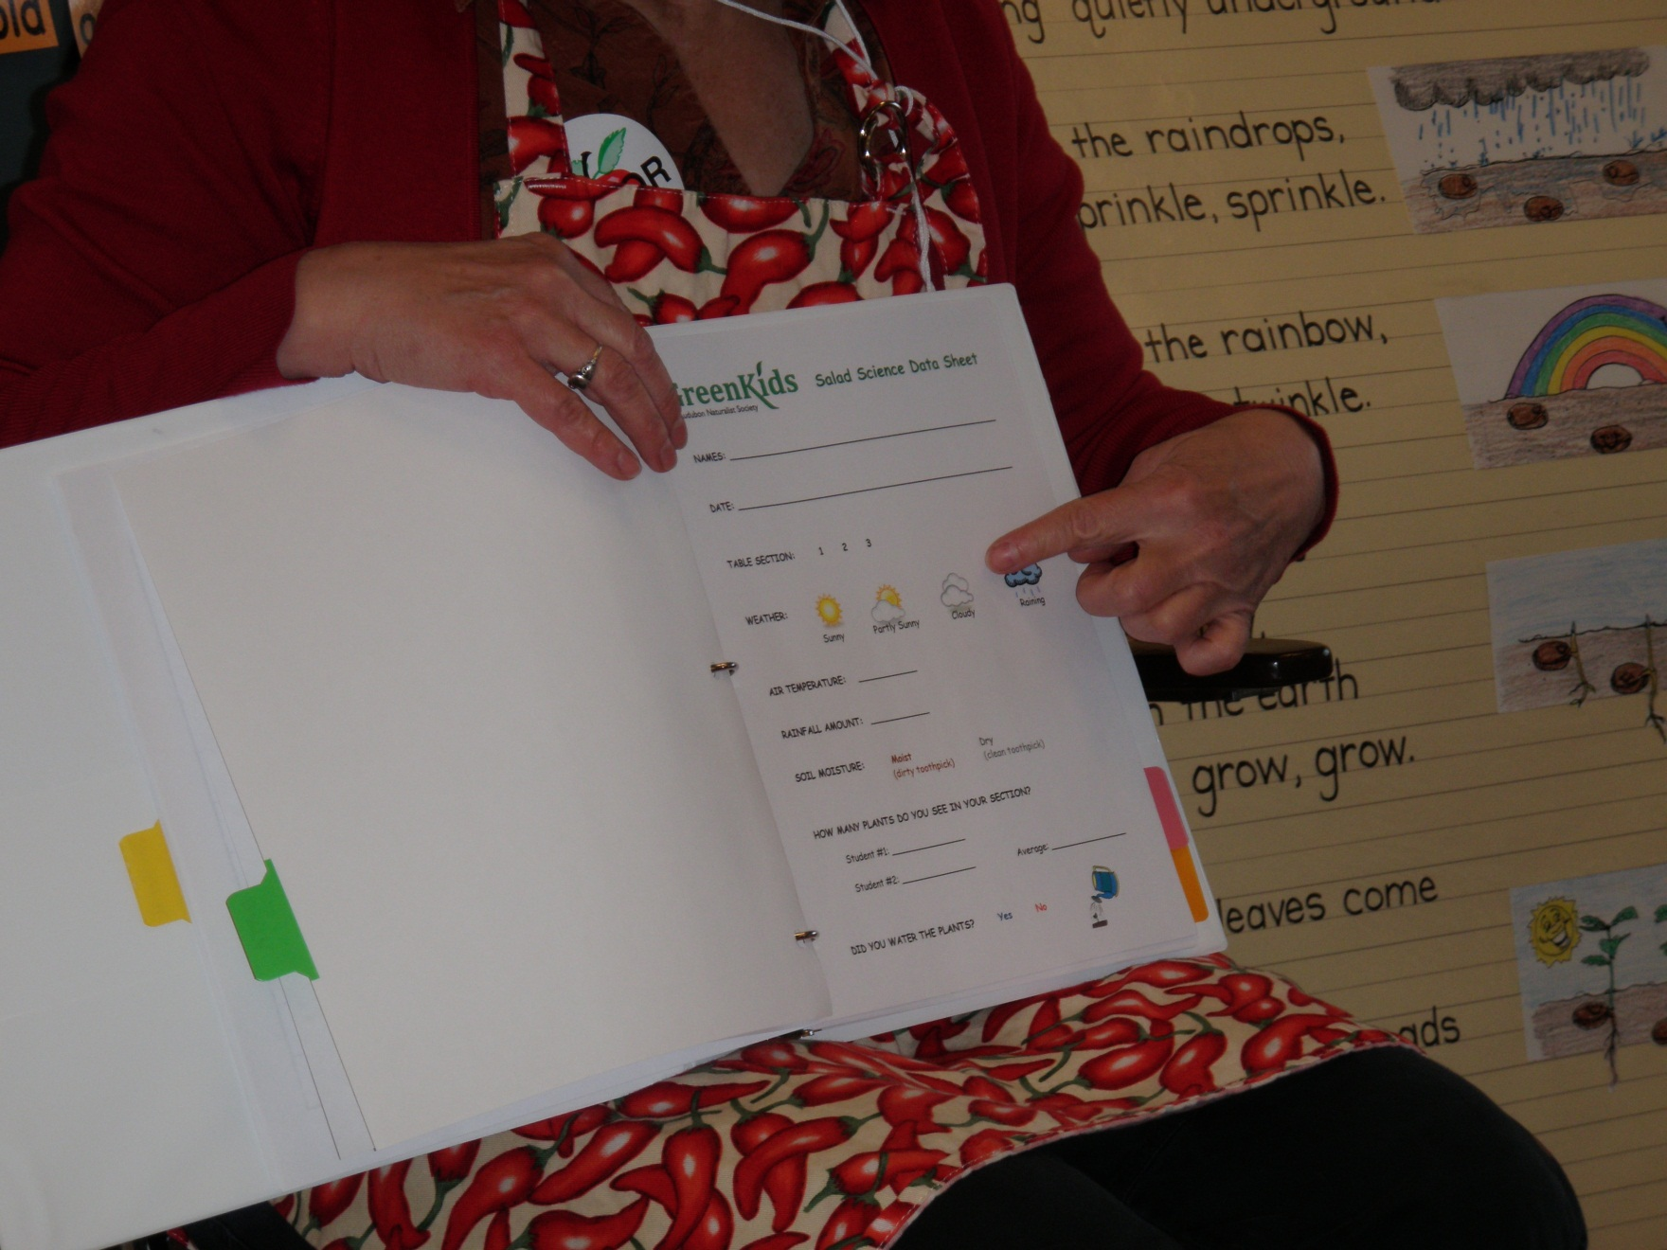
Data collection directions
12

Slide 14
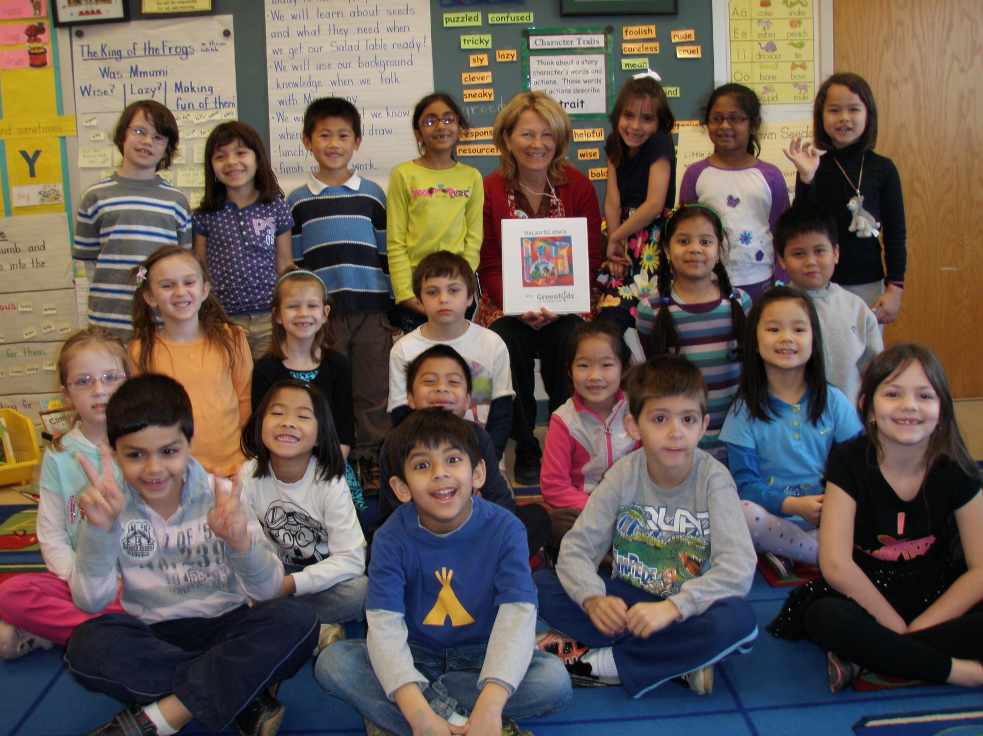
Let’s get growing!
13

Slide 15
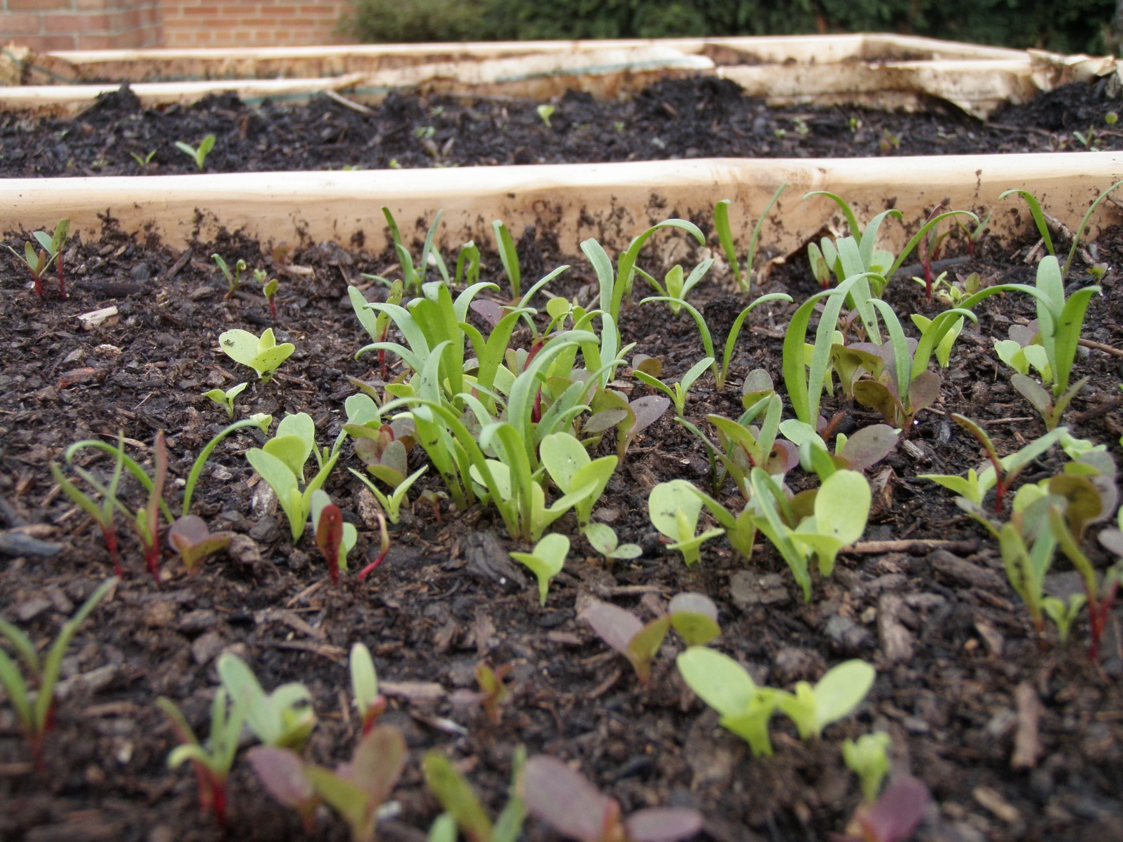
April 21
14

Slide 16
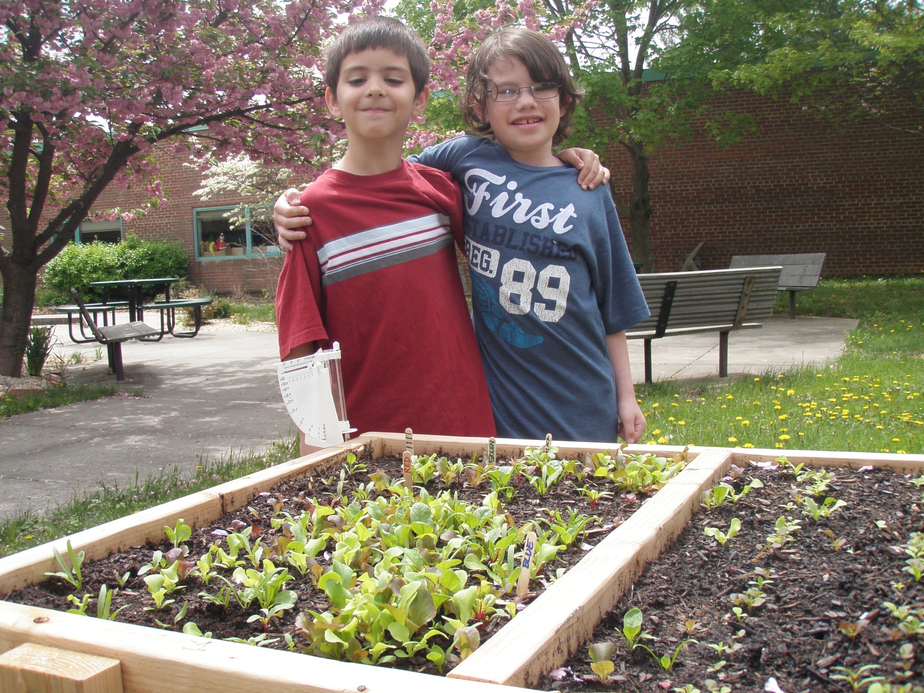
April 27
15

Slide 17
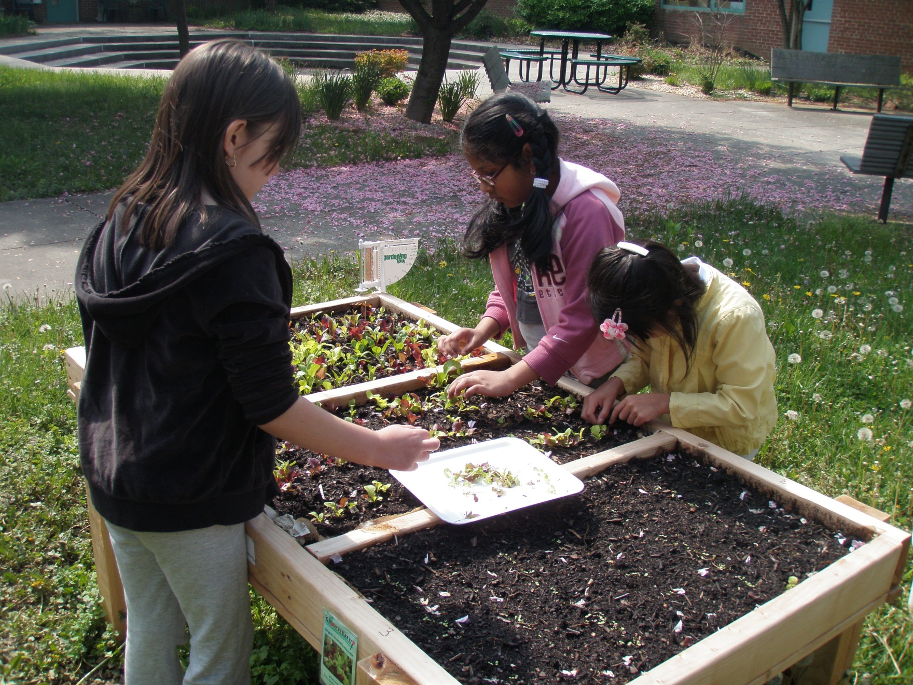
Thinning and transplanting
May 2
16

Slide 18
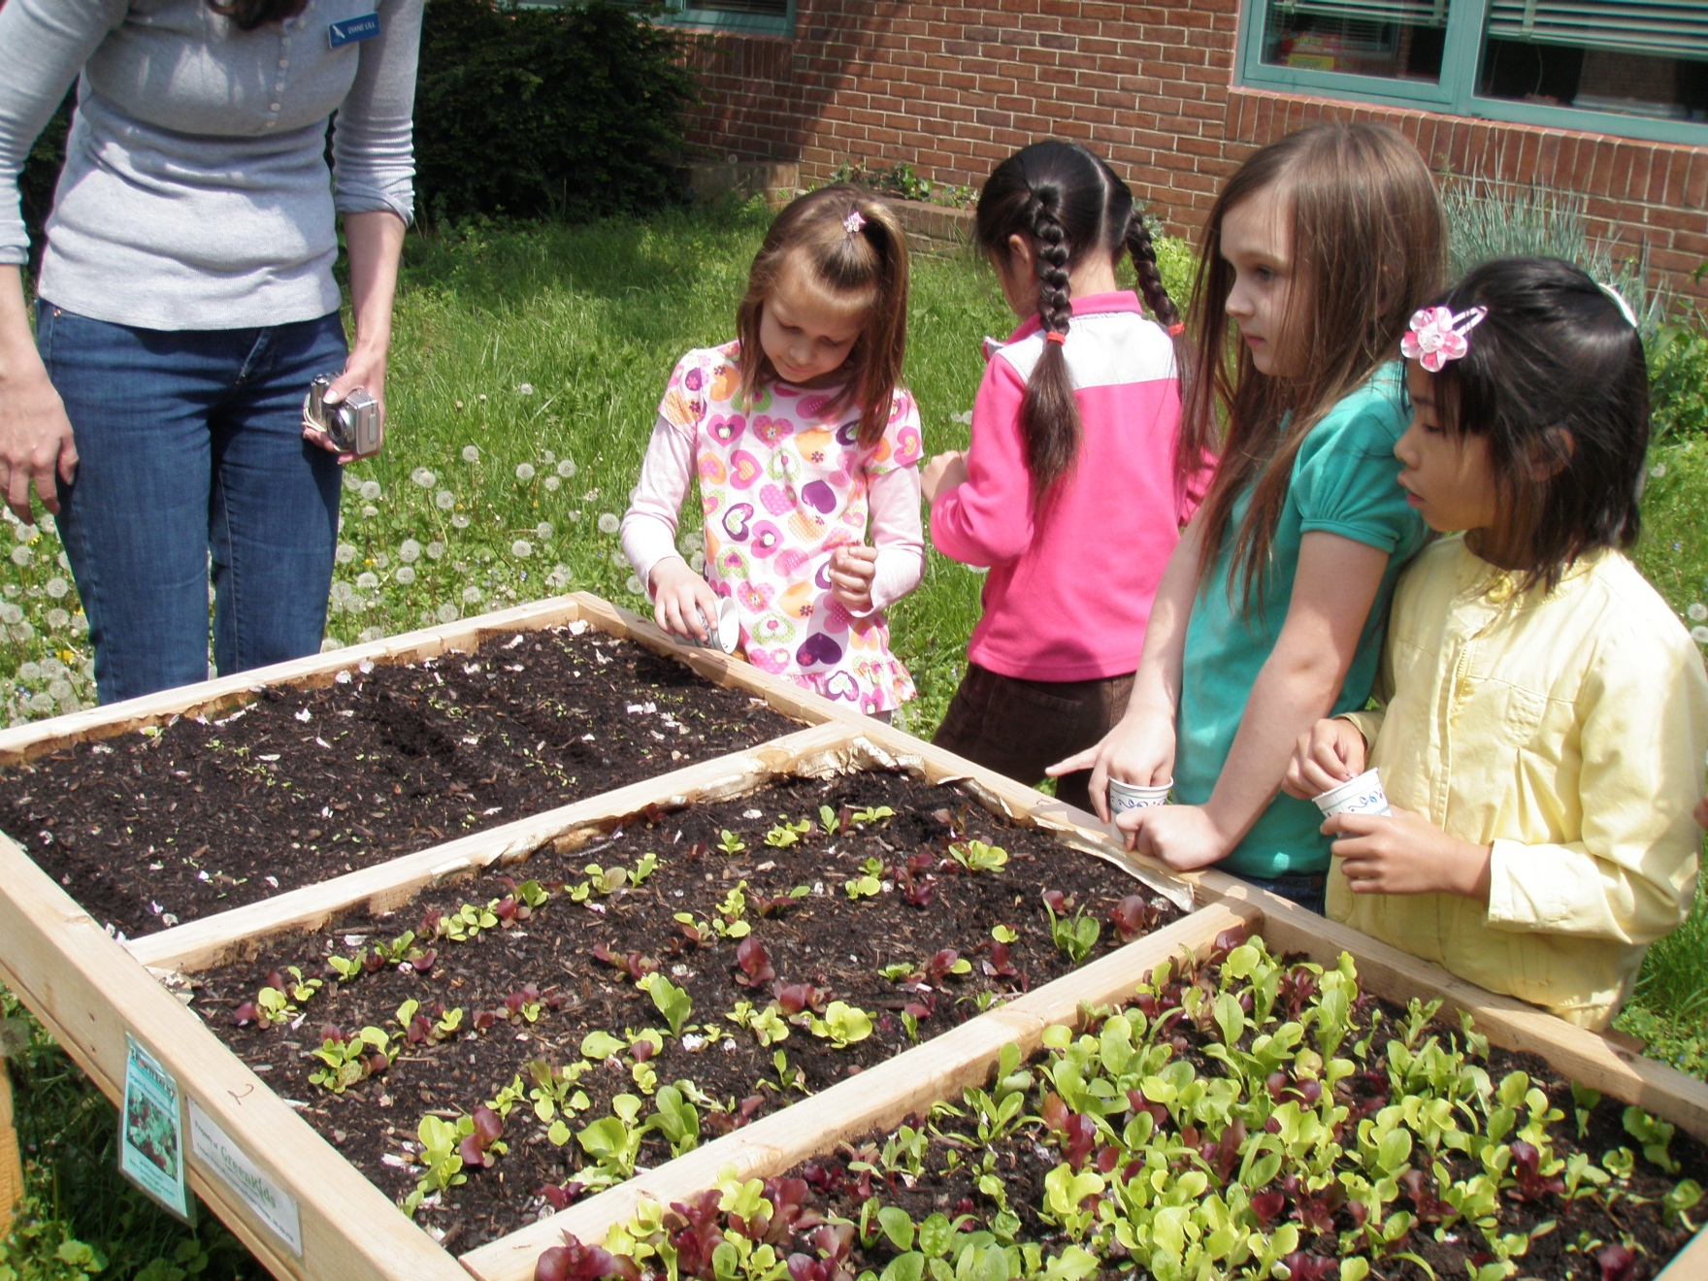
Adding compost harvested from the worm bin
17

Slide 19
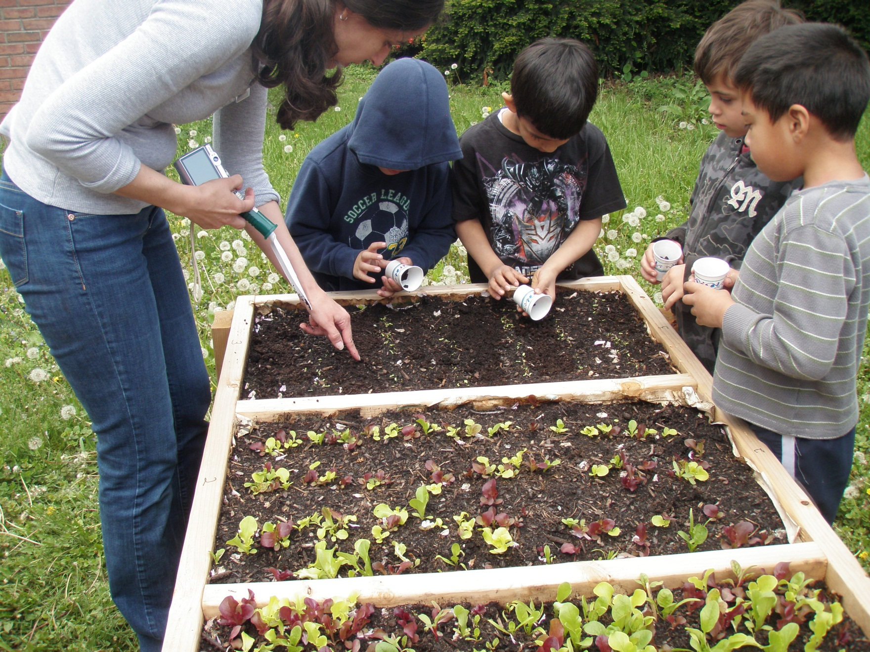
18

Slide 20
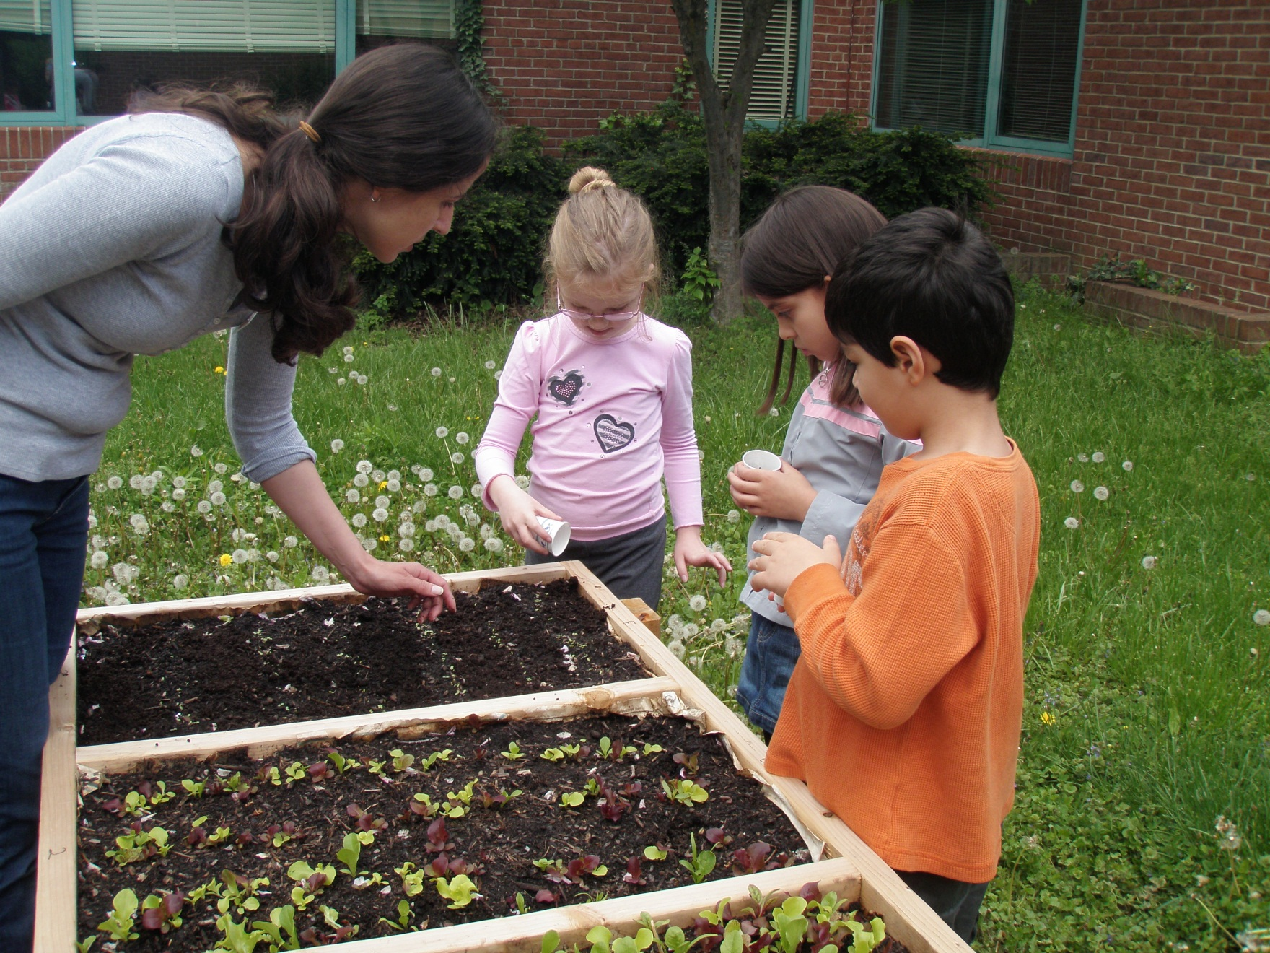
19

Slide 21
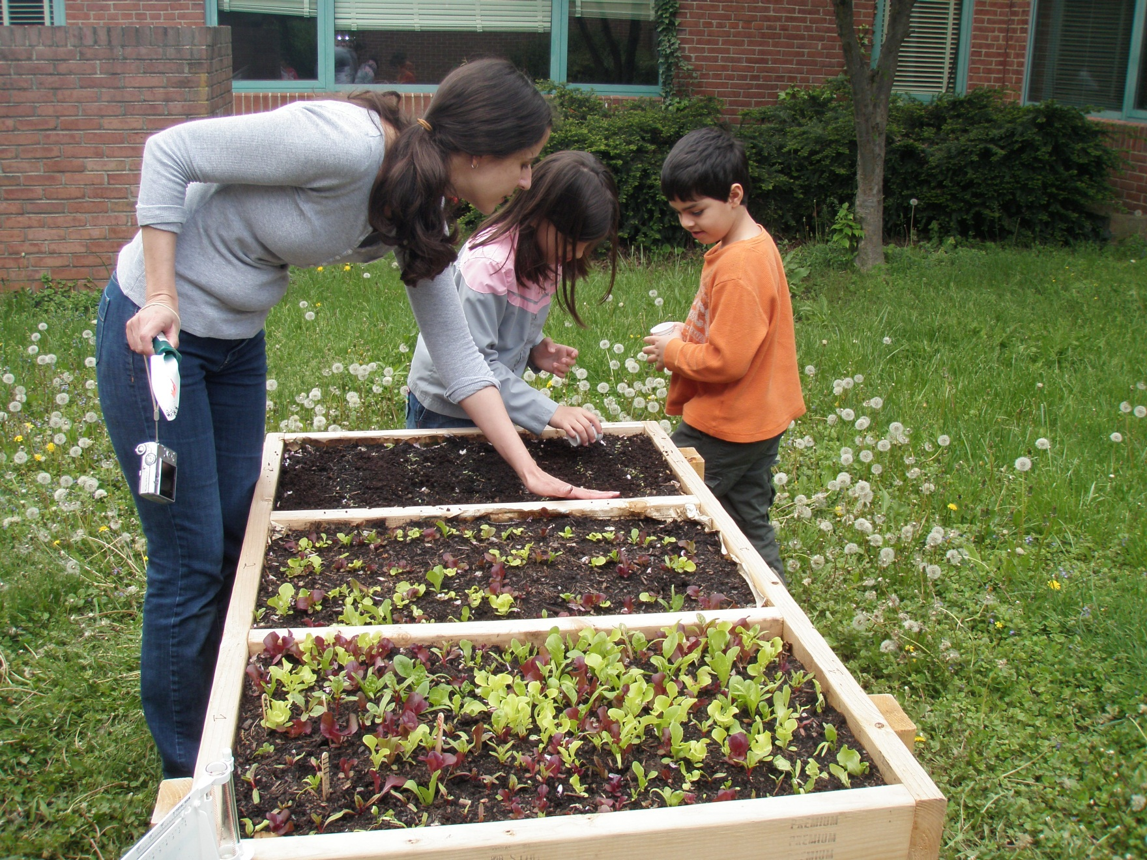
20

Slide 22
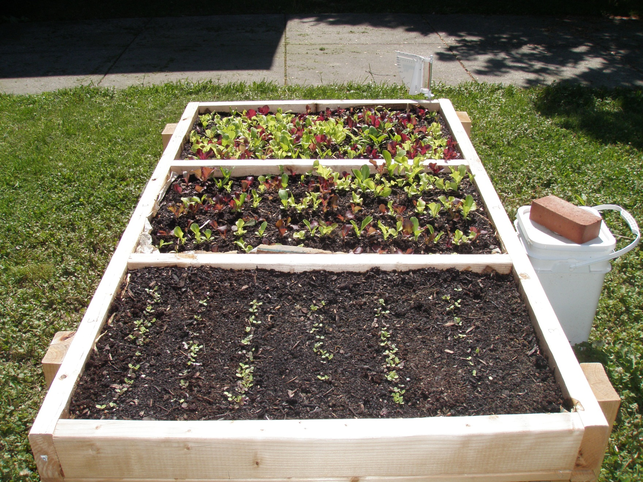
21

Slide 23
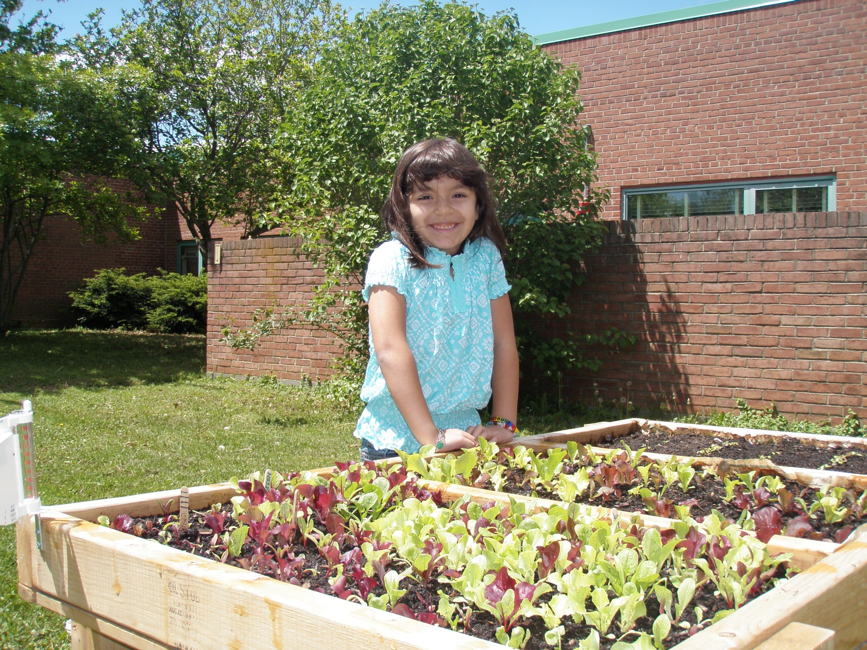
May 5
22

Slide 24
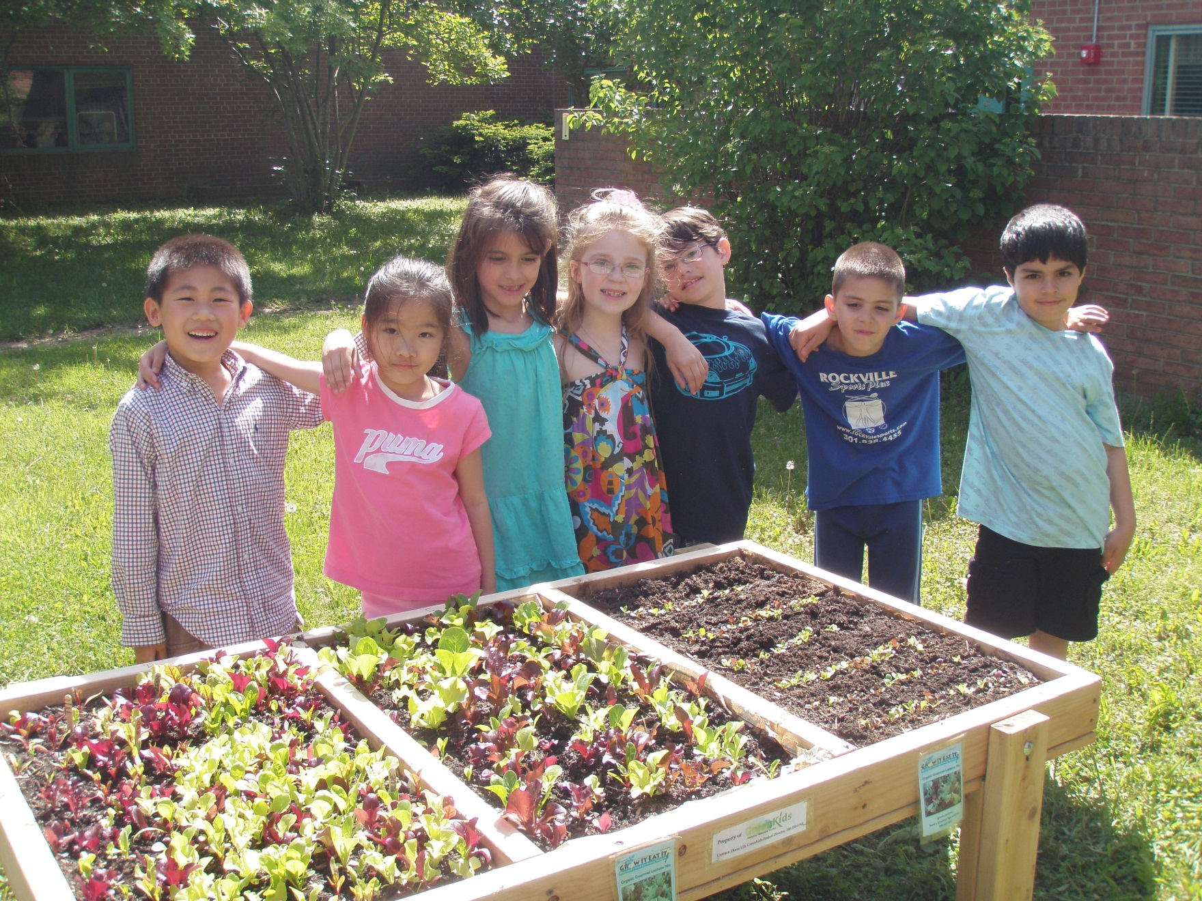
May 10
23

Slide 25
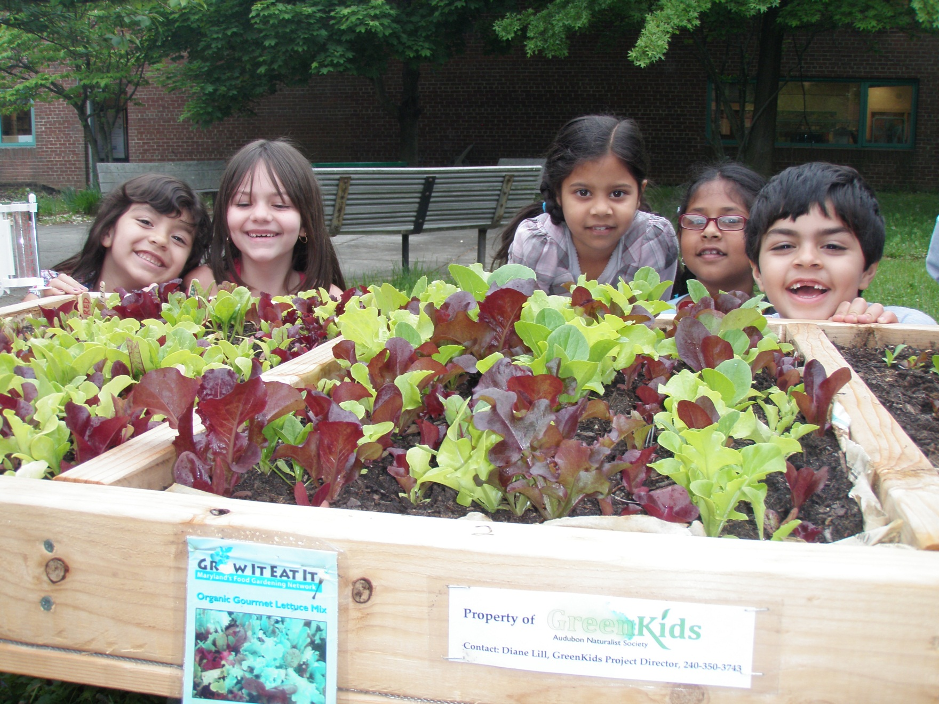
May 13
24

Slide 26
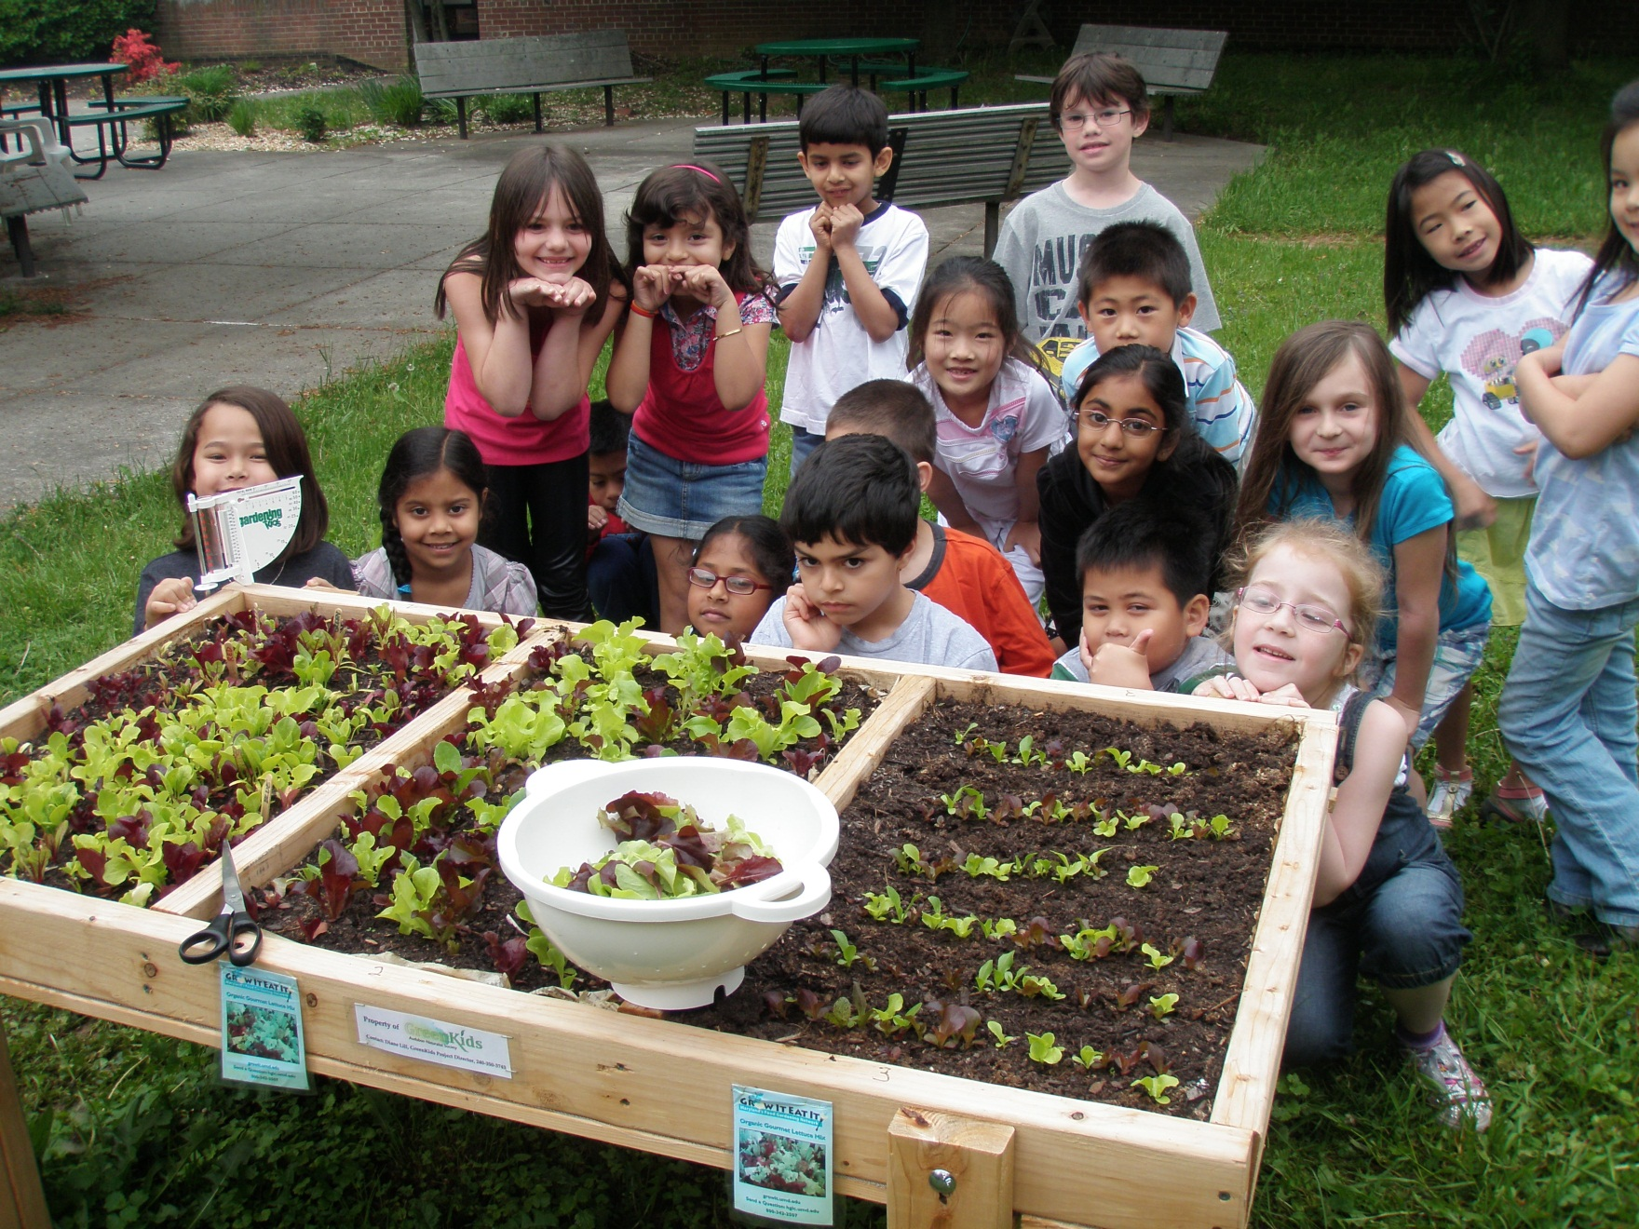
Harvesting sections 1 and 2
May 13
25

Slide 27
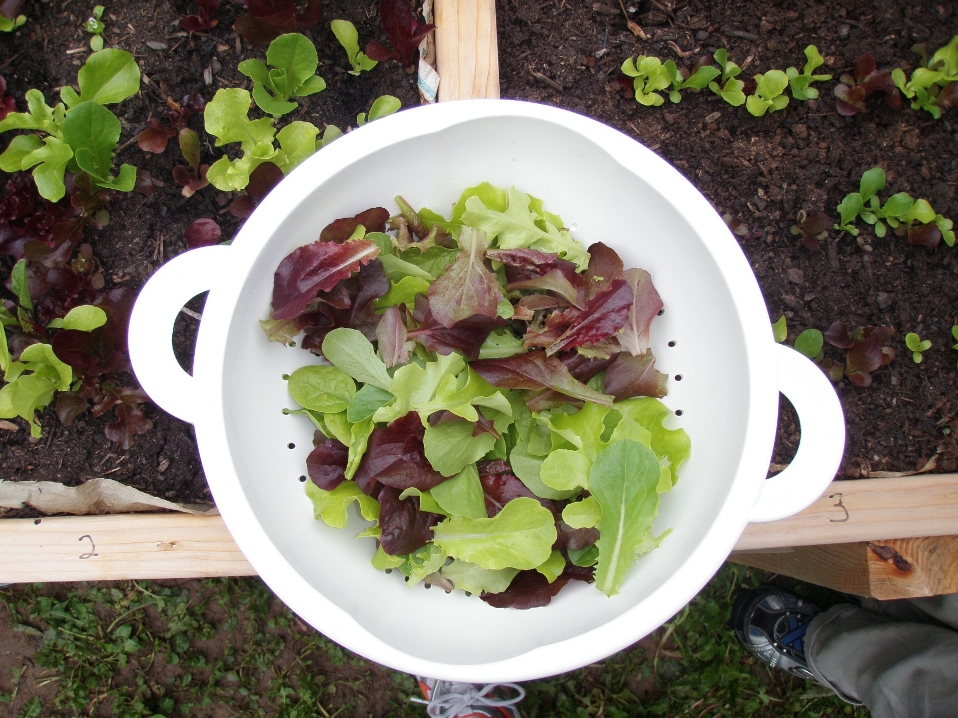
26

Slide 28
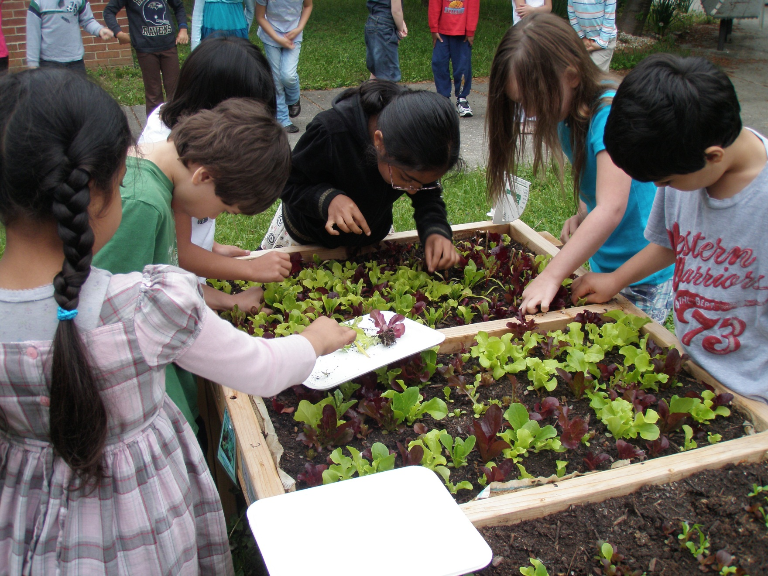
Thinning
May 13
27

Slide 29
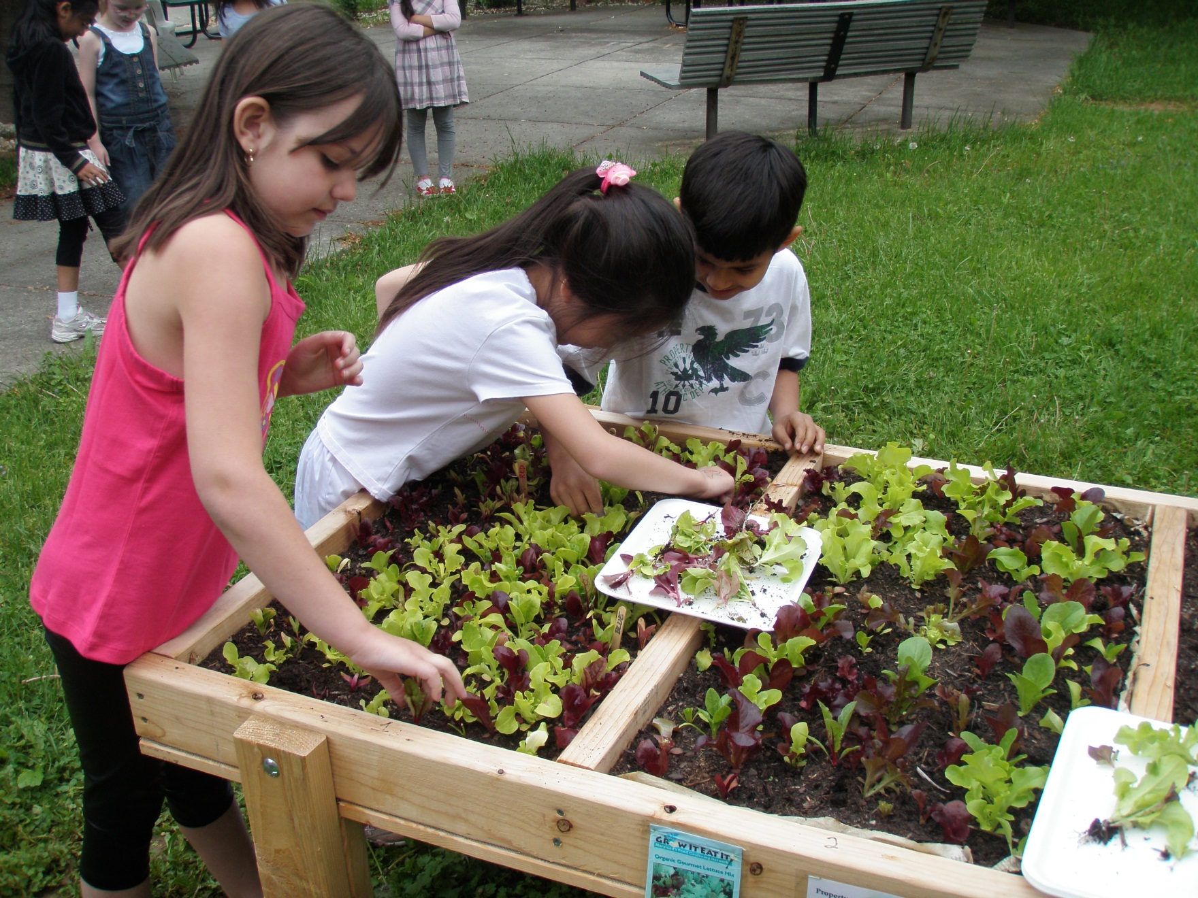
28

Slide 30
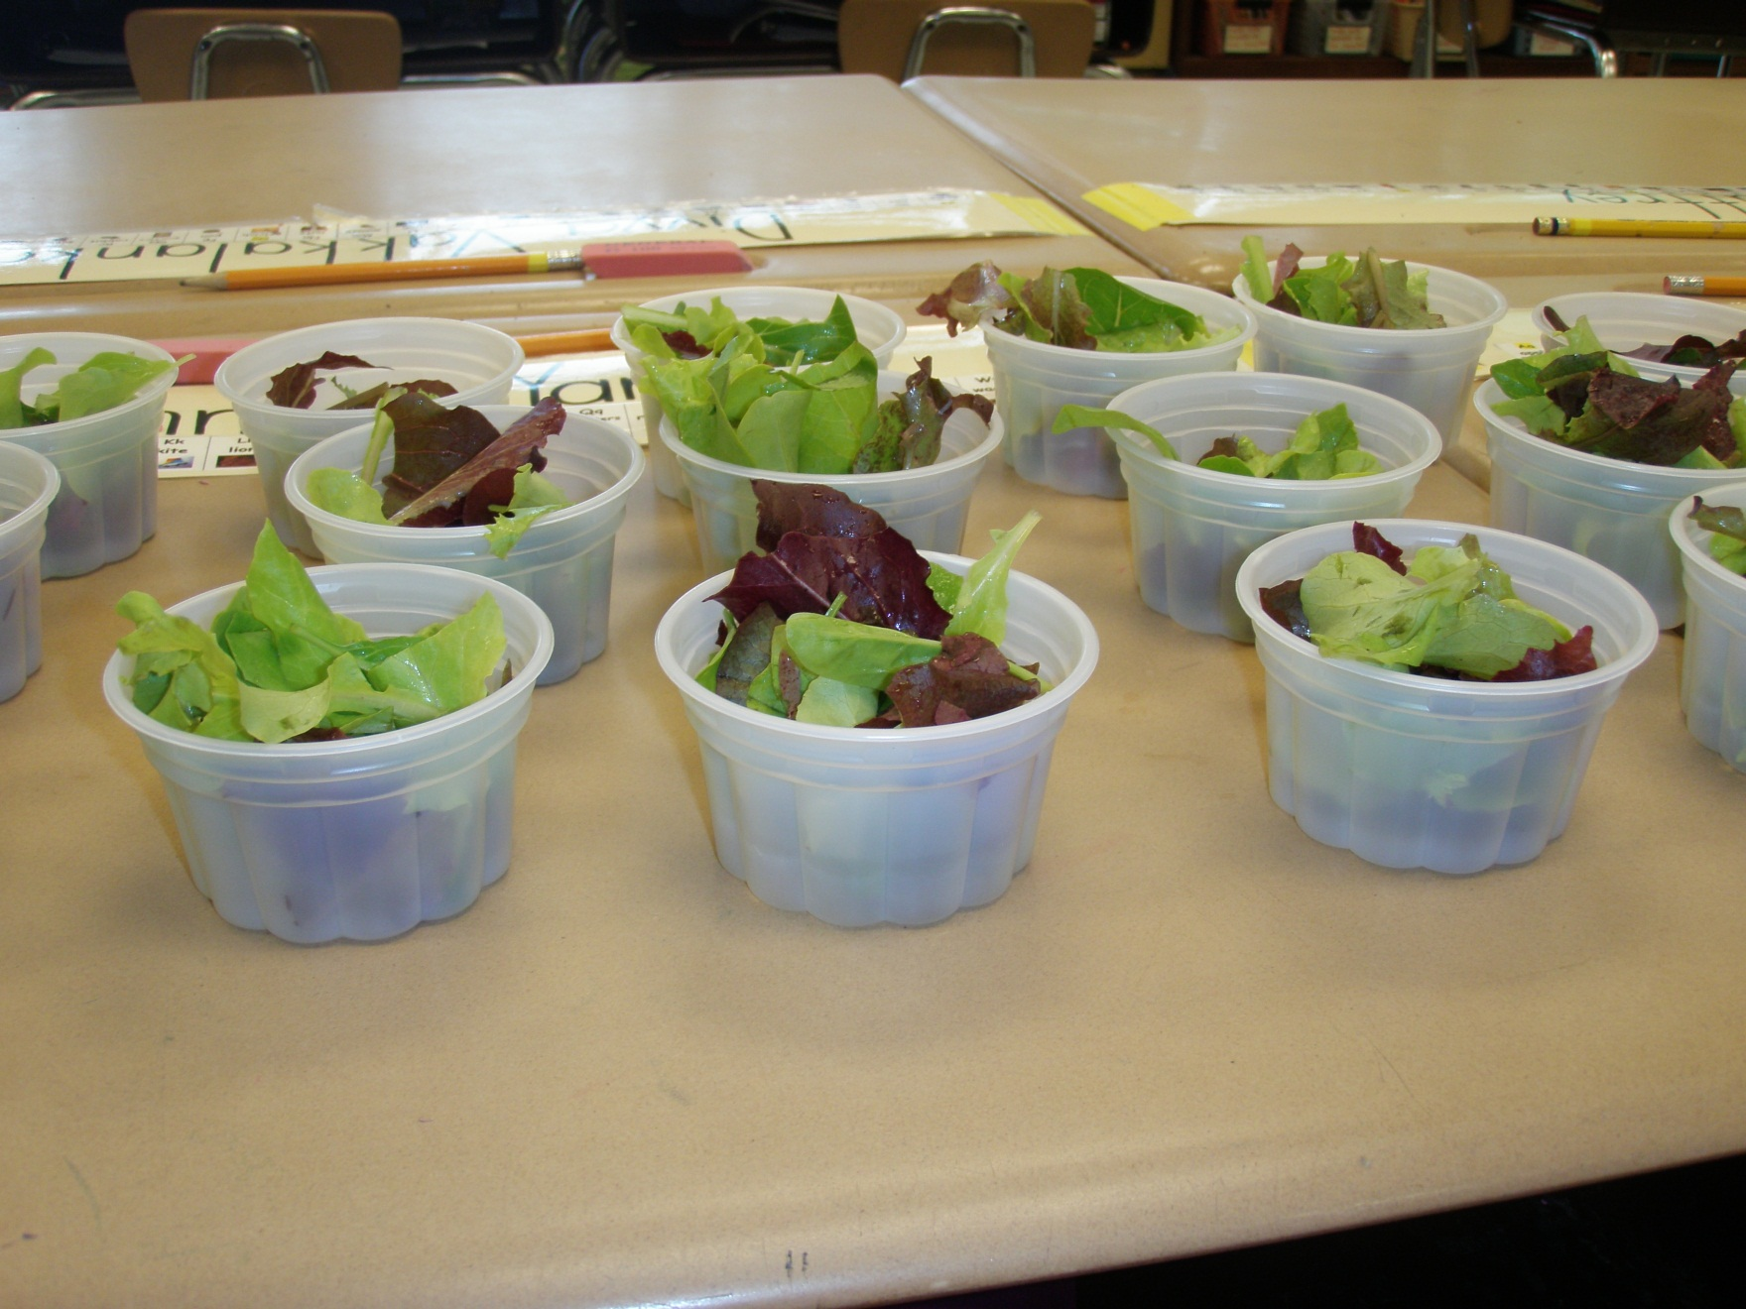
Our first taste test!
29

Slide 31
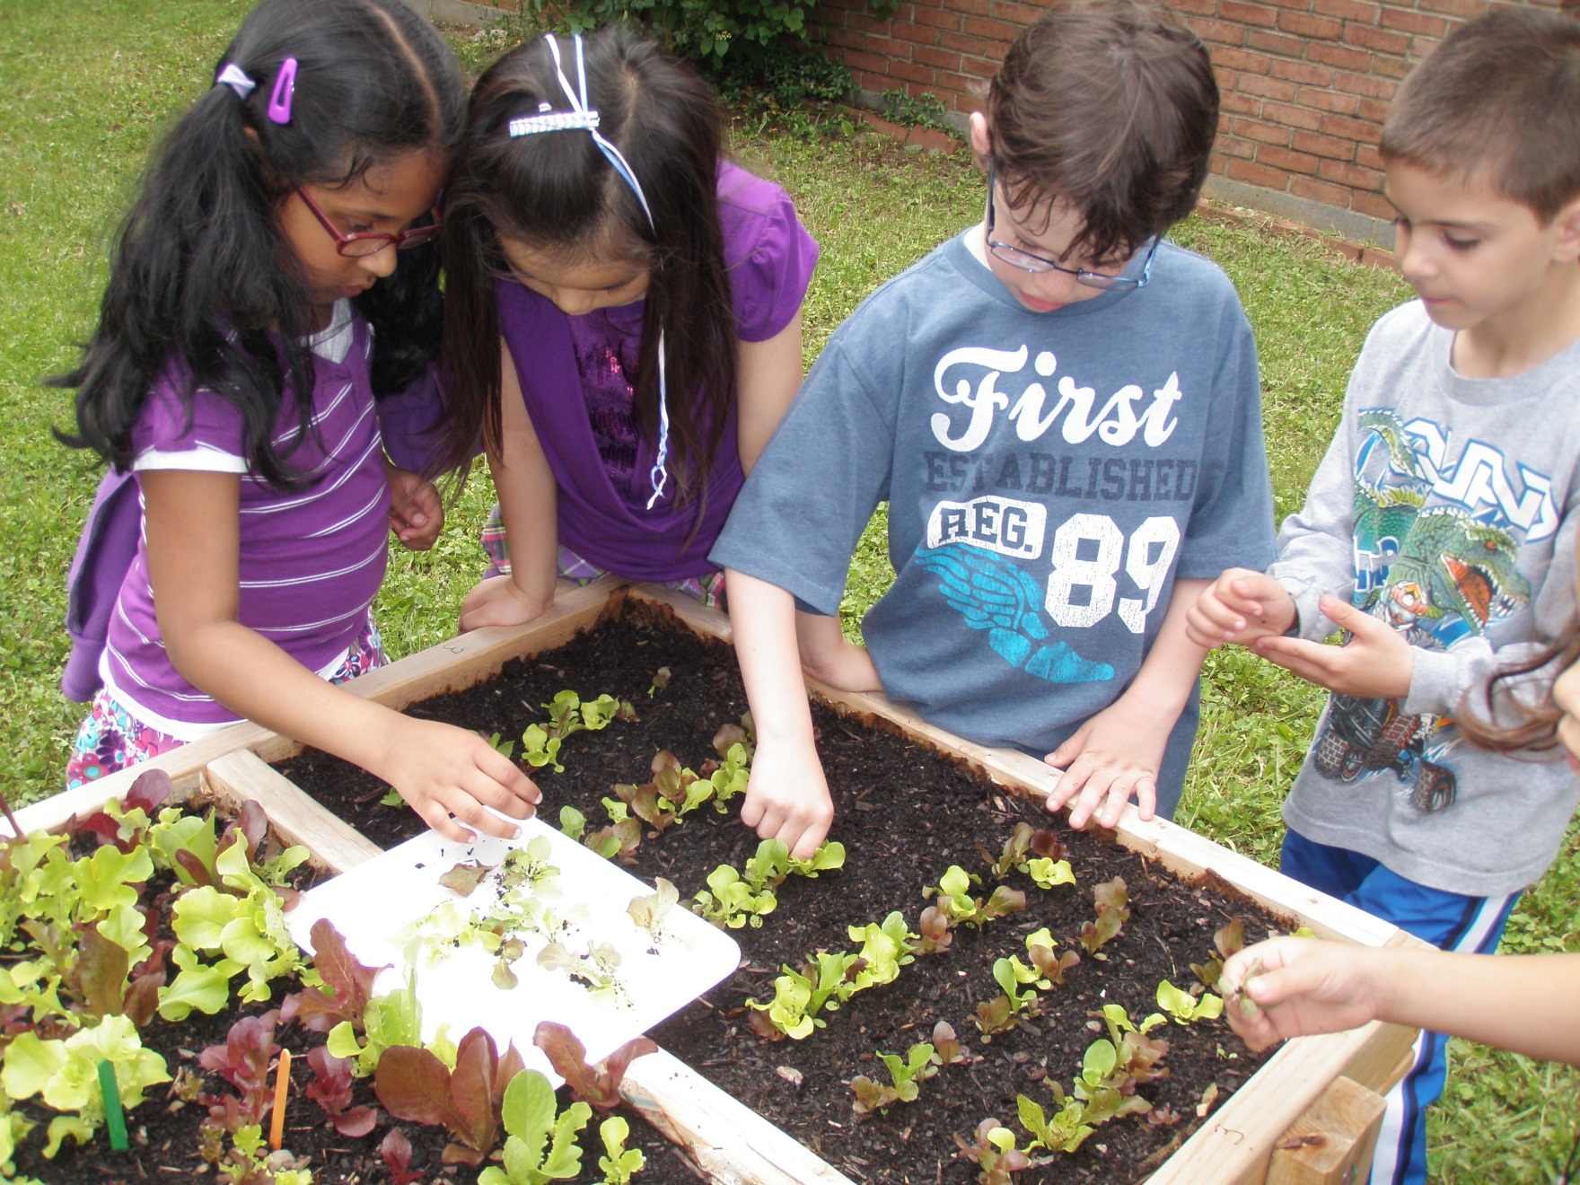
Thinning section 3
May 16
30

Slide 32
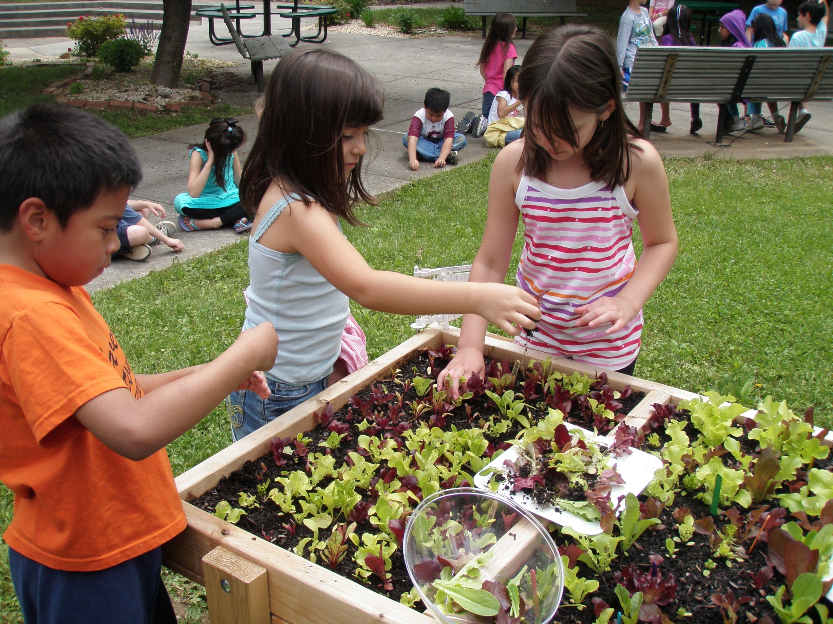
31

Slide 33
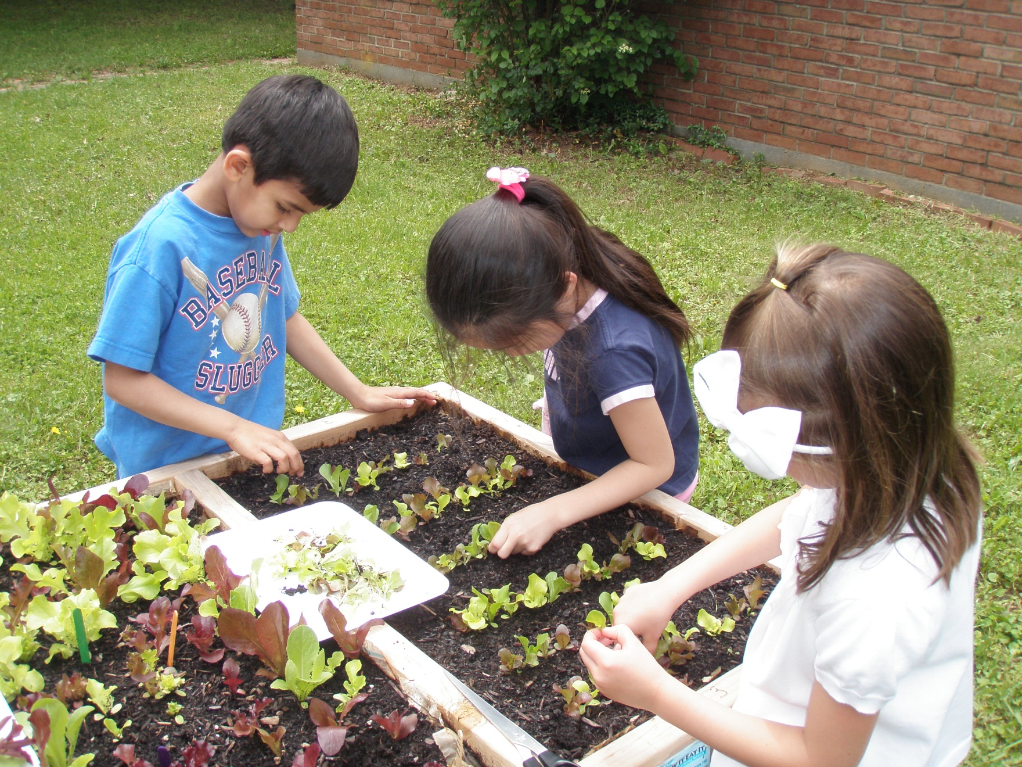
32

Slide 34
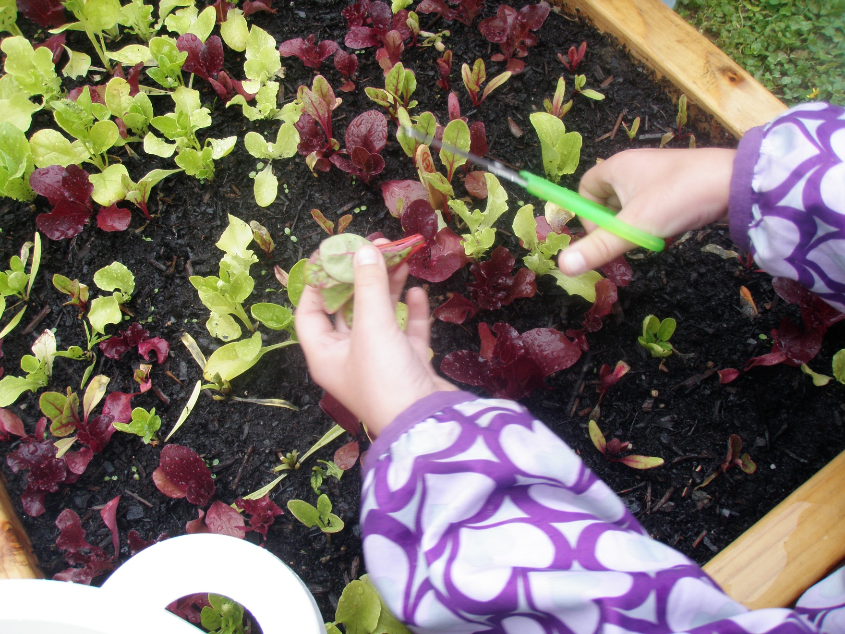
Harvesting
May 18
33

Slide 35
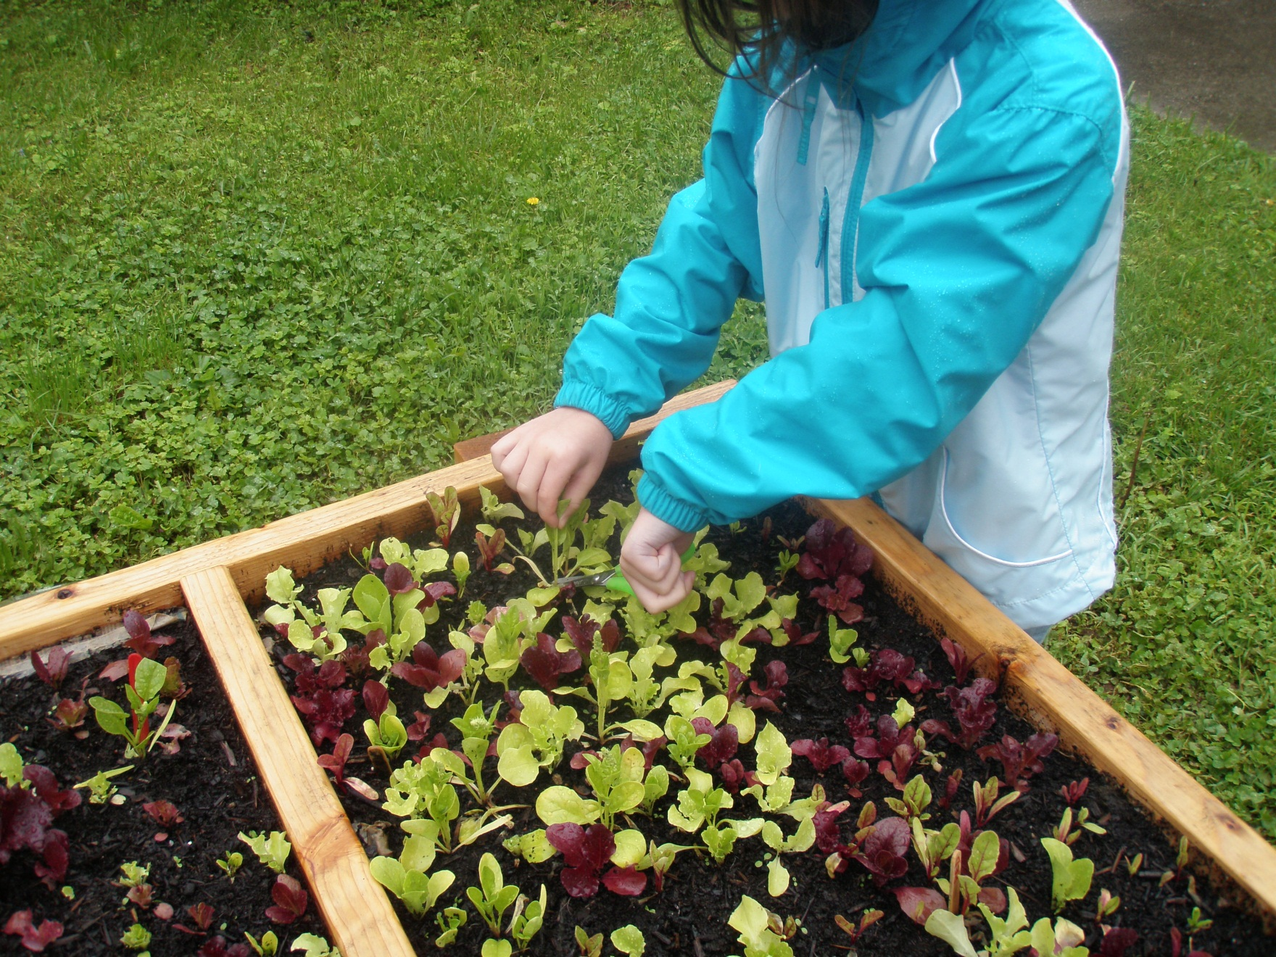
34

Slide 36
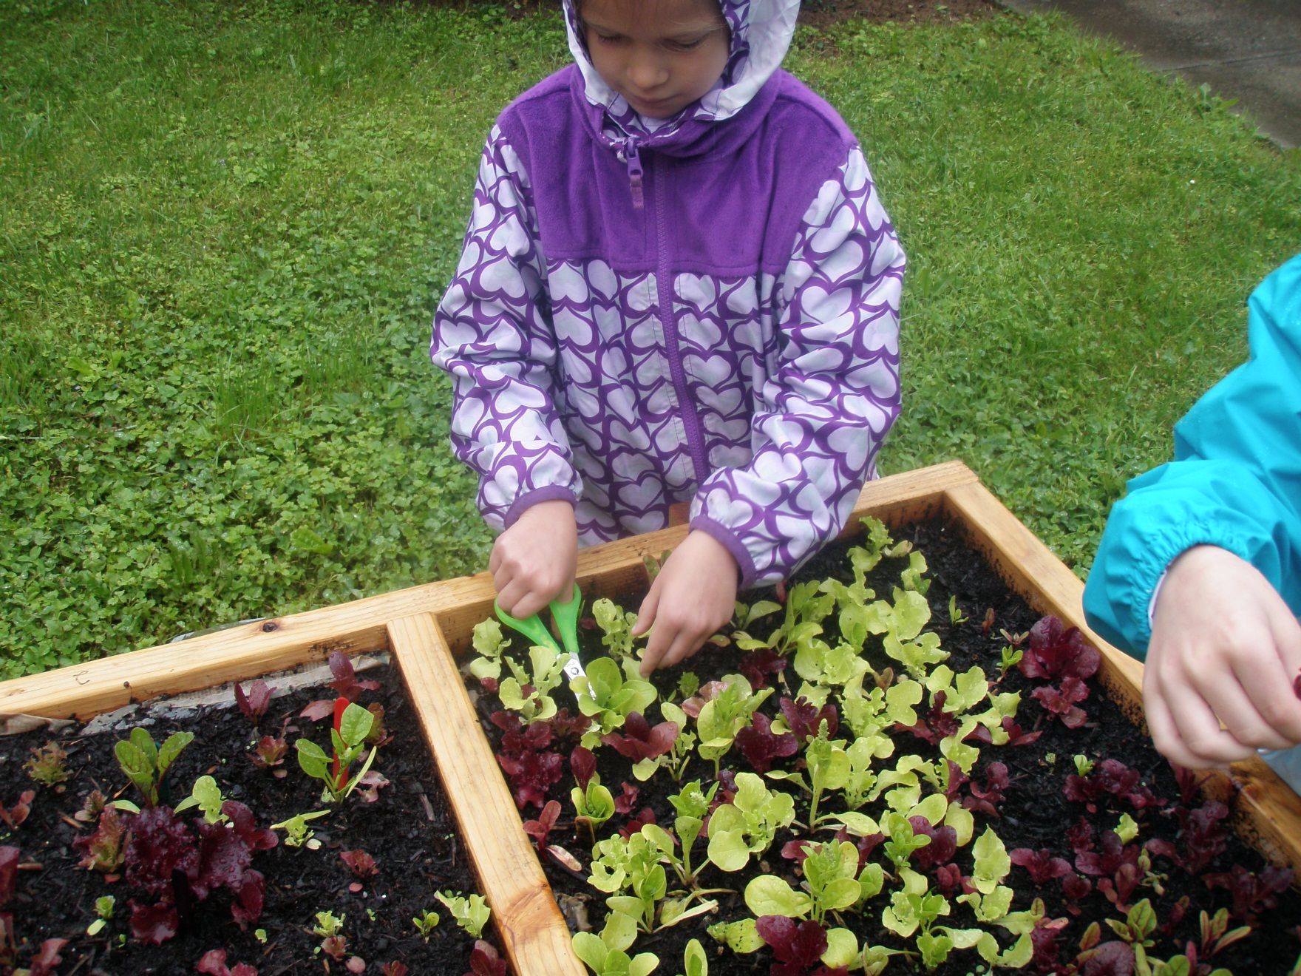
35

Slide 37
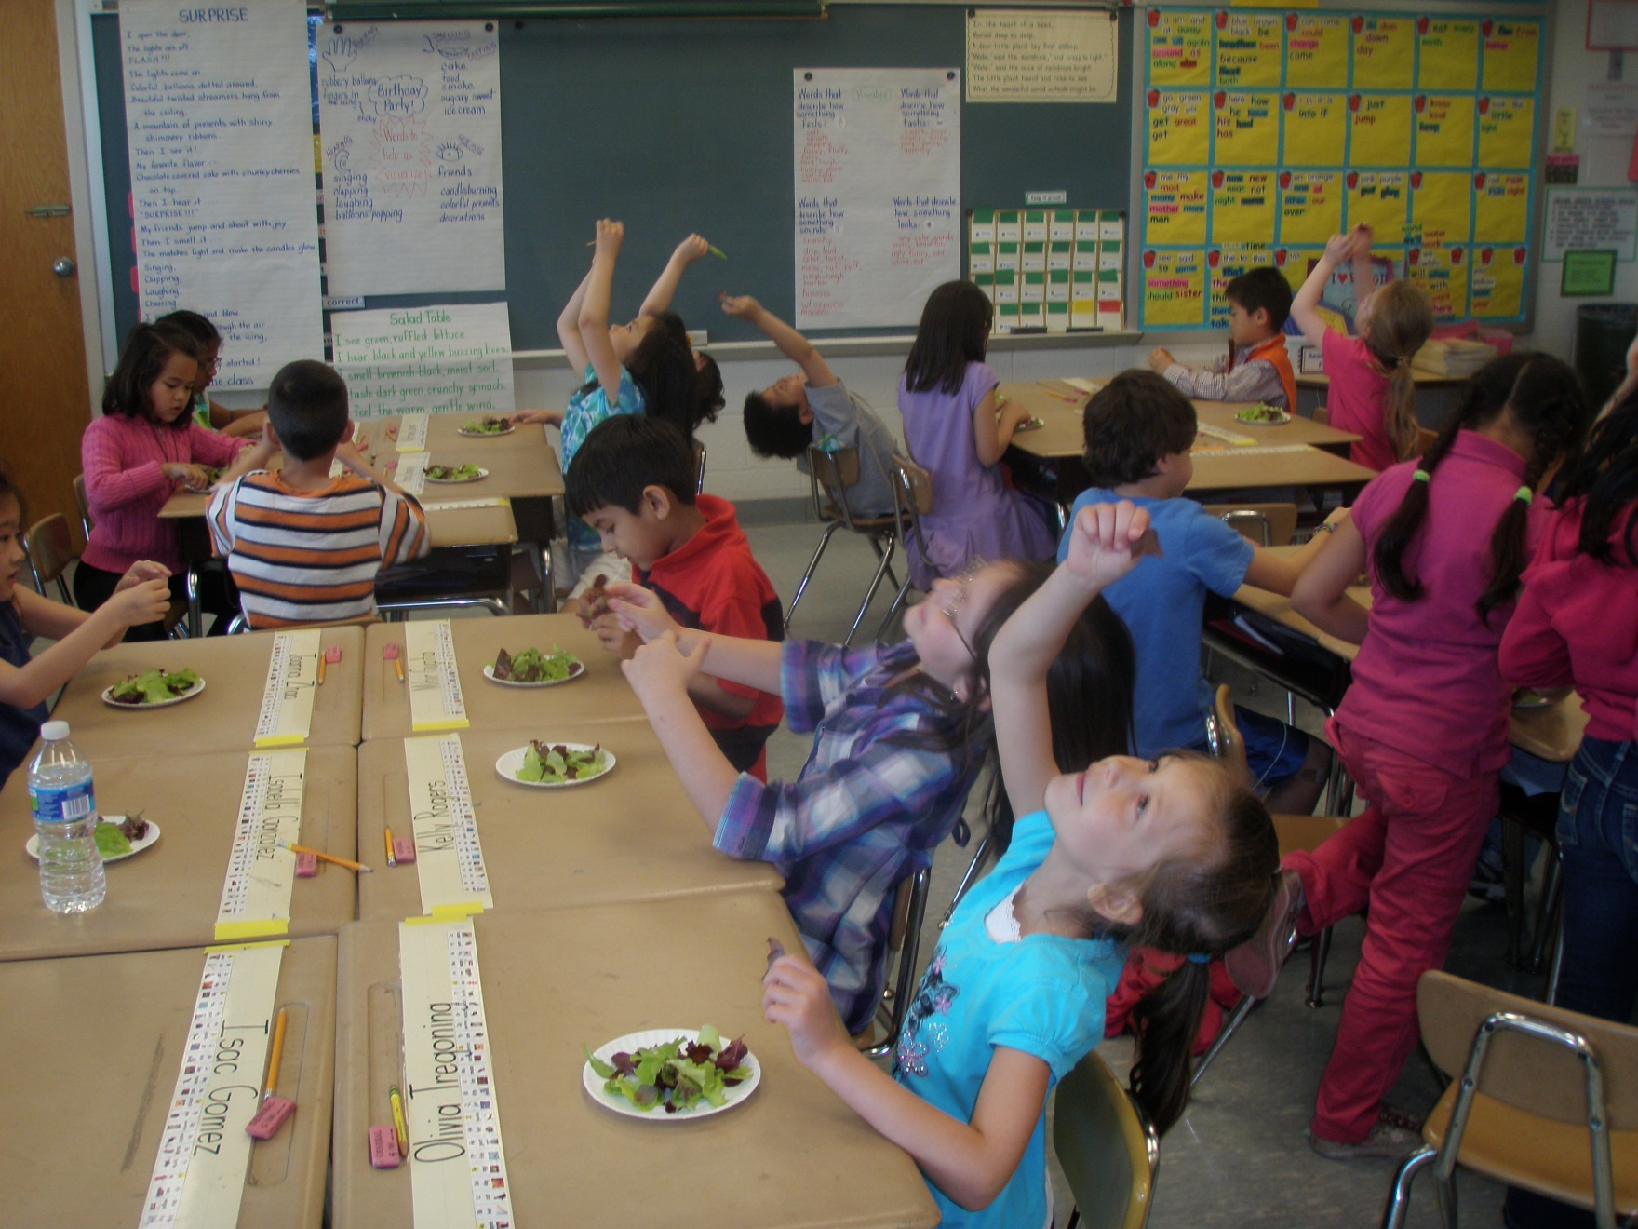
Checking out the veins
May 18
36

Slide 38
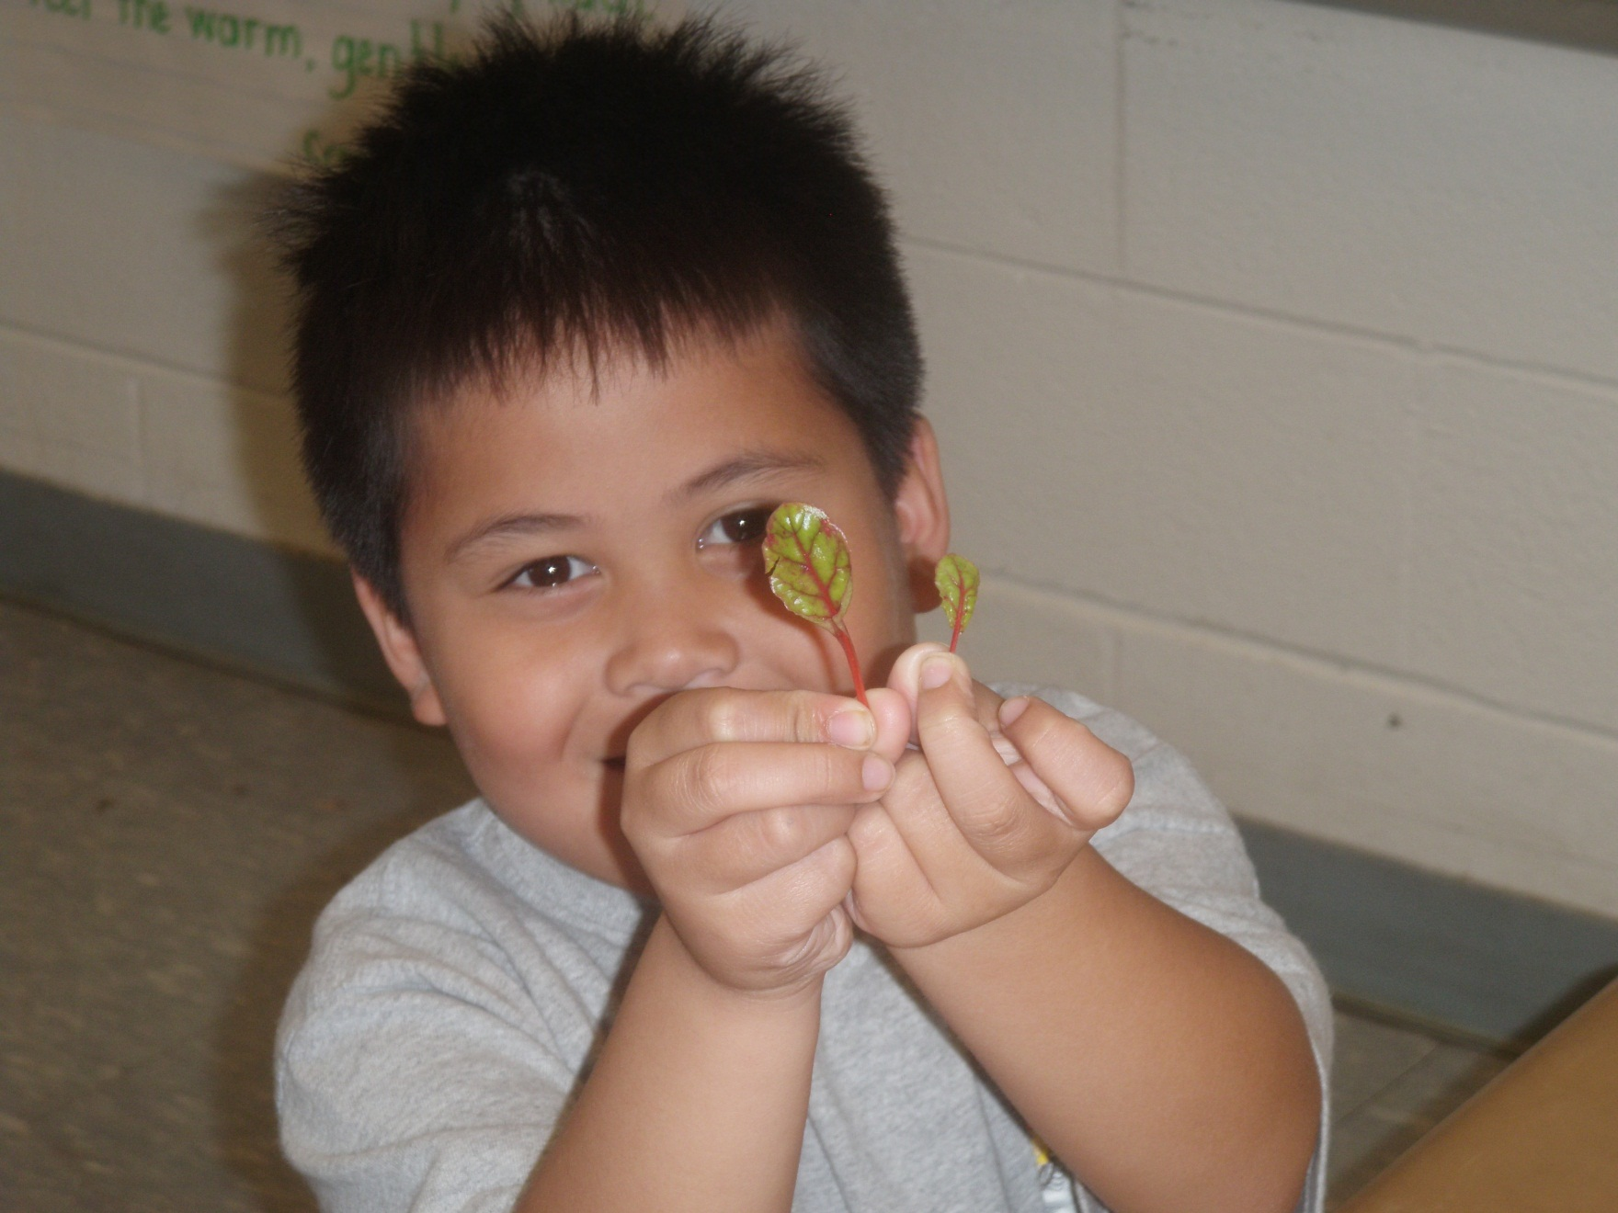
37

Slide 39
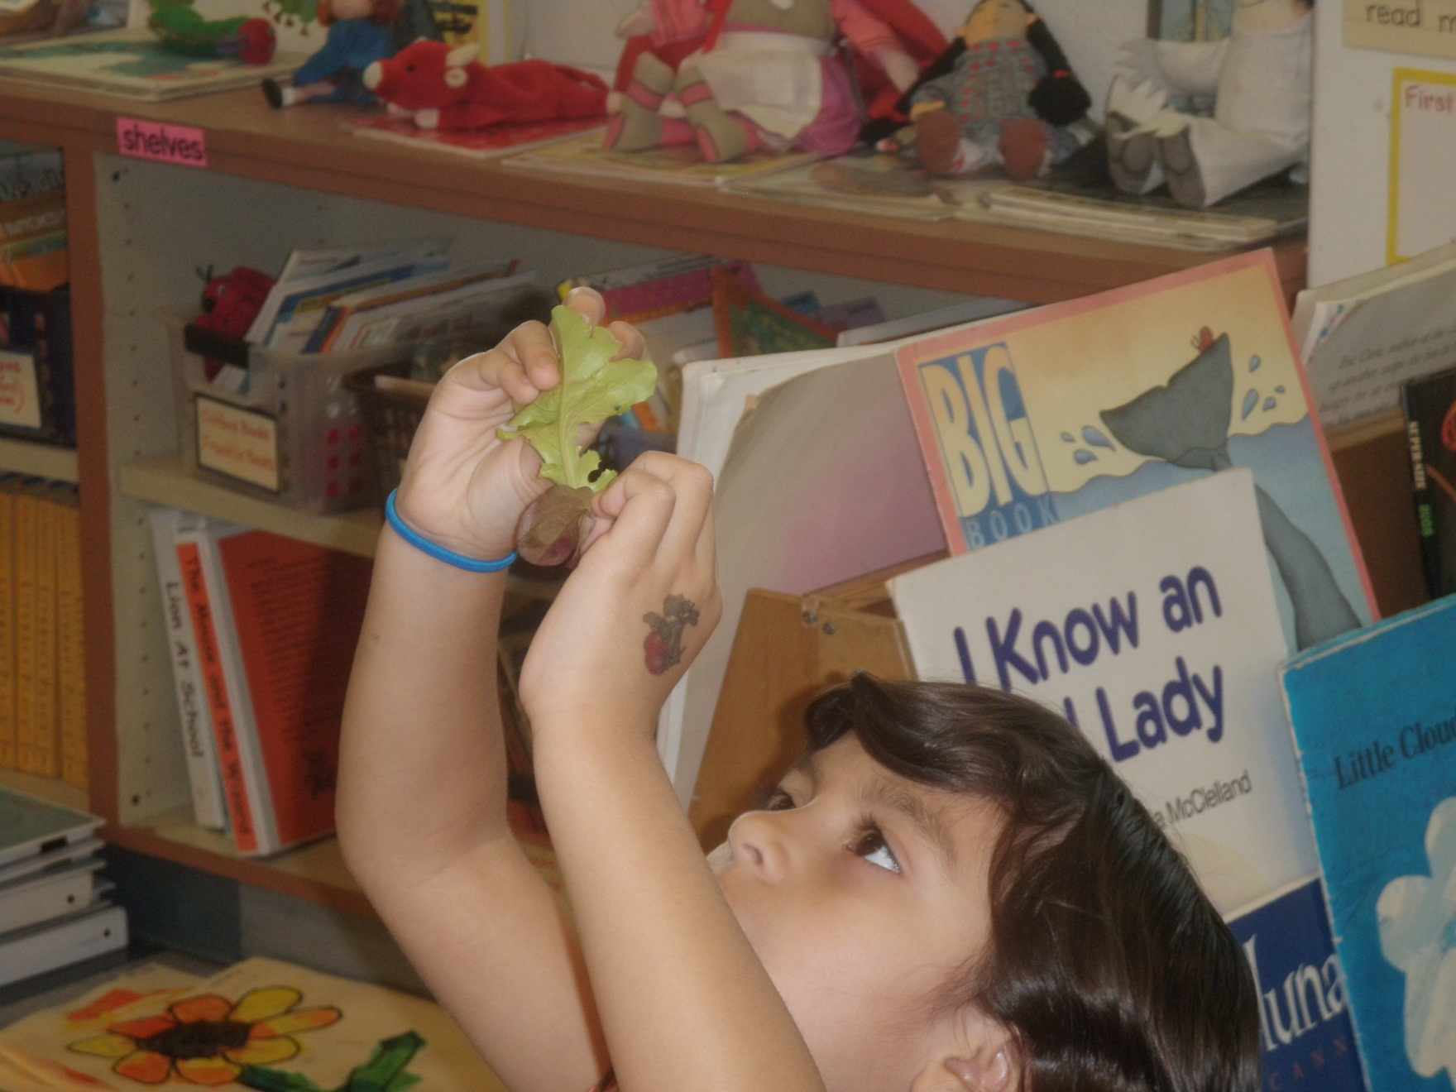
38

Slide 40
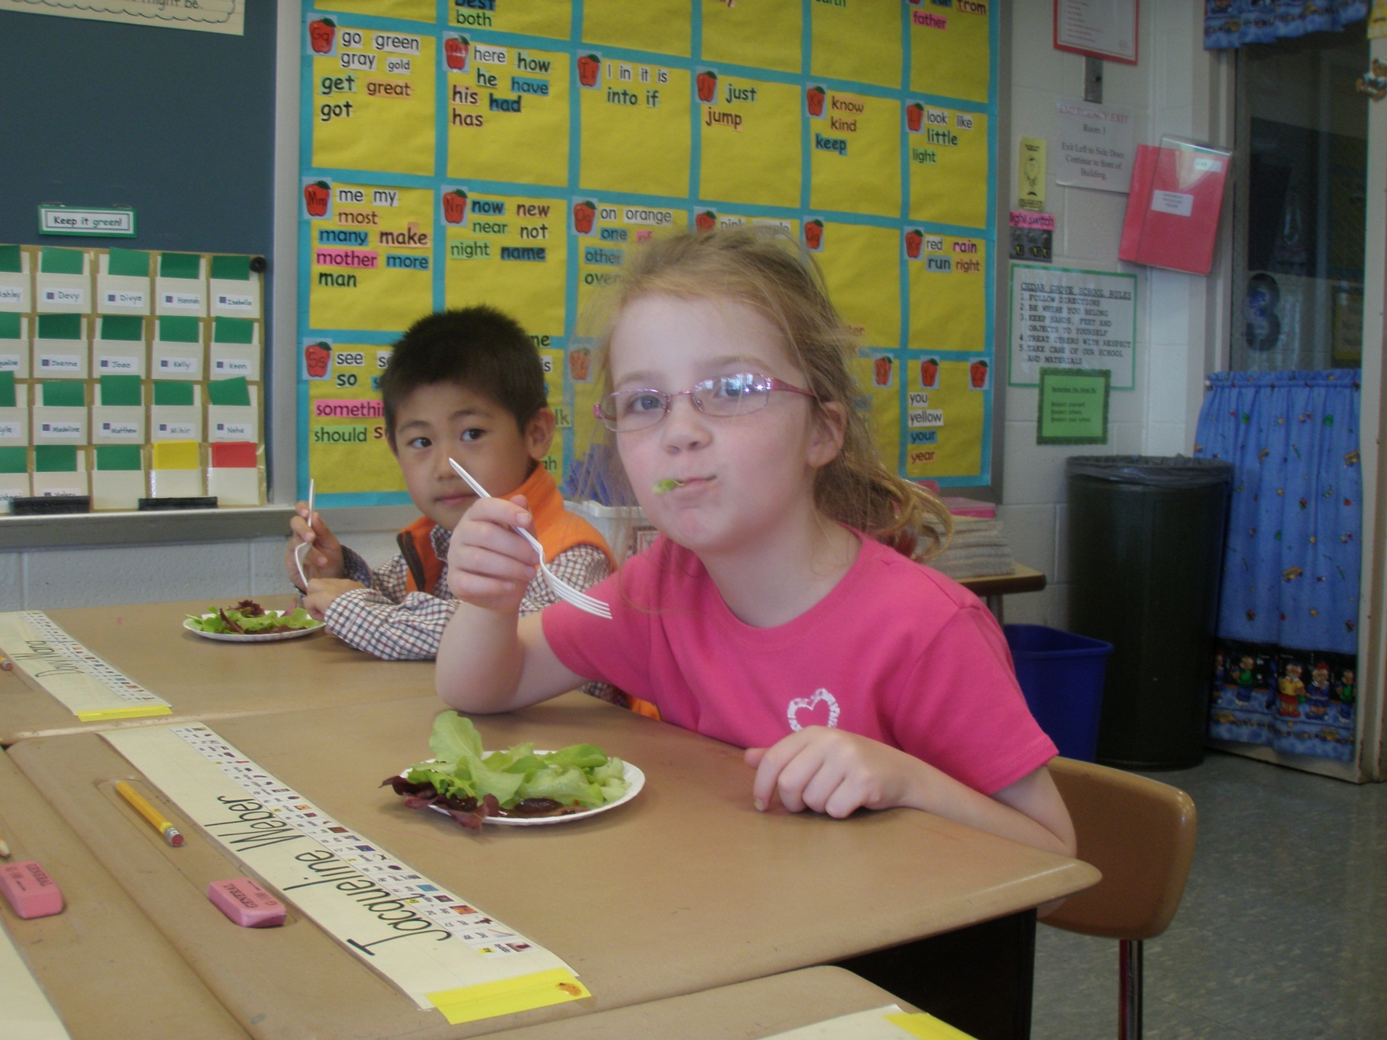
2nd taste test
39

Slide 41
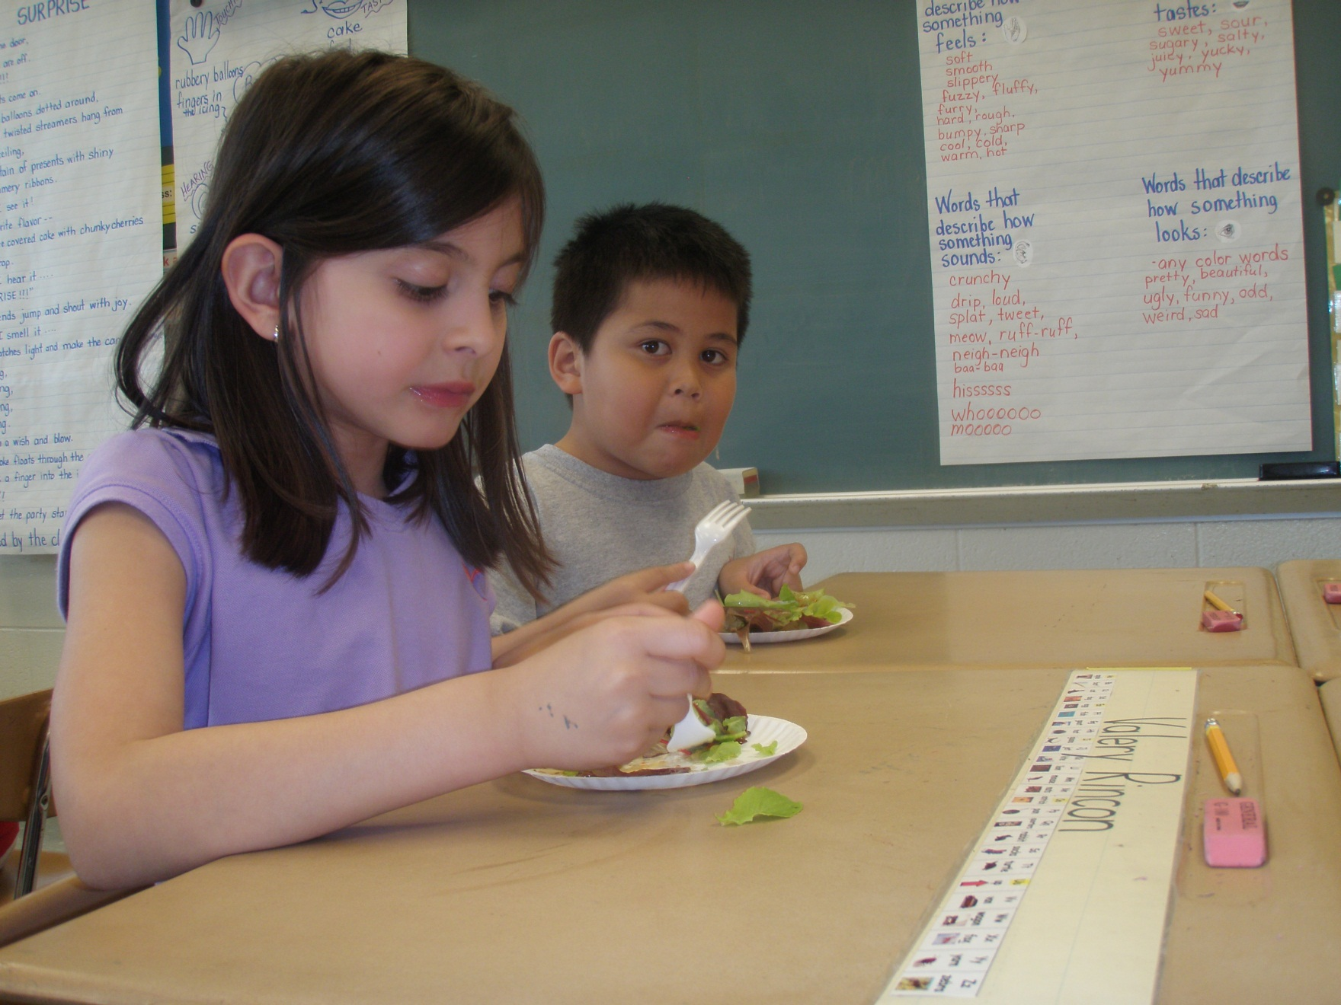
40

Slide 42
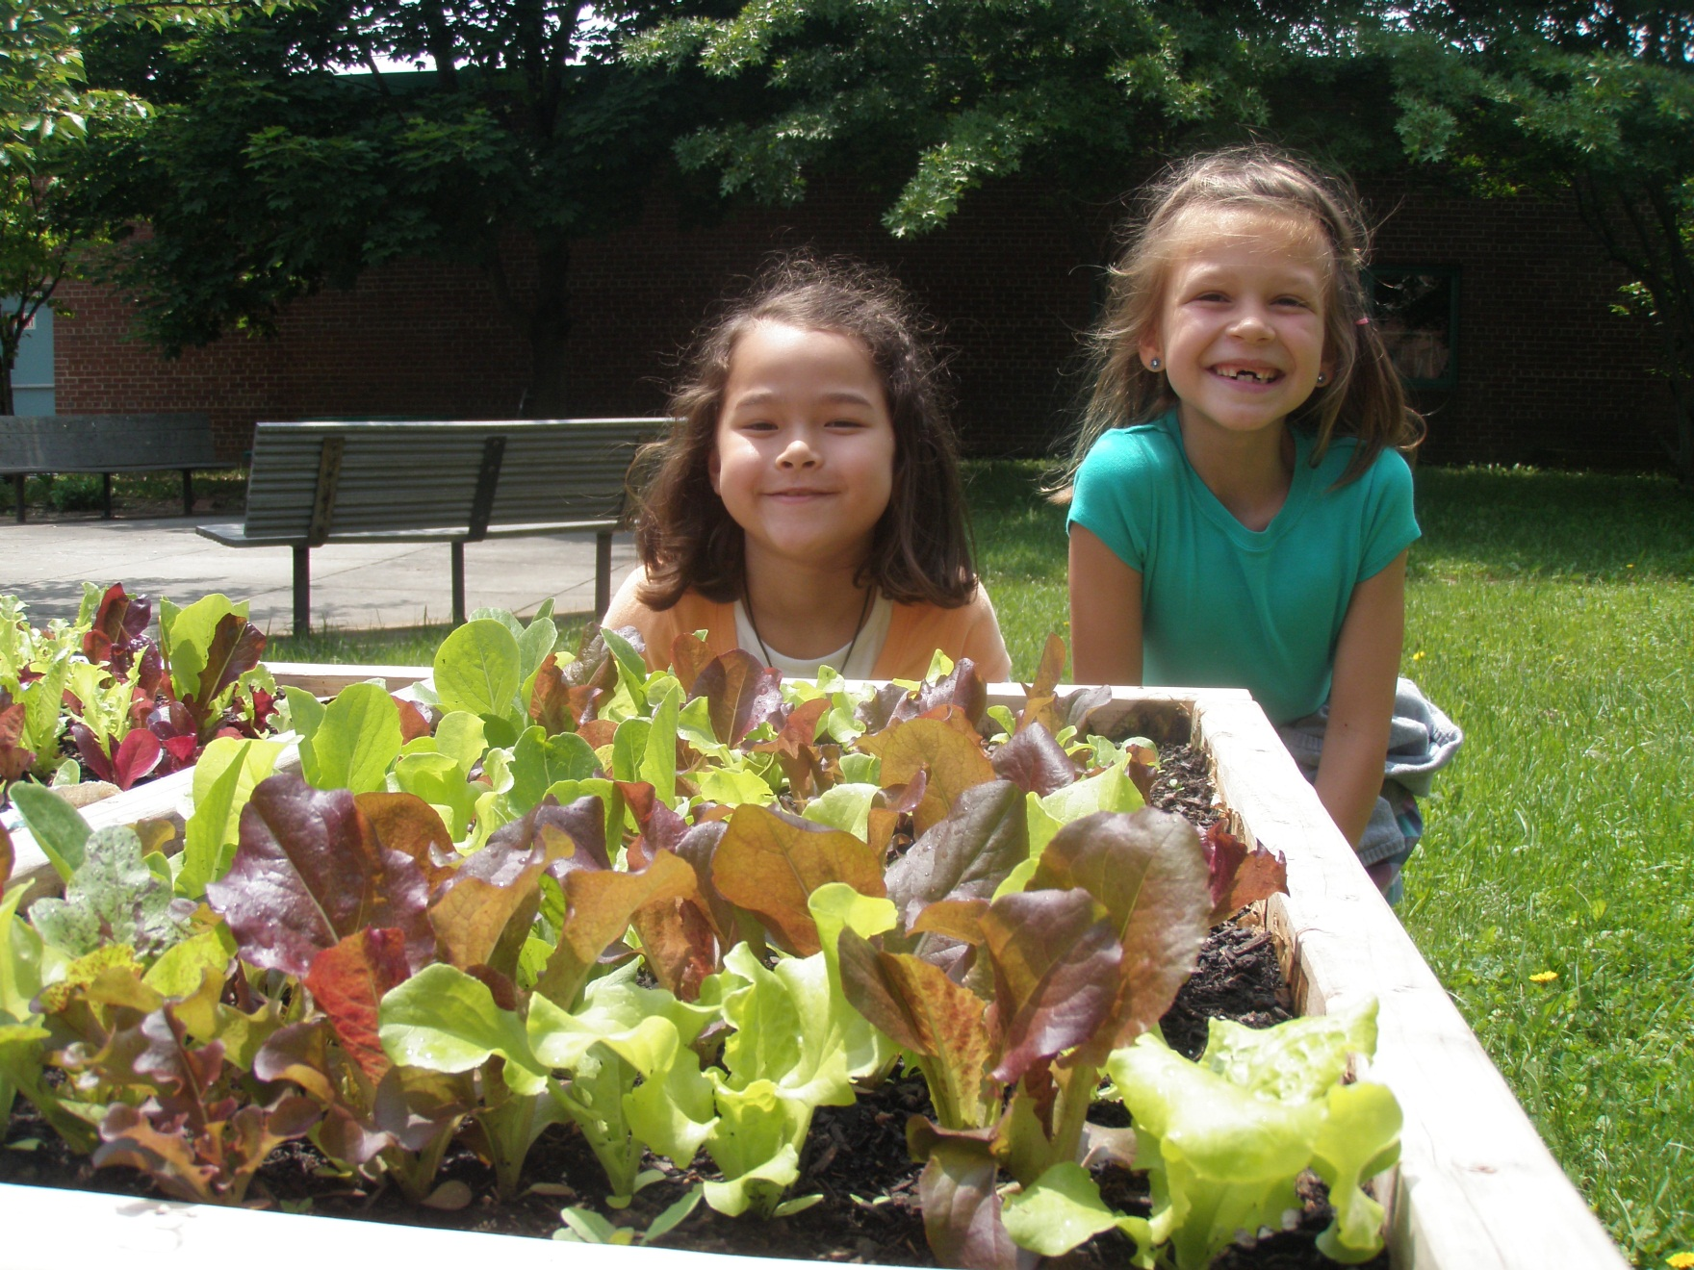
May 23
41

Slide 43
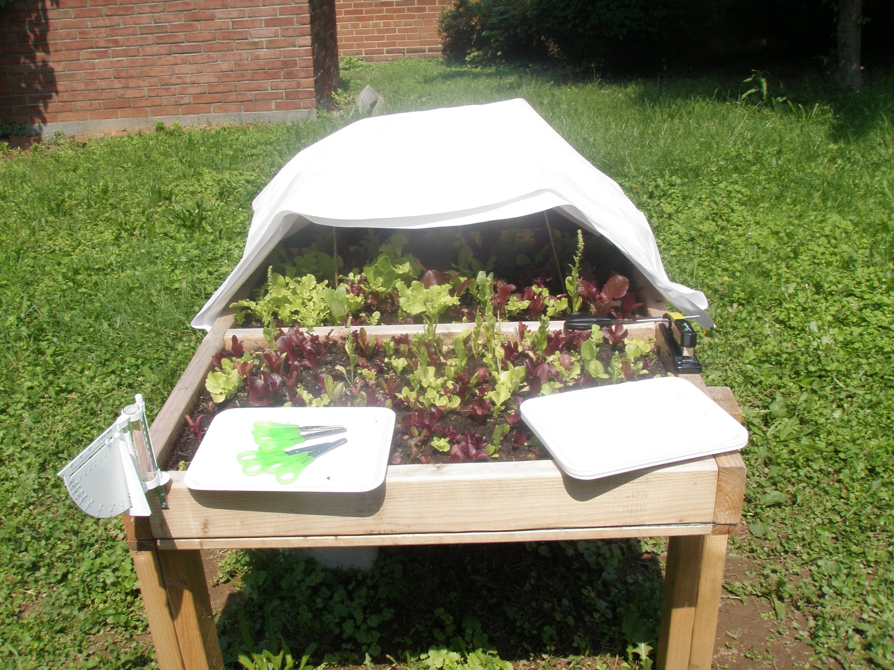
Trying to beat the heat
May 26
42

Slide 44
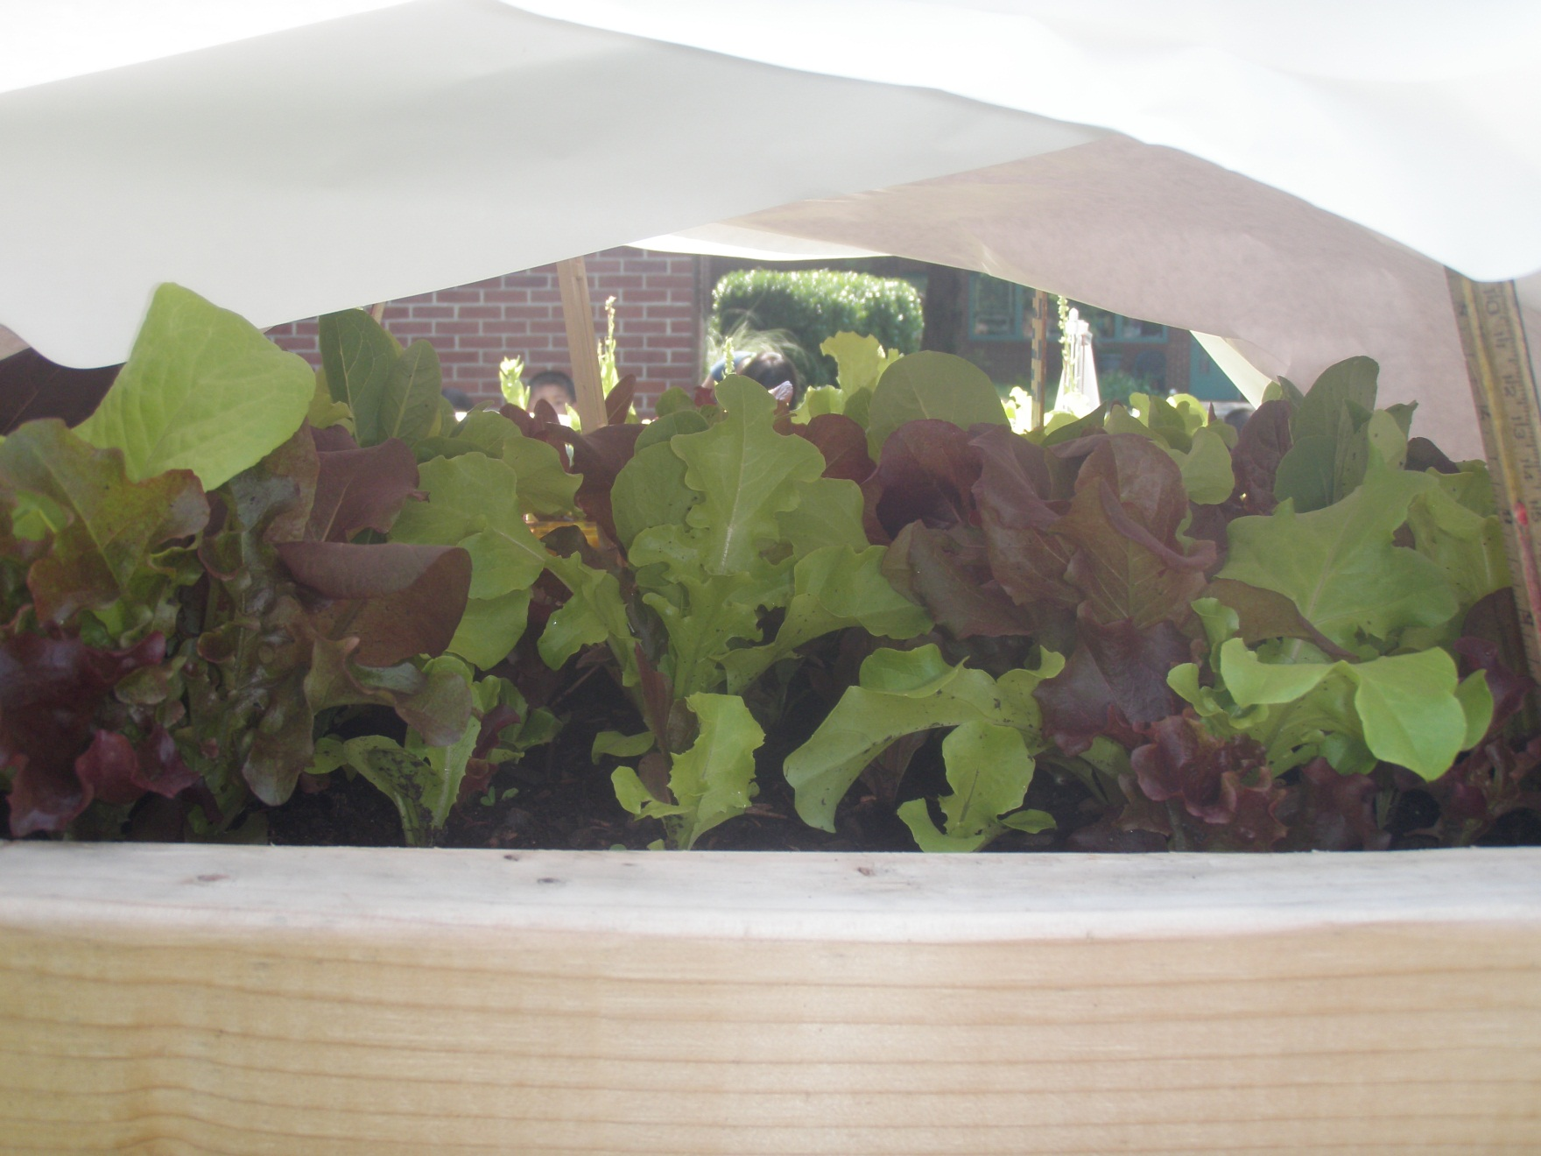
10 degrees cooler under the tent
43

Slide 45
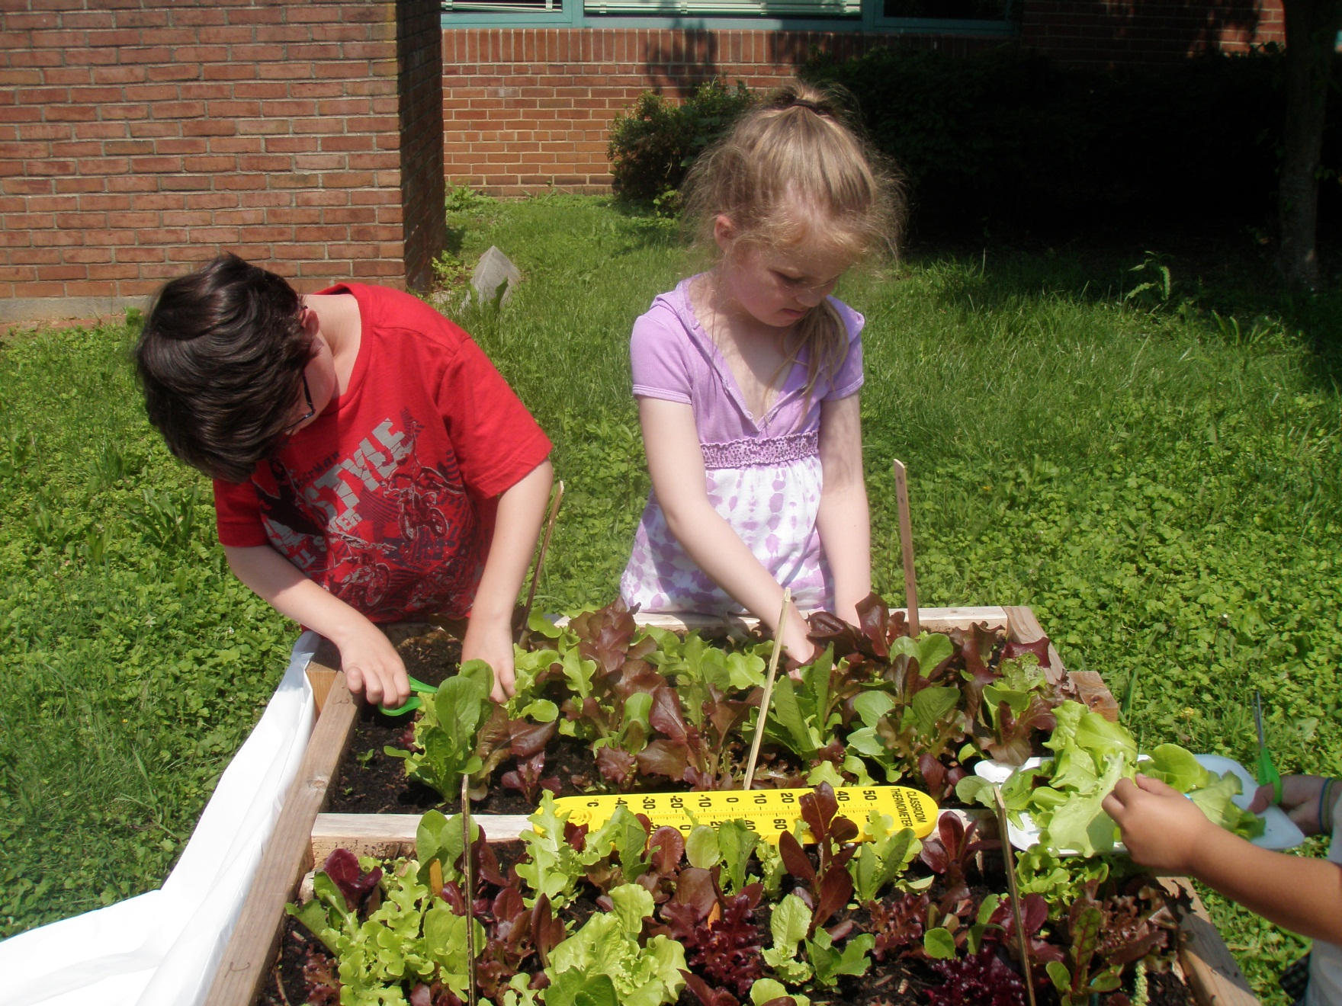
Harvest
May 26
44

Slide 46
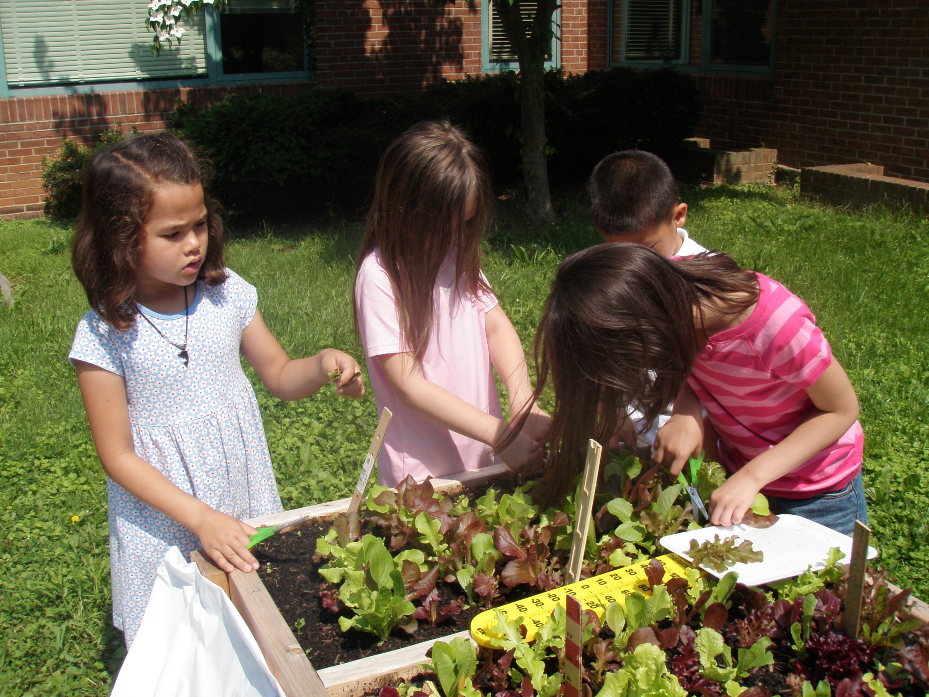
45

Slide 47
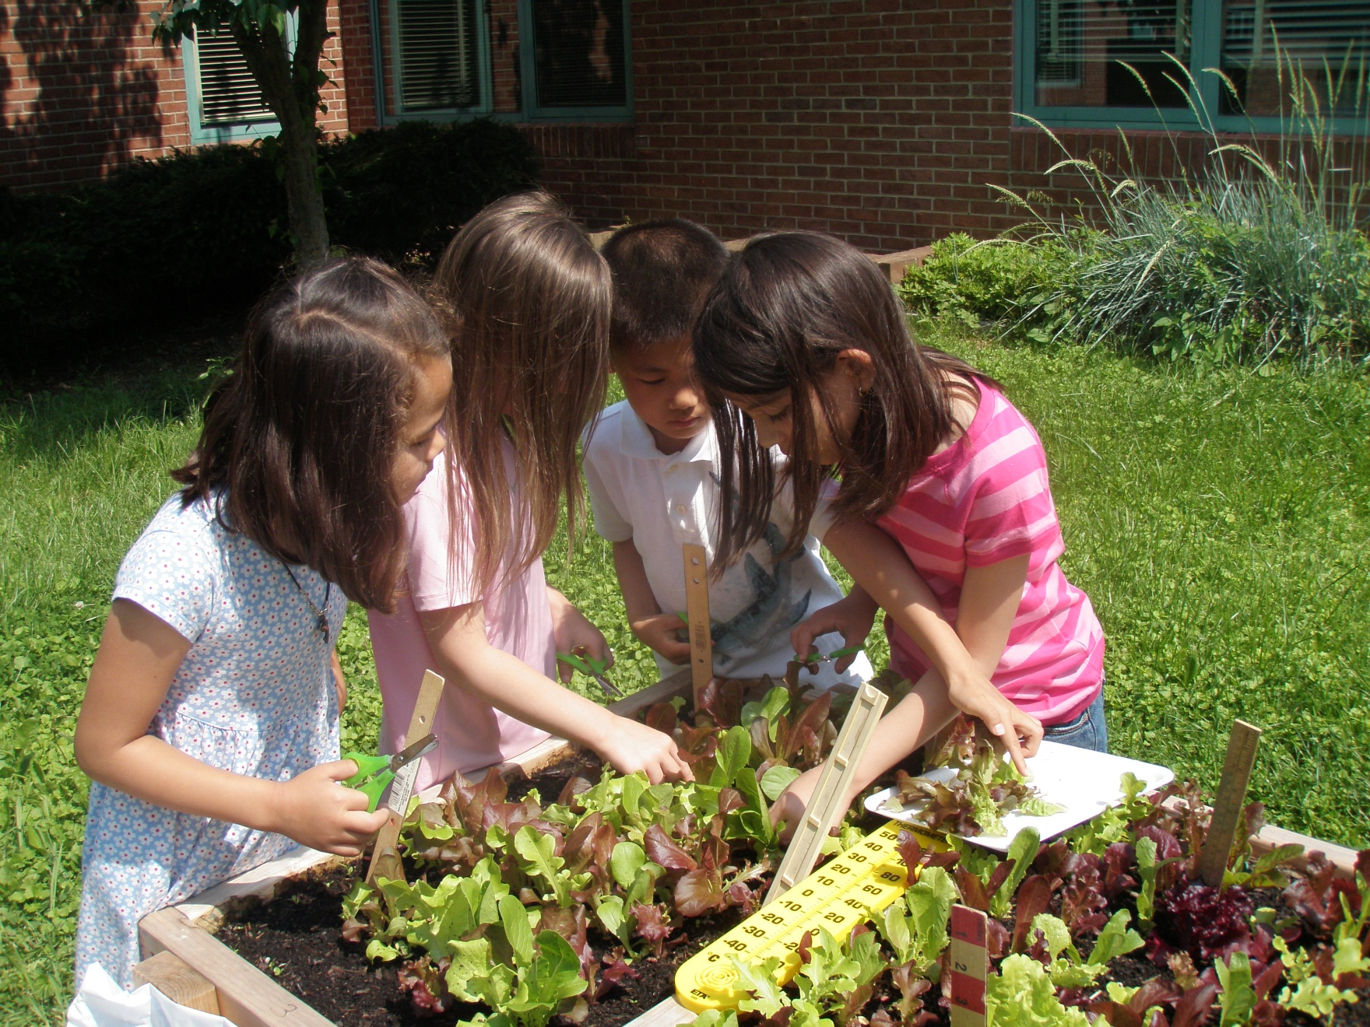
46

Slide 48
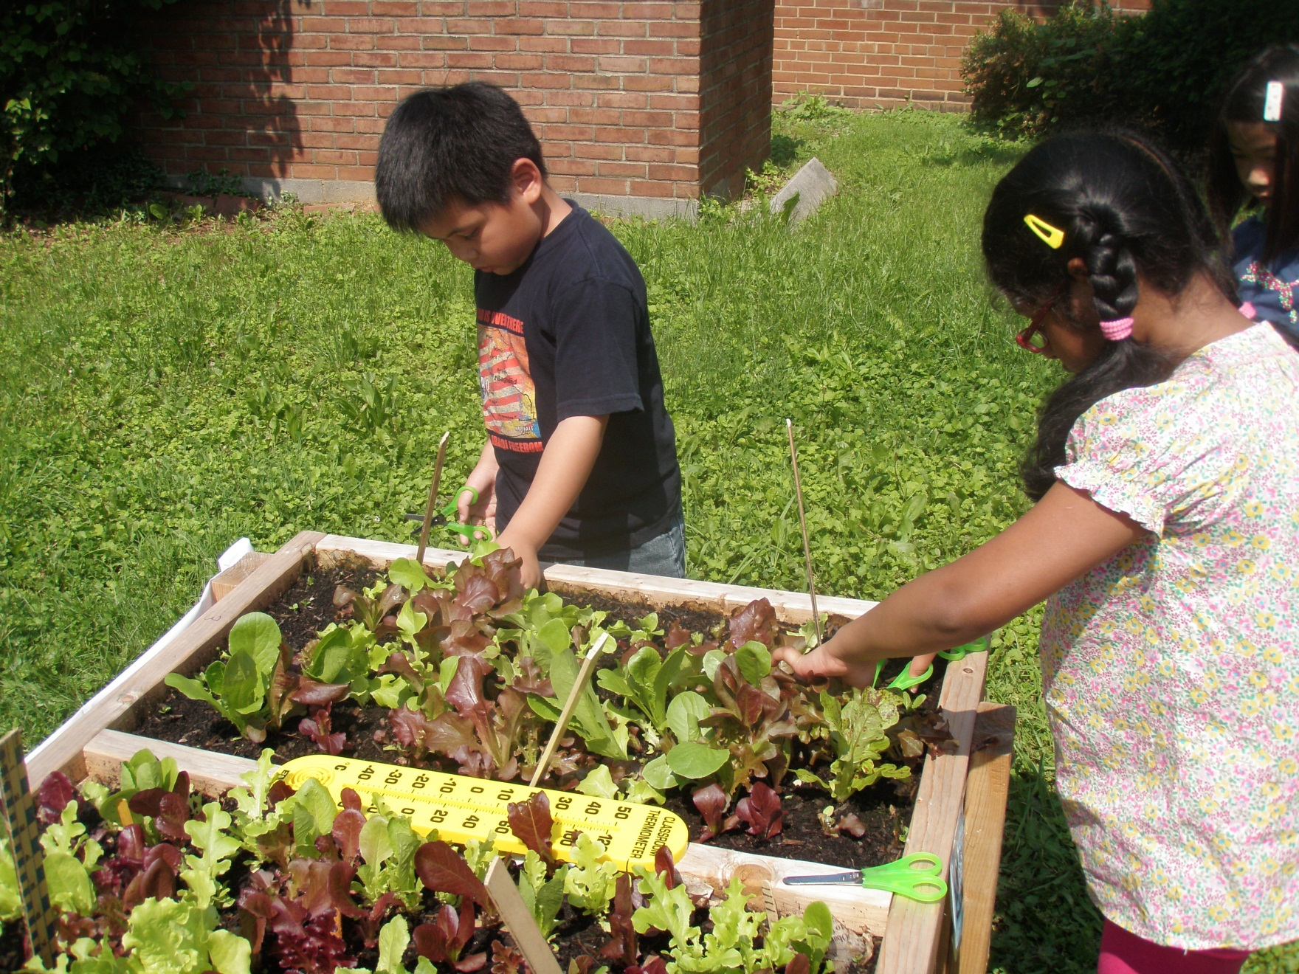
47

Slide 49
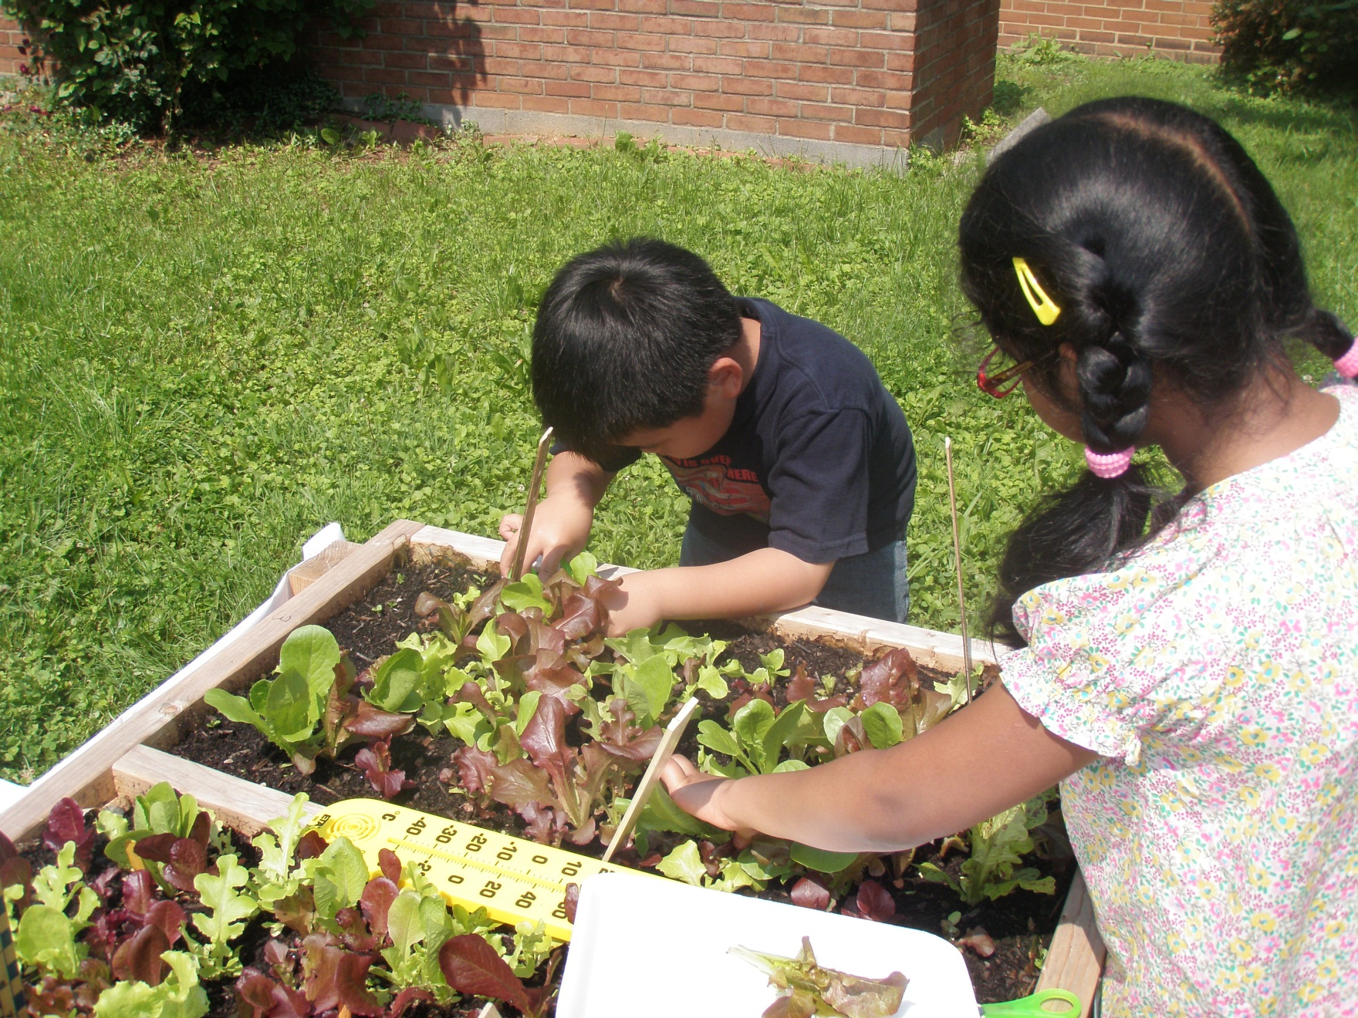
48

Slide 50
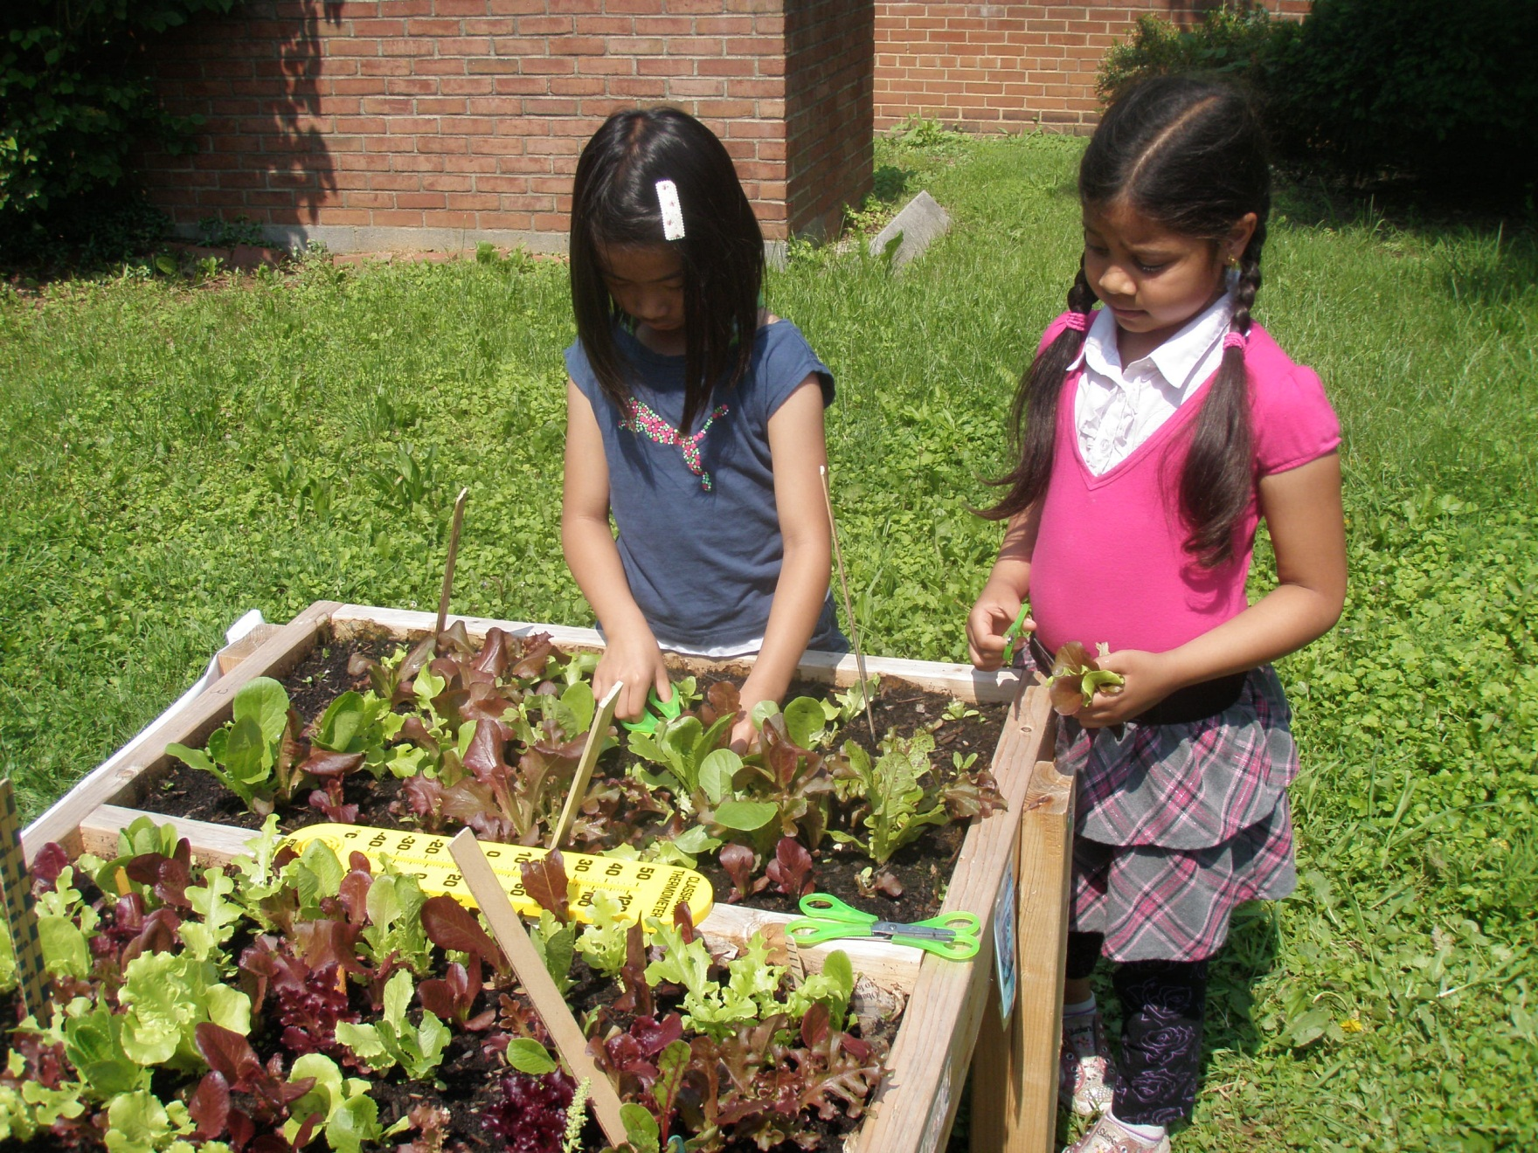
49

Slide 51

50

Slide 52

51

Slide 53

52

Slide 54

53

Slide 55

Our greens traveled about 100 walking steps to our plate. How far did your lettuce have to travel?
54

Slide 56

55

Slide 57

3rd taste test
May 27
Using pictures to identify the greens
56

Slide 58

57

Slide 59

58

Slide 60

59

Slide 61

60

Slide 62

61

Slide 63







With Thanks to:

