Slide 1
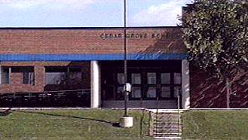
Cedar Grove Elementary Germantown, MD
Montgomery County Forestry Board
Tree Planting
October 27, 2010

Slide 2
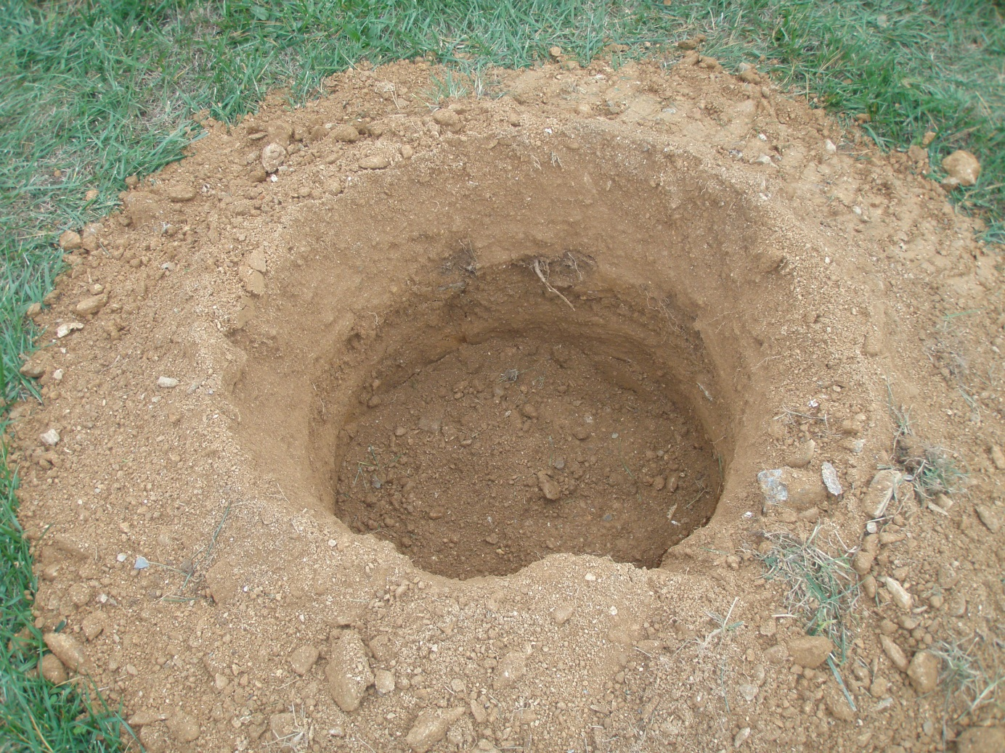
October 26
Before the rain…

Slide 3
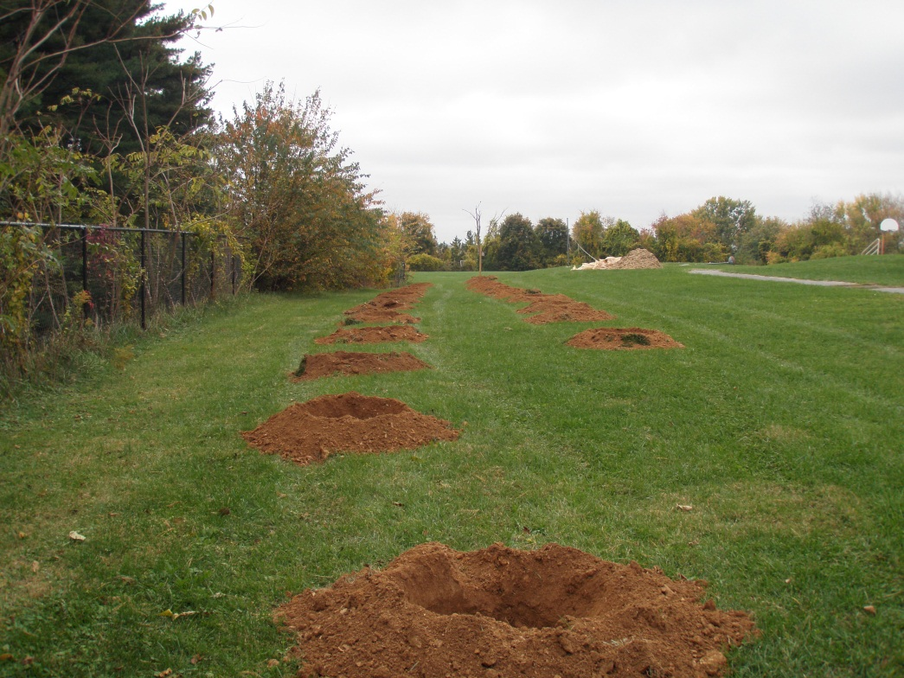
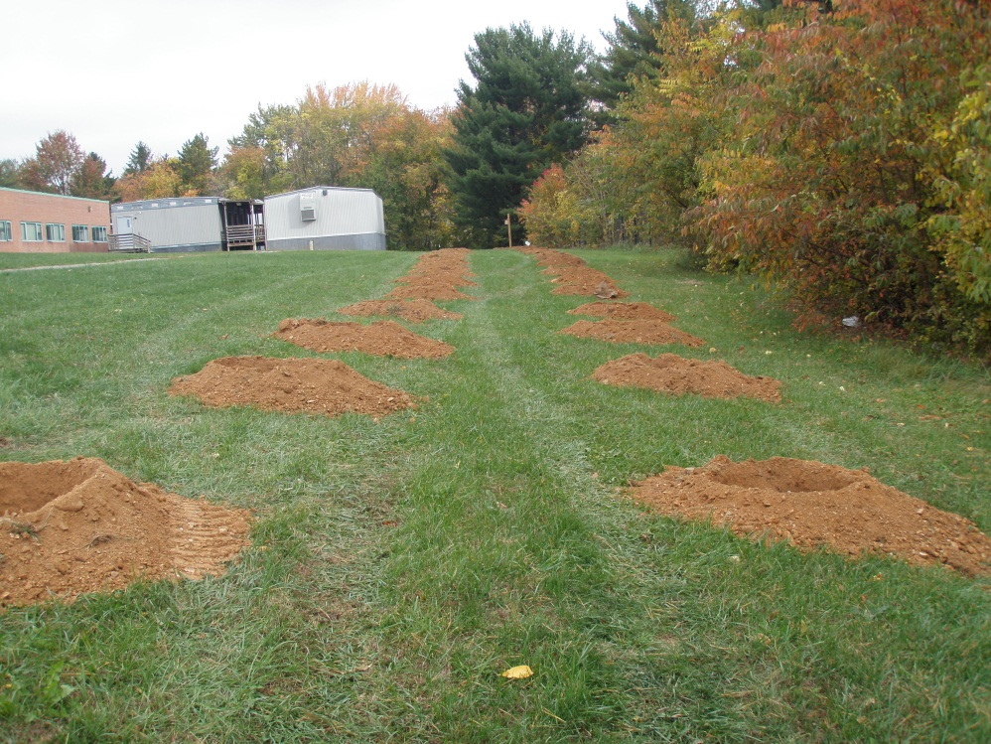
Holes dug by Kelly Landscaping

Slide 4
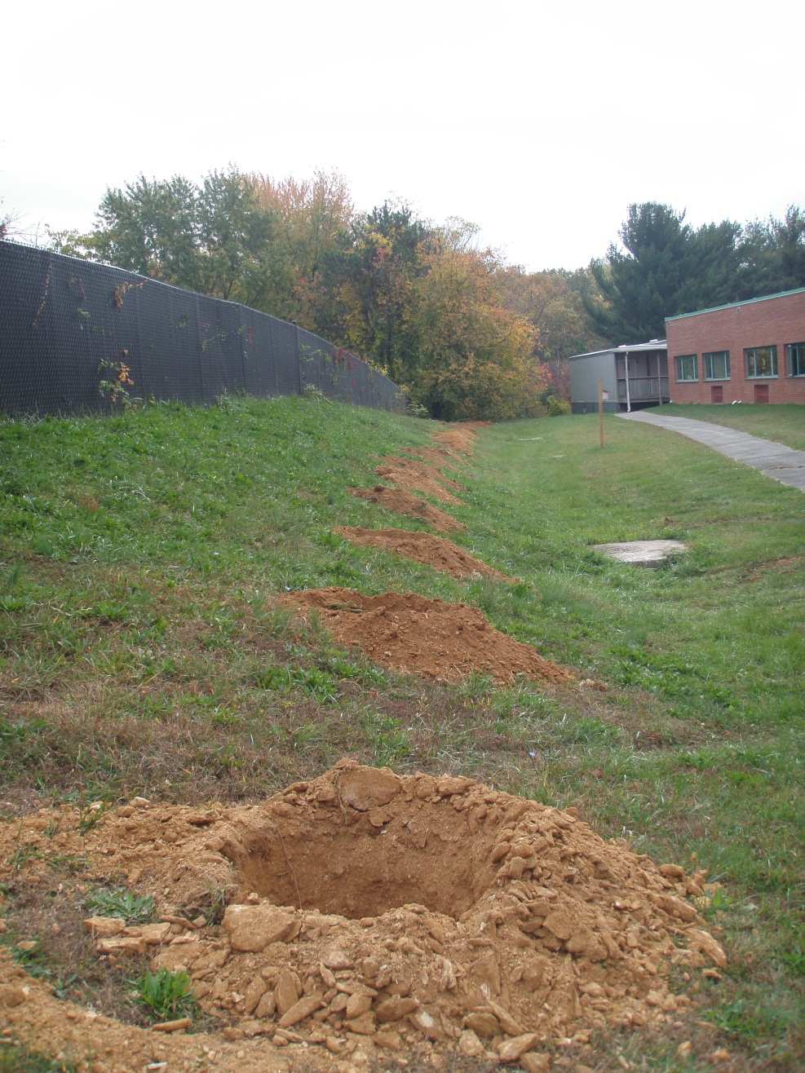
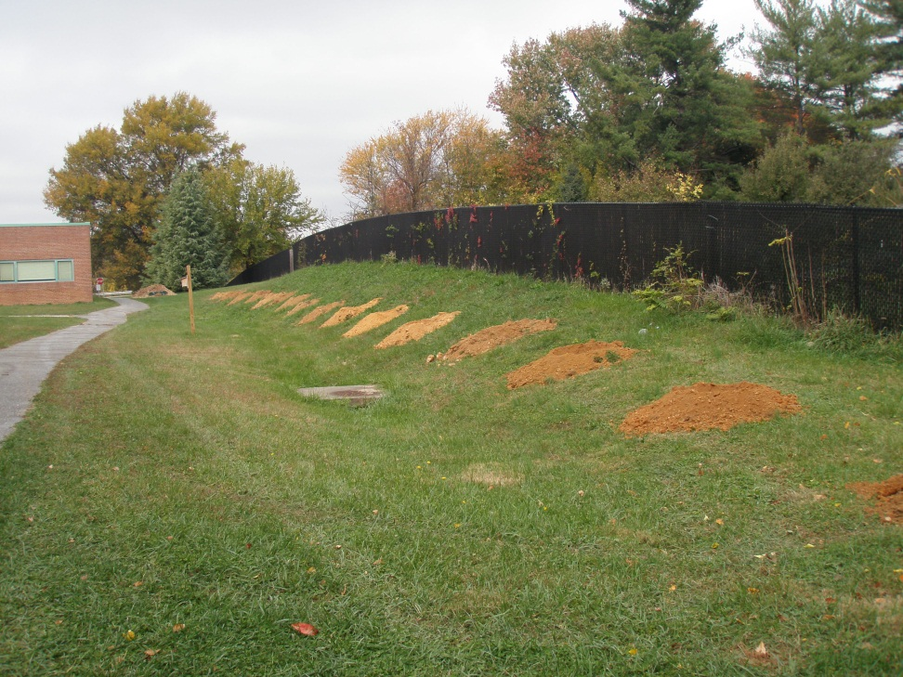

Slide 5
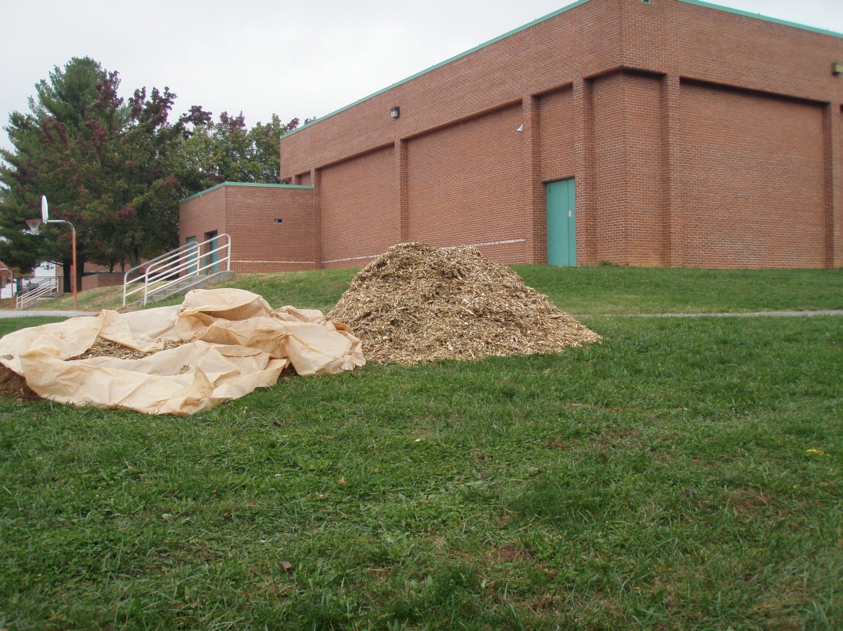
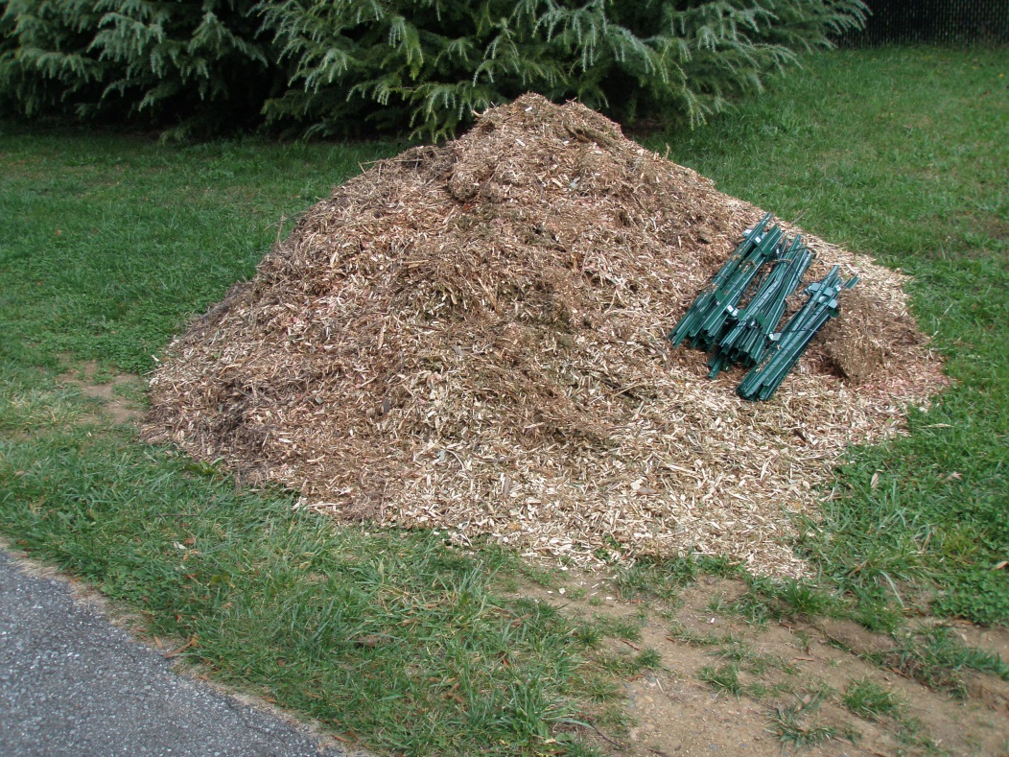
Mulch provided by
Pepco

Slide 6
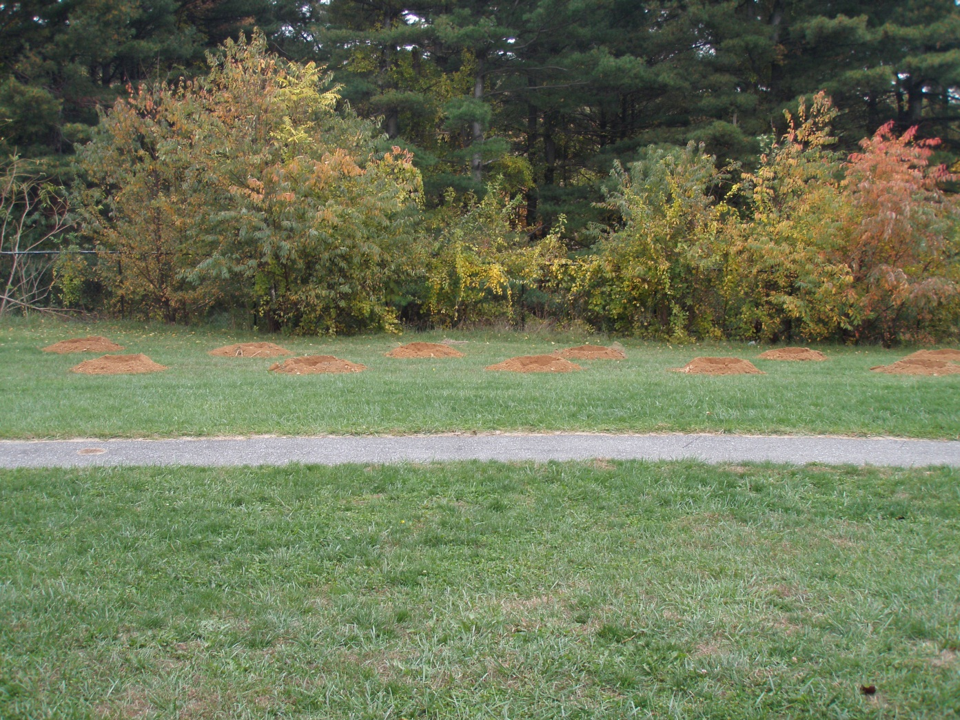
We’ll work on those ‘invasives’ next….

Slide 7
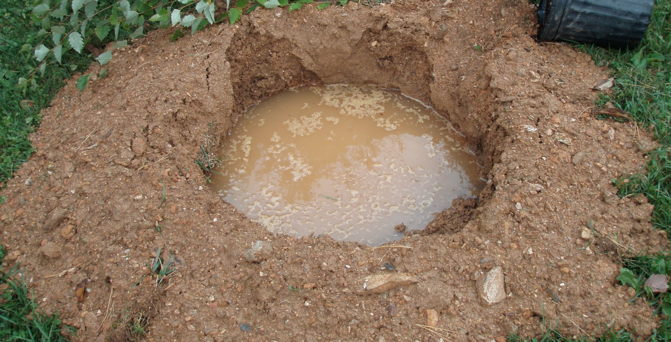
And then came the rain...
…but we must be living right, because it stopped just in time!

Slide 8
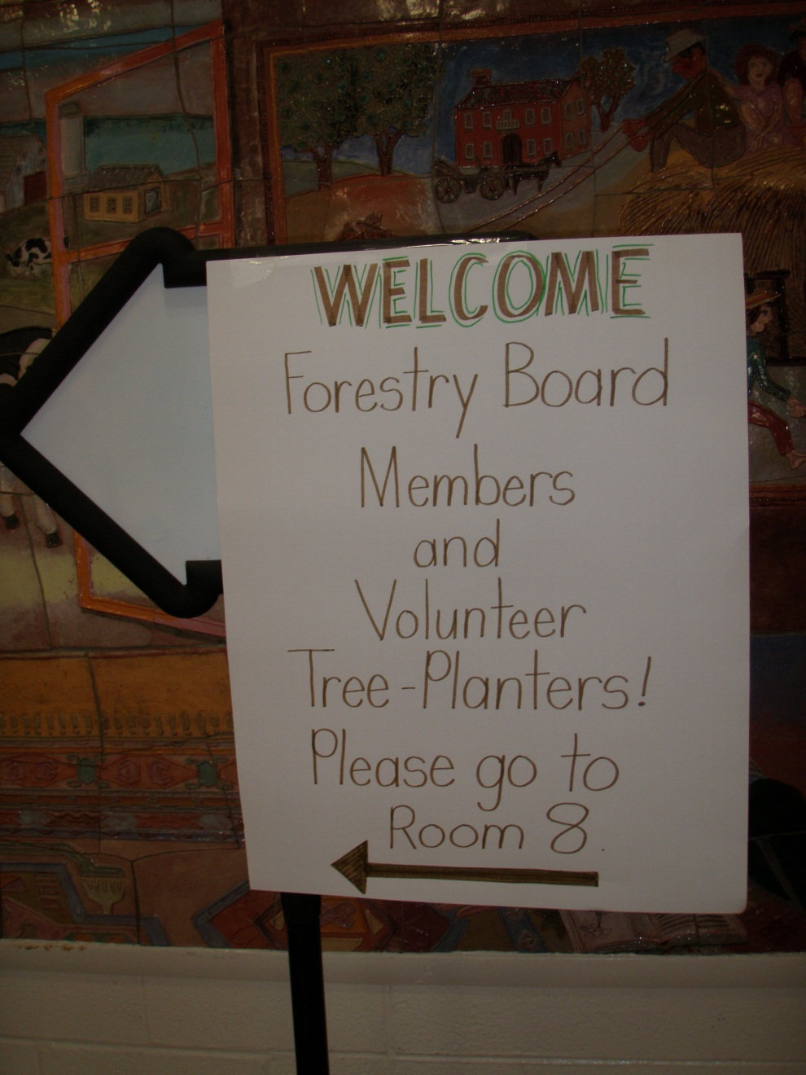
We love our volunteers…
Coffee,
juice,
snacks
and
lunch!

Slide 9
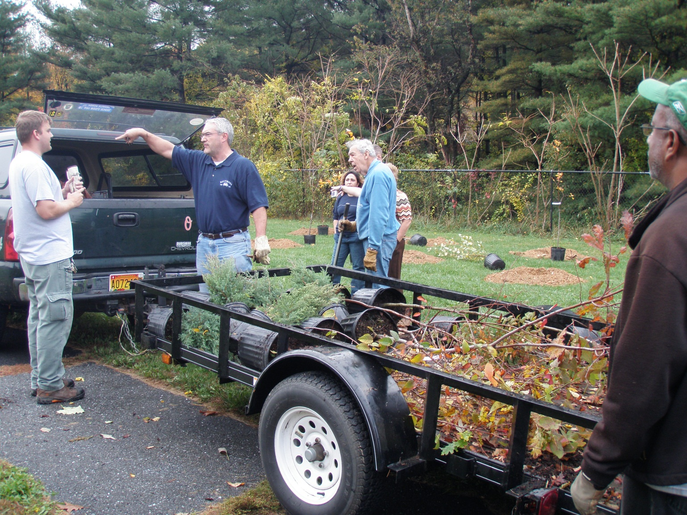
Forestry Board Members In Action

Slide 10
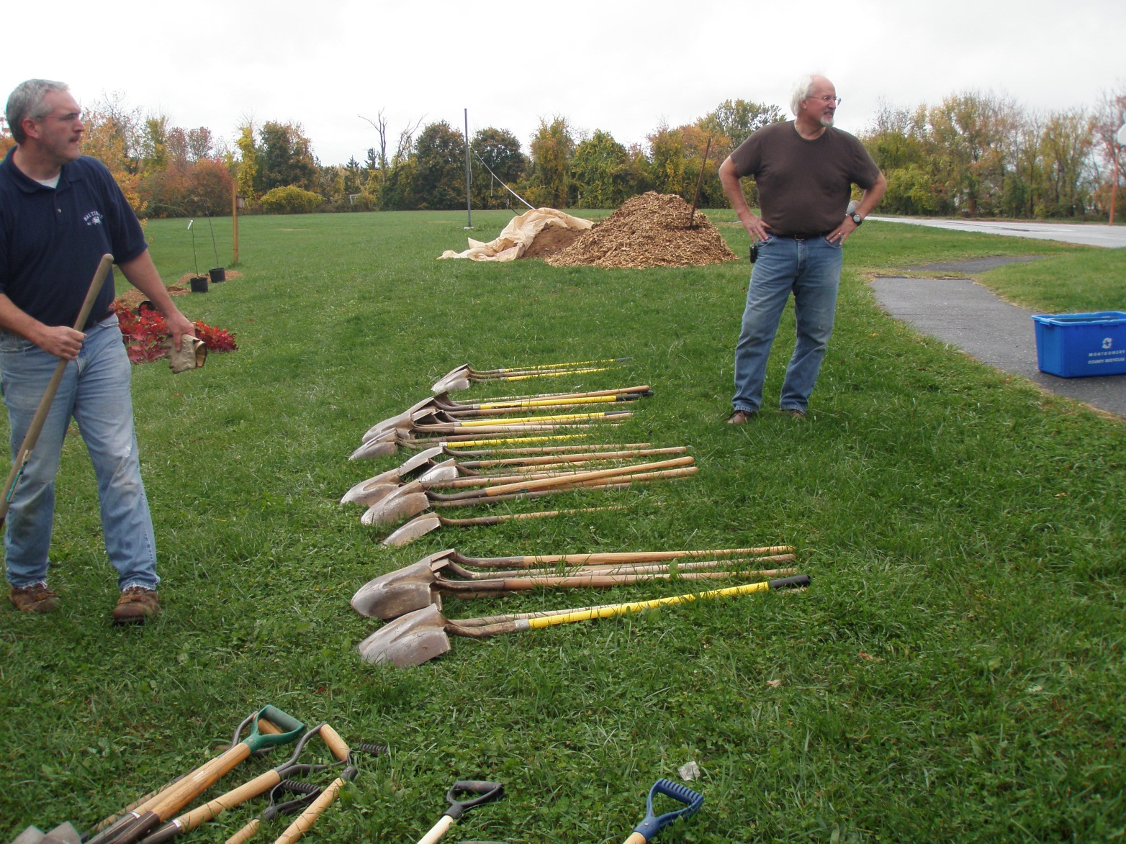
We can’t go wrong with two Daves!

Slide 11
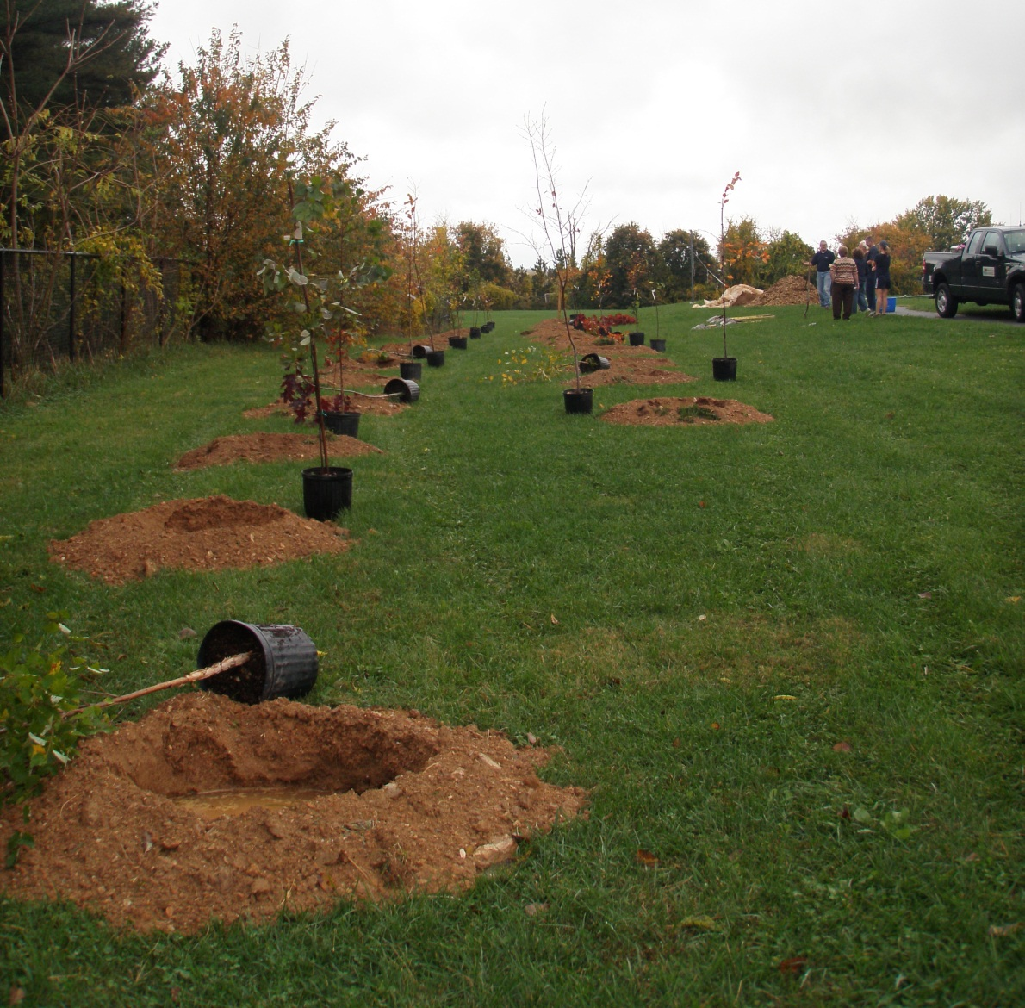

Slide 12
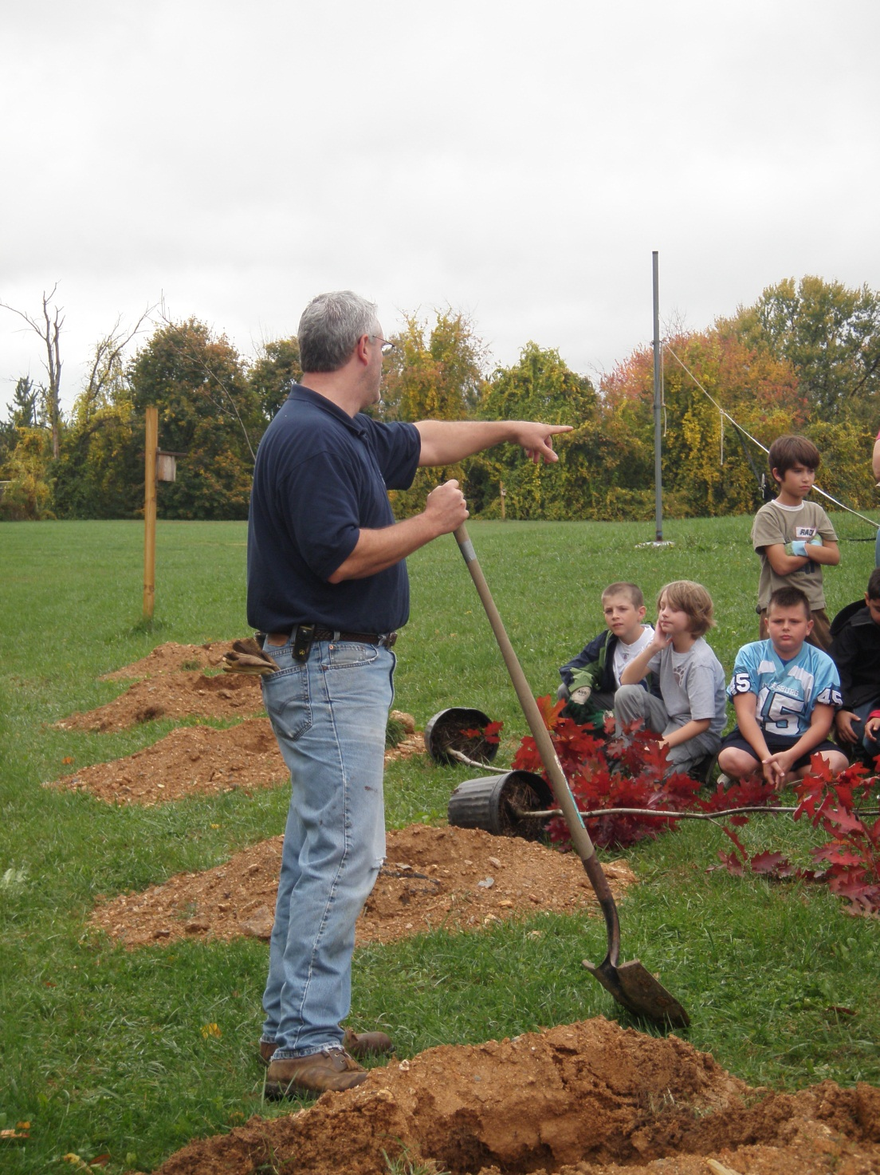
It’s hard to
listen to instructions
when you’re wondering, “Which tree
will be
‘mine’?”

Slide 13
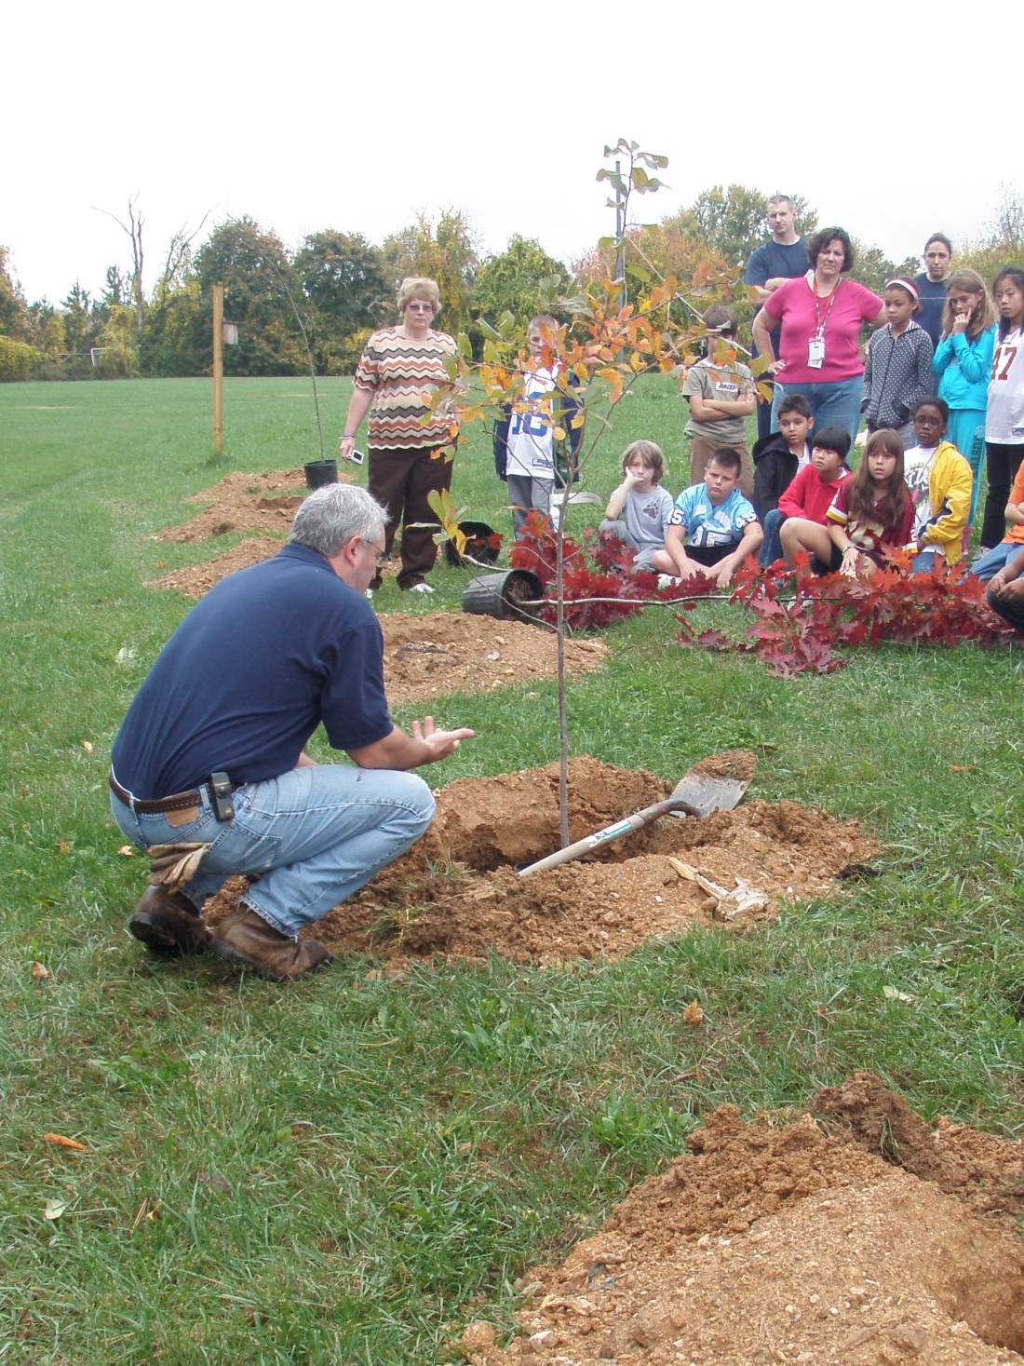
Use the handle
of the shovel
as a guide.
Do you need
to fill in or
dig deeper?

Slide 14
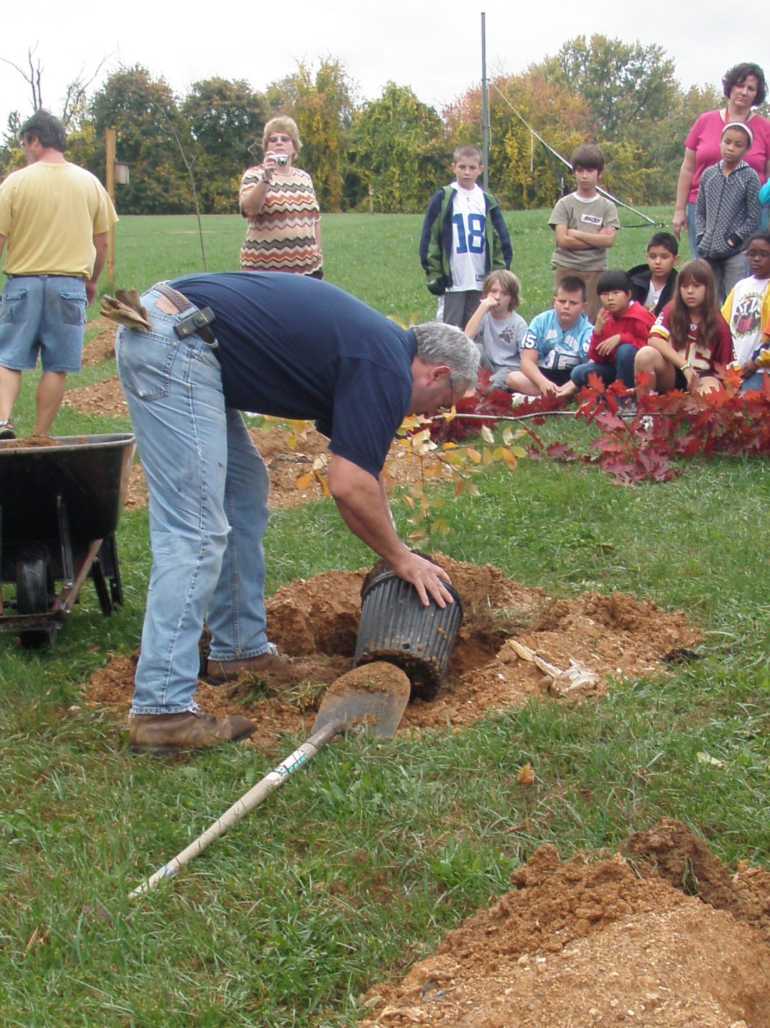
Tap the pot
all around
to loosen the
soil before
lifting the tree
out of the container.

Slide 15
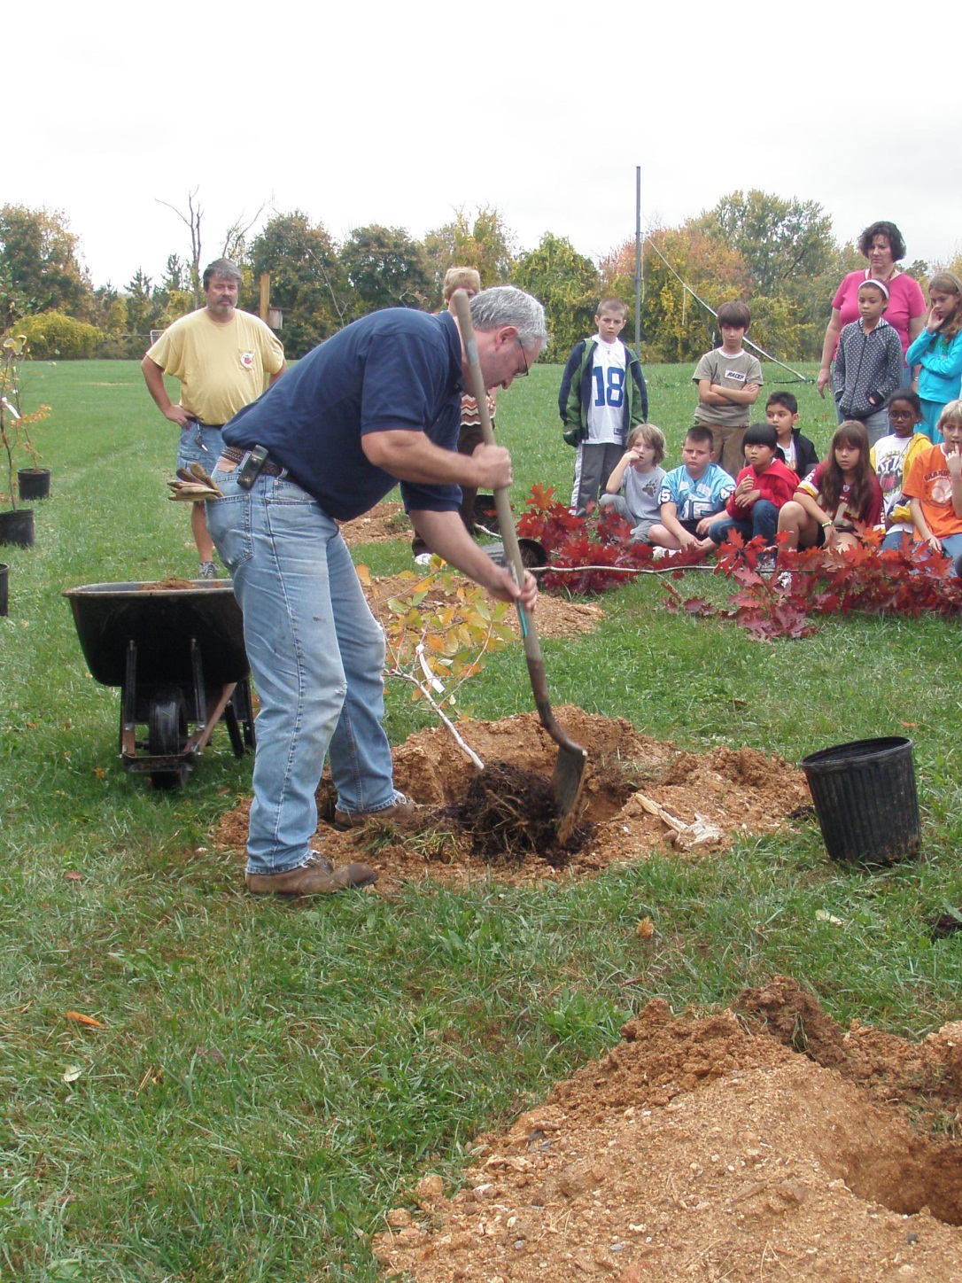
Use the edge
of the shovel
to loosen
the root ball
and allow the
roots to spread.

Slide 16
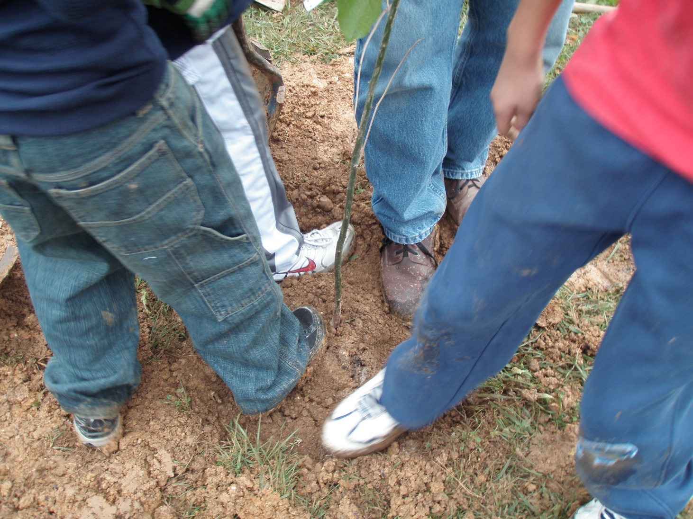
Fill the hole and press all around.
Teamwork!

Slide 17
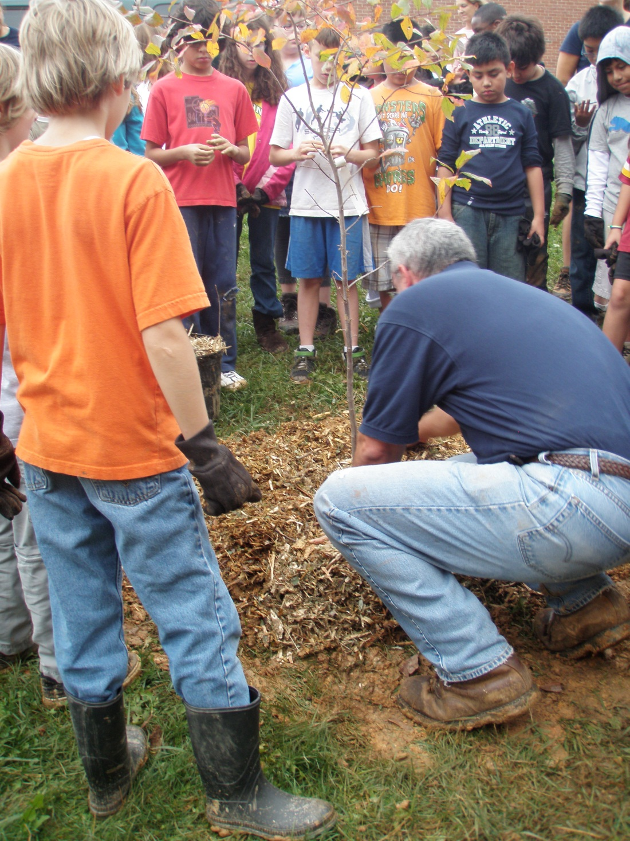
Mulching instructions:
make a
‘doughnut’
around
the tree.

Slide 18
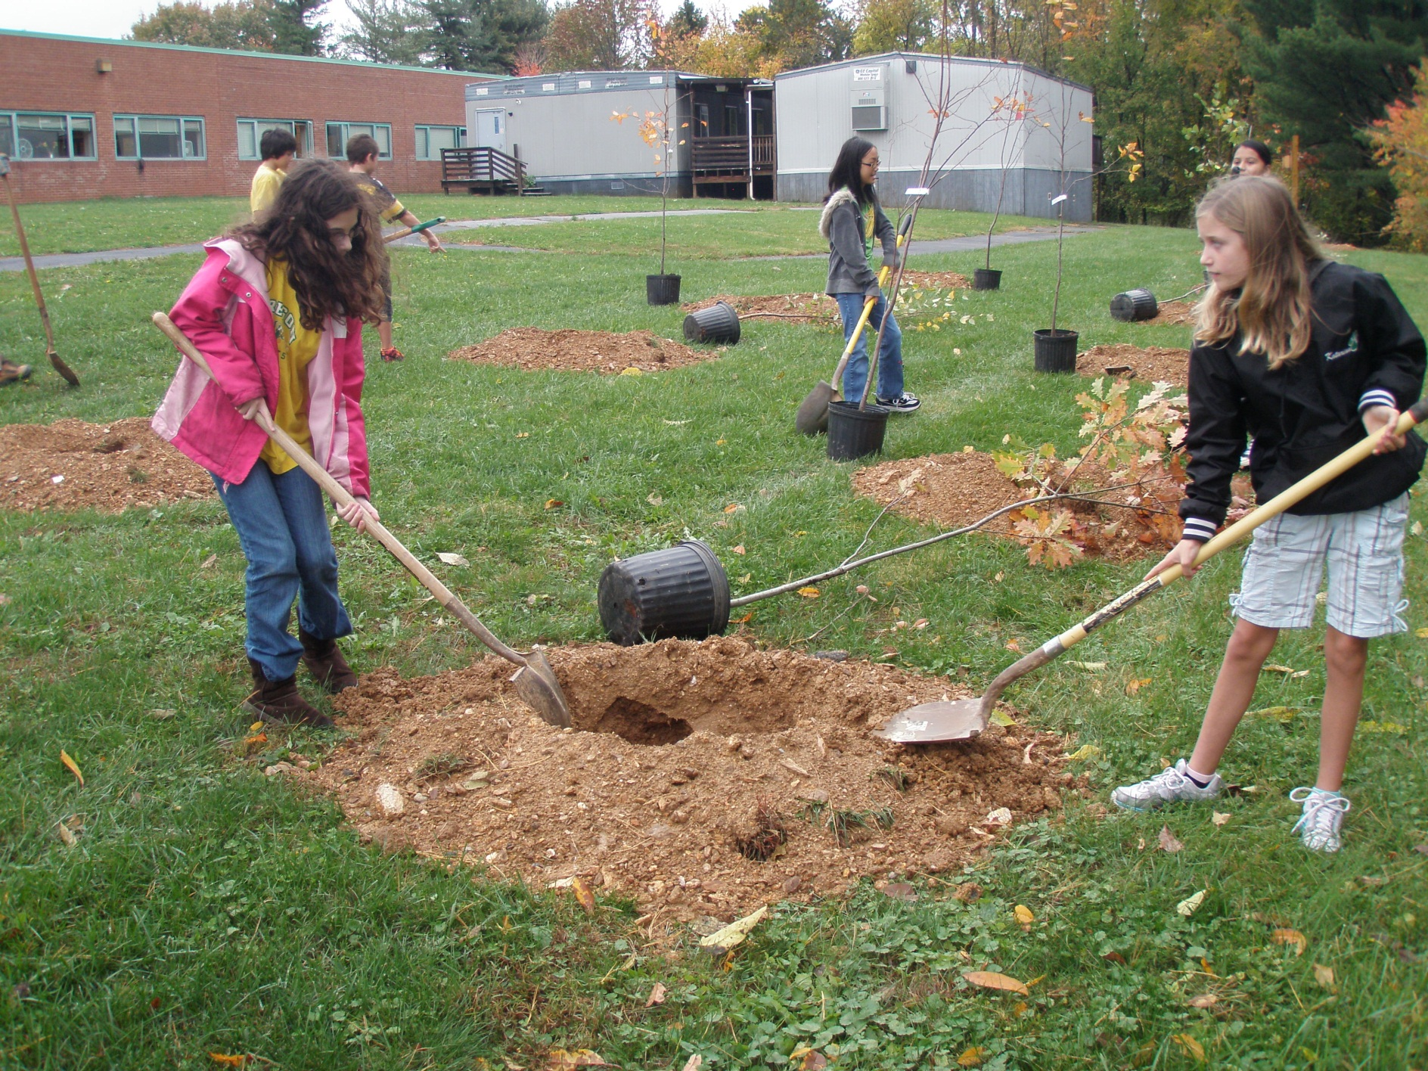

Slide 19
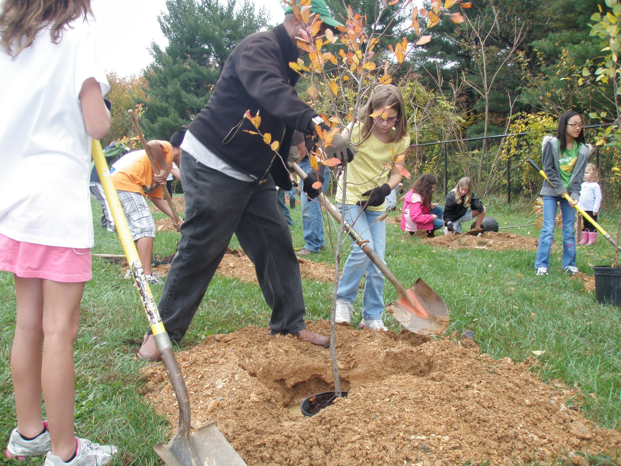

Slide 20
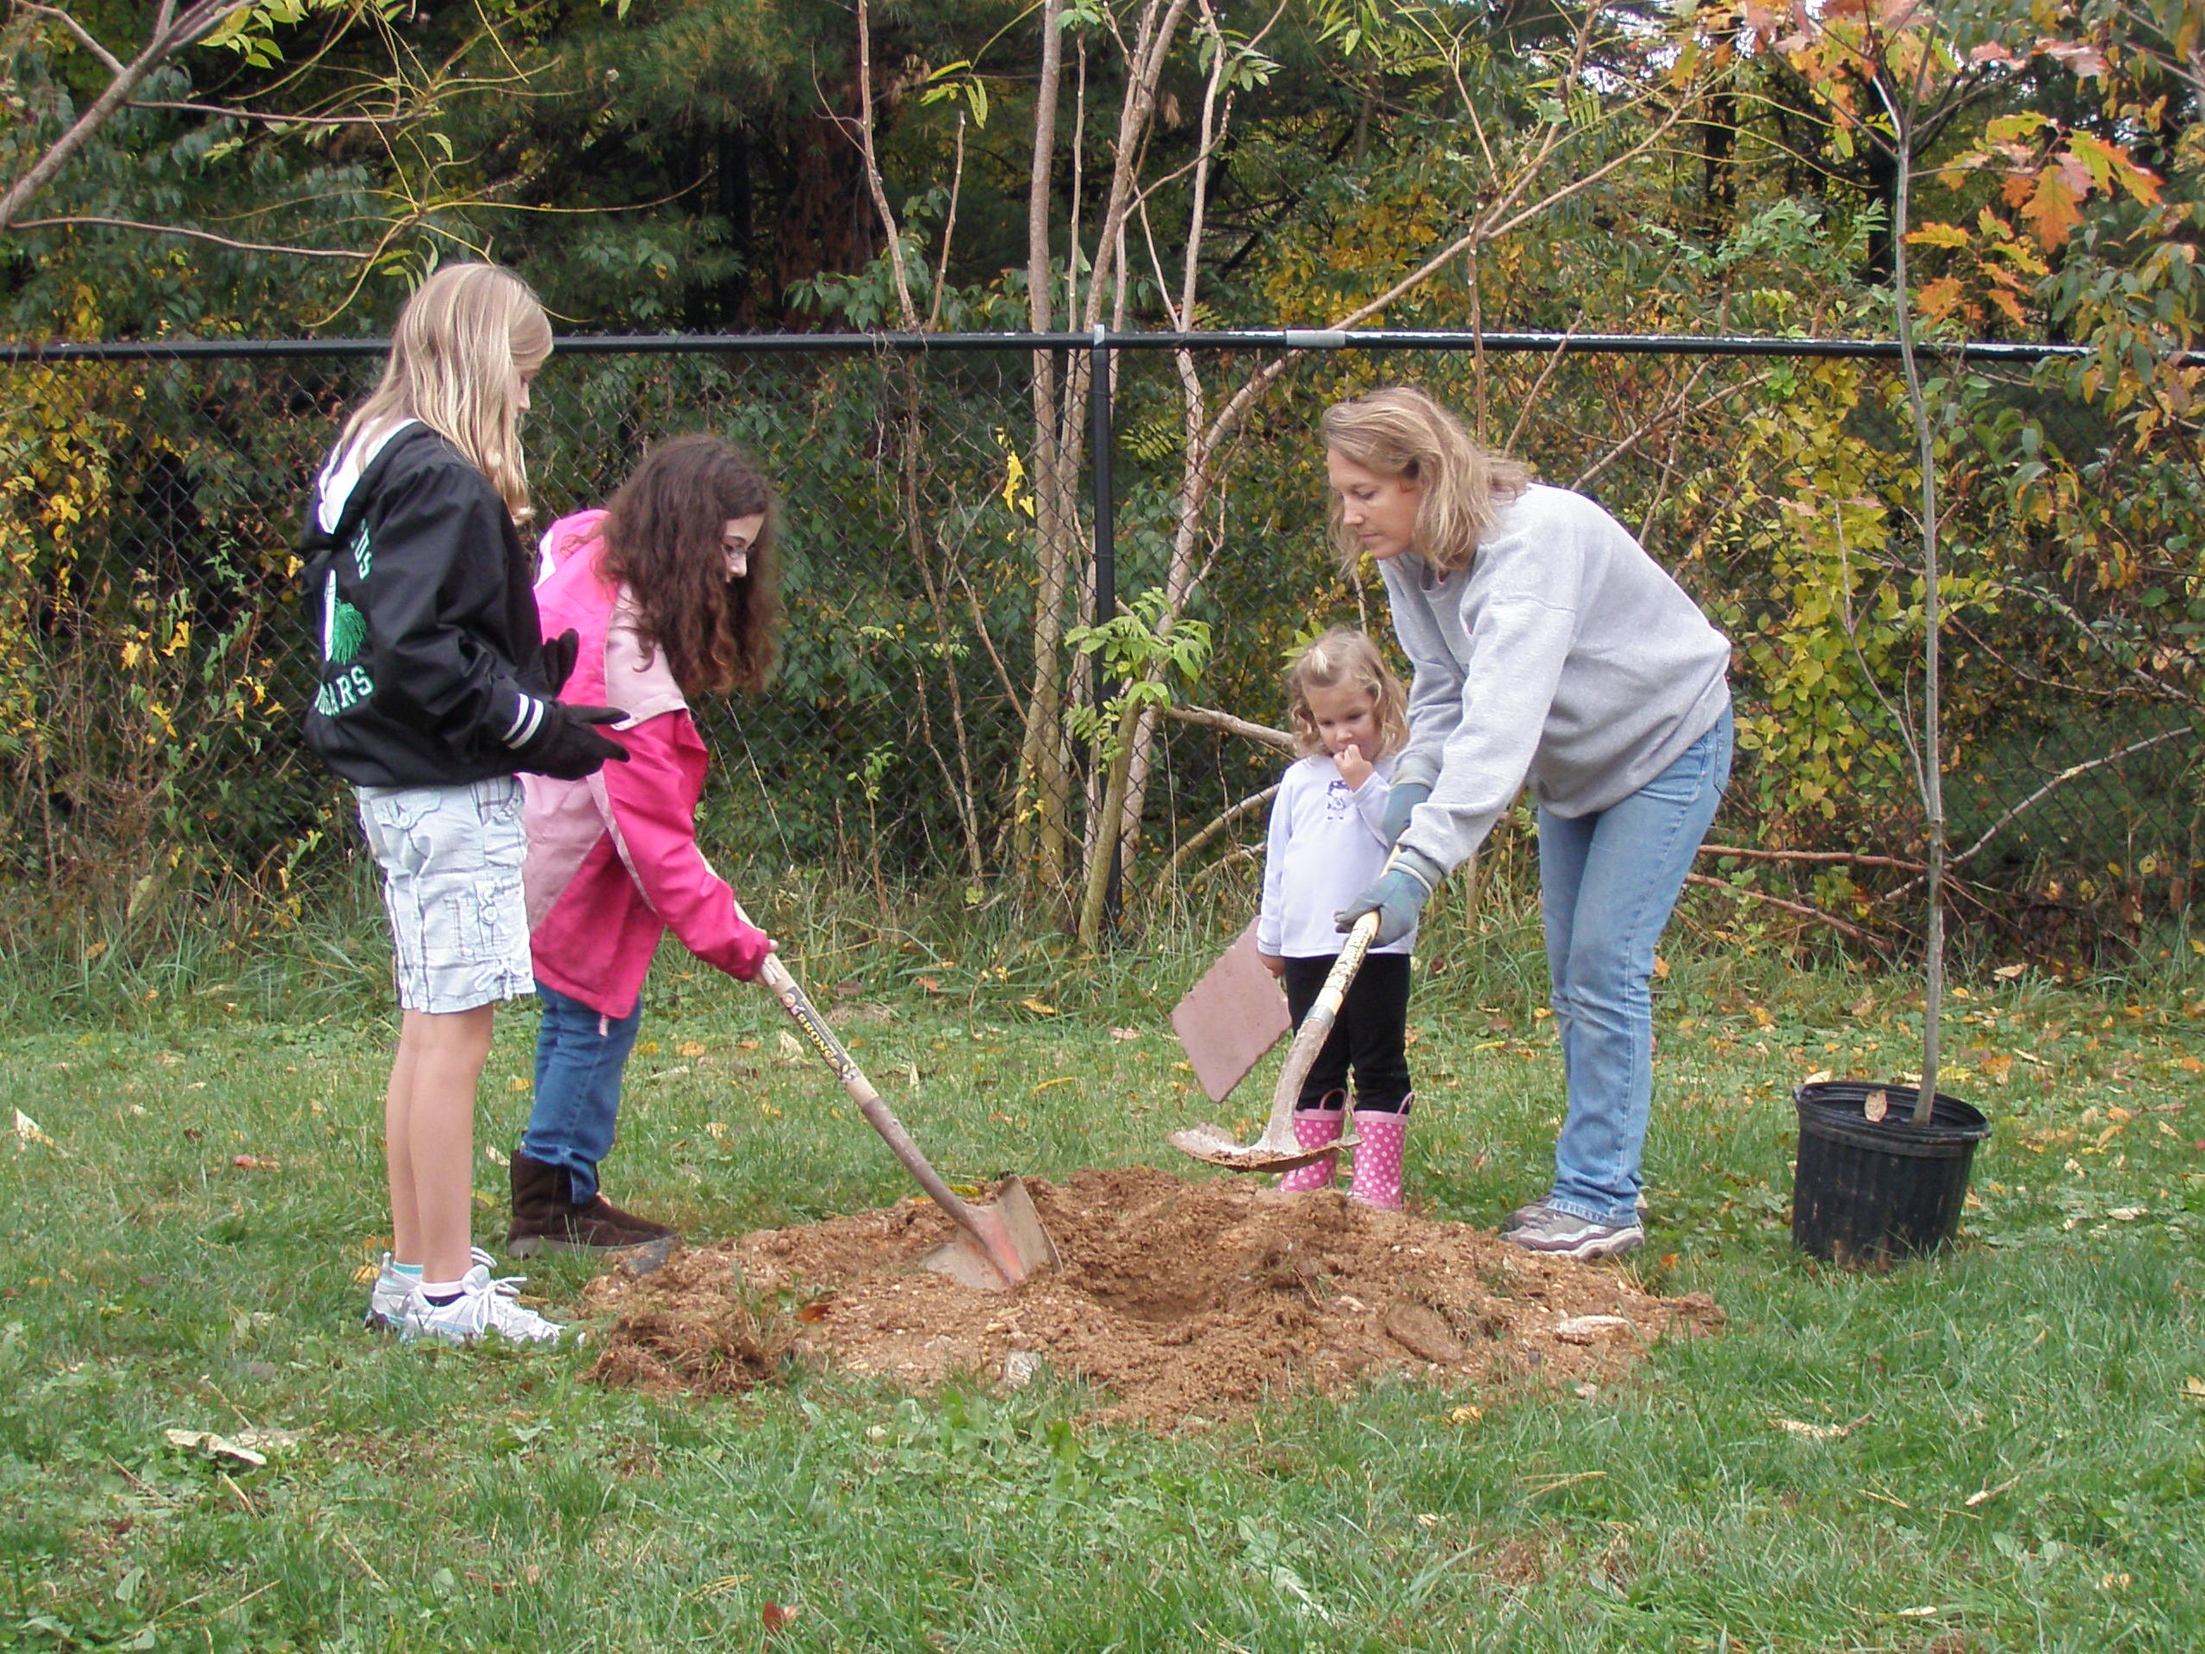

Slide 21
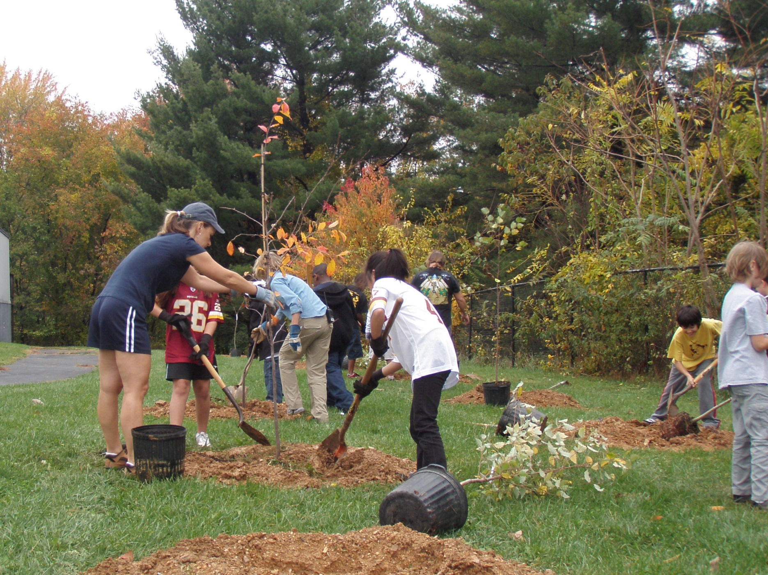

Slide 22
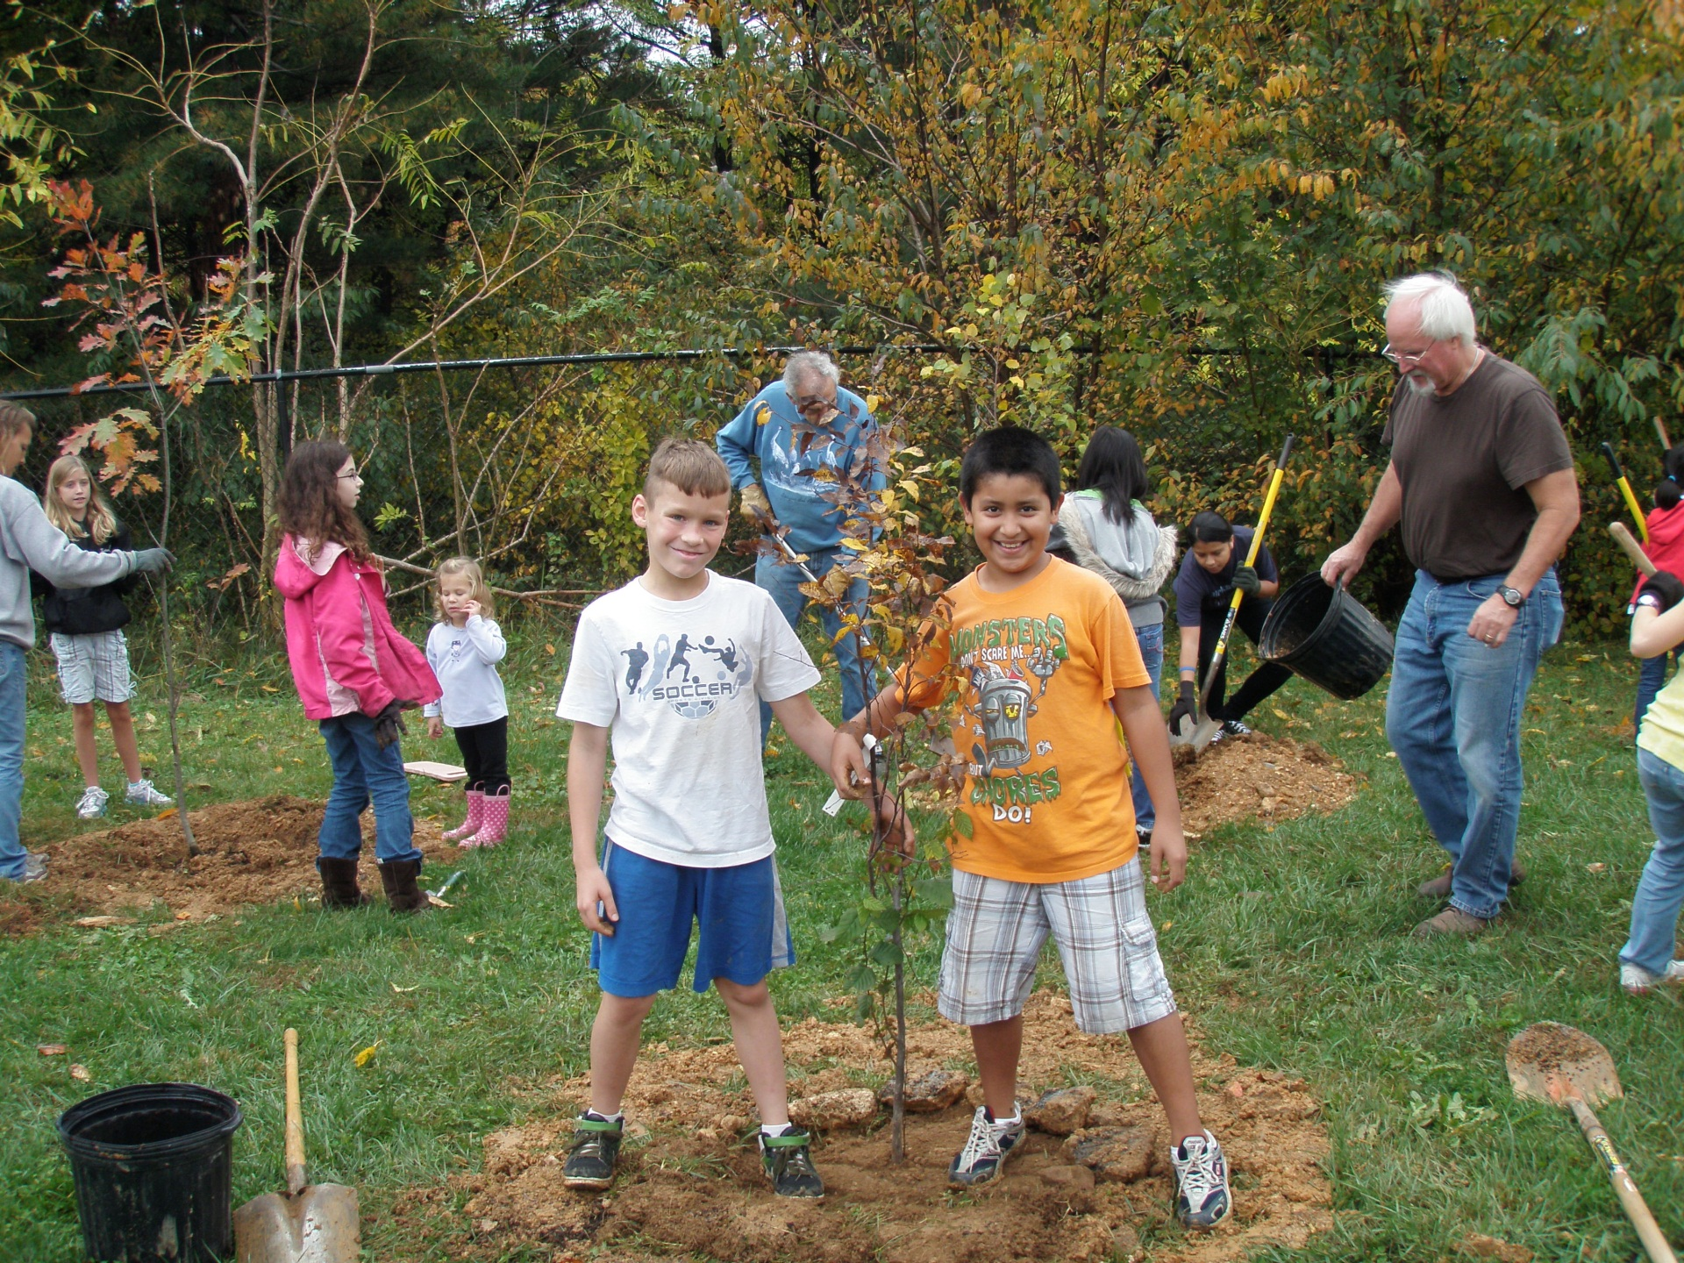

Slide 23
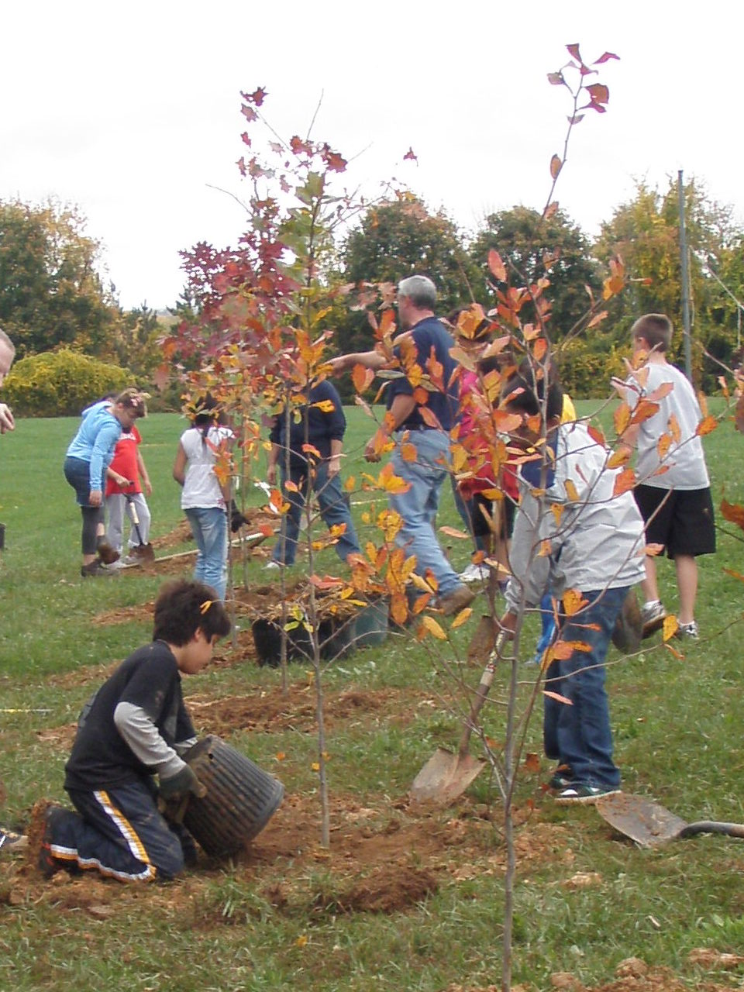
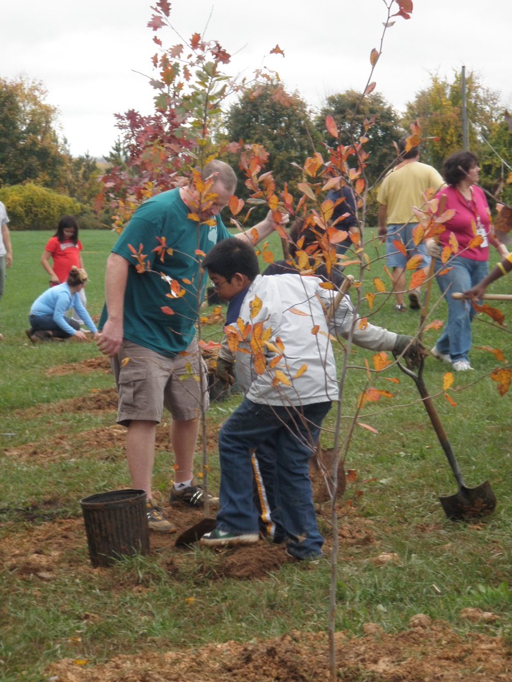

Slide 24
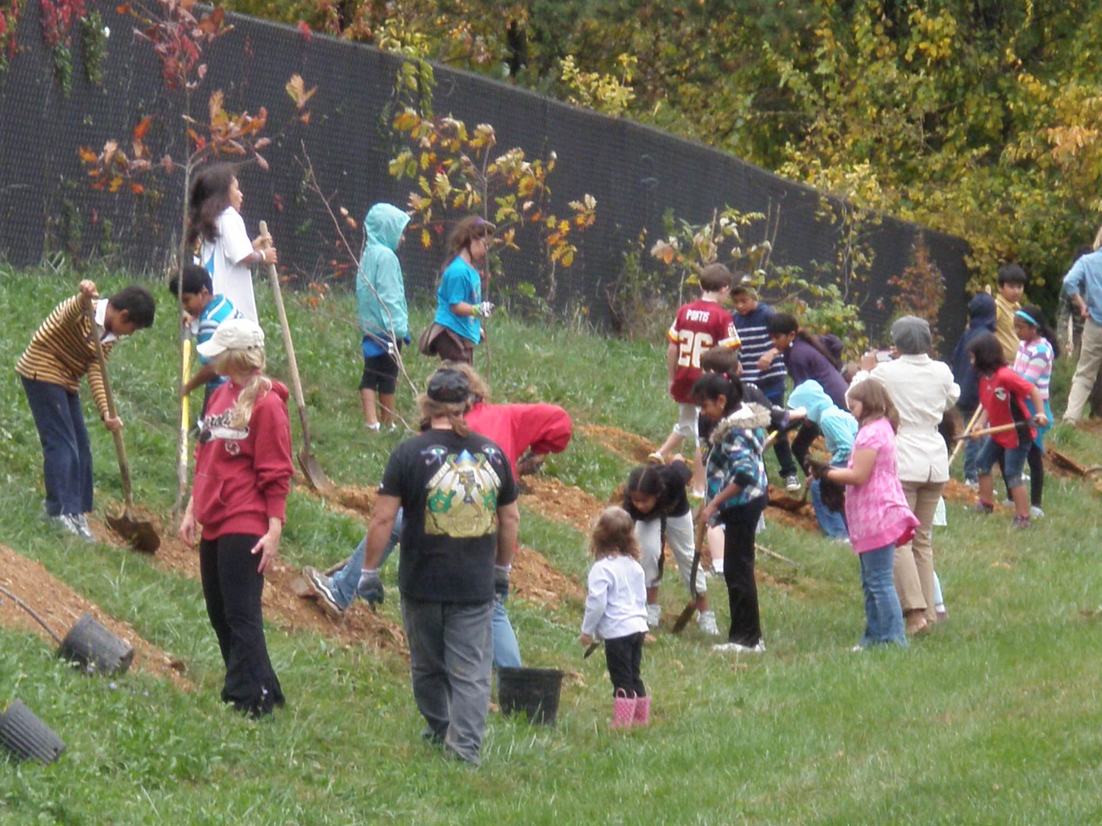

Slide 25
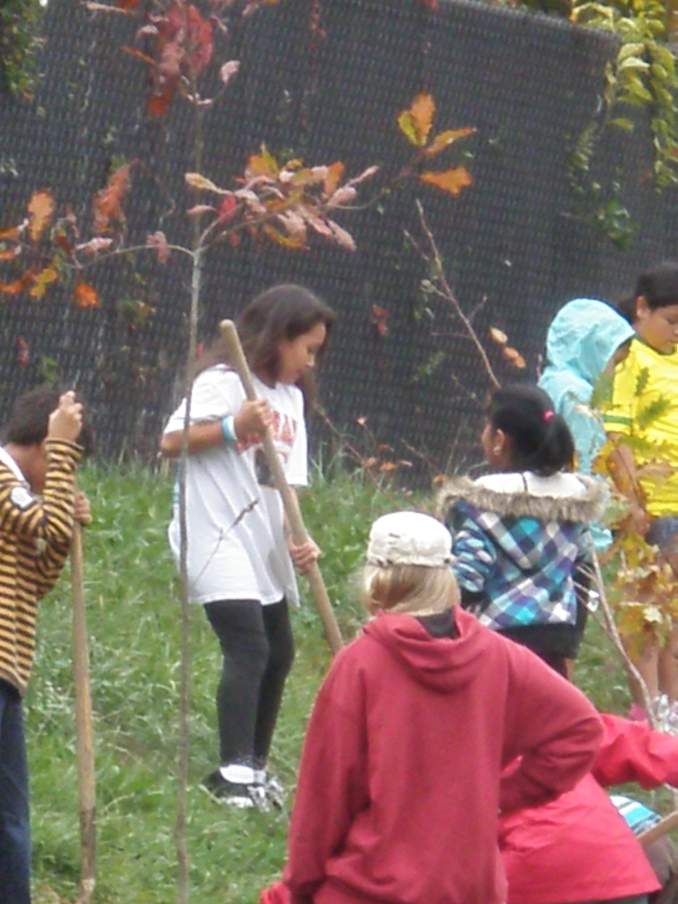

Slide 26
Bonus
activity…
…spending the
rest of the day
in just your socks!

Slide 27
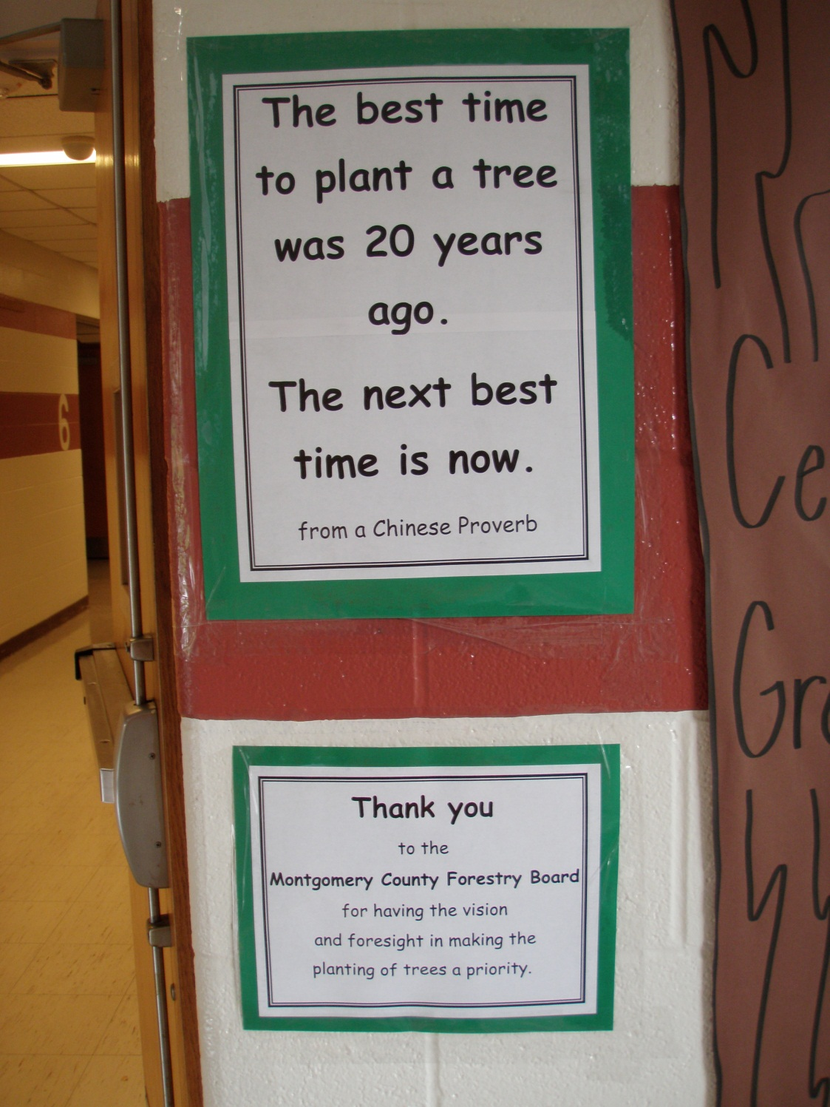
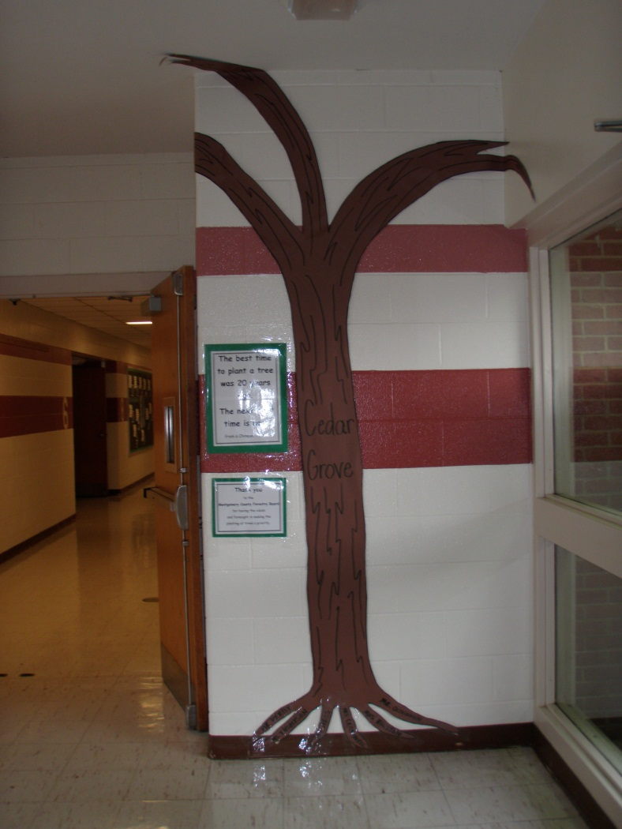
We are grateful for this wonderful opportunity!

Slide 28
…and the earth smiled…

Slide 29
Photographs of Cedar Grove students
appear with parental permission.
Mitchell, Joni. “Big Yellow Taxi.” Music video by Counting Crows performing Big Yellow Taxi. (C) 2002 Interscope Geffen (A&M) Records A Division of UMG Recordings Inc.

